Slide 1


STRIVING FOR EXCELLENCE
Scholars Curriculum
Intent Framework
"Every child, in every school, has access to excellent education and character development in a secure and caring environment."

Slide 2

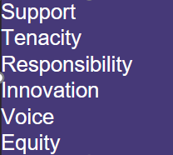
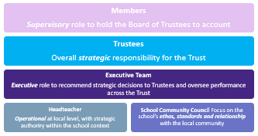
At Scholars we are working together to strive for excellence . To achieve this, we know that the curriculum our pupils receive must be exceptional in its intent, as well as how well it is delivered in classrooms
Our schools belong to one Trust and therefore we recognise the value, and indeed requirement for us to articulate what a Scholars Governance looks like to ensure the highest accountability so that Every child, in every school, has access to excellent education and character development in a secure and caring environment."
The 6 pillars of the Scholars Values
OUR GOVERNANCE STRUCTURE

Slide 3

A Scholars Curriculum
drives our shared vision,
Striving for Excellence
"Every child in every school has access to excellent education and character development in a secure and caring environment."
and is grounded in our values.
Support
Tenacity
Responsibility
Innovation
Voice
Equity
A Scholar’s Curriculum will:
Surpass statutory expectations
Be shaped by and for our communities
Be informed by evidence
Be delivered by practitioners who are continually learning
Bring school values to life
Meet Trust quality standards

Slide 4

Surpass statutory expectations
Statutory Assessment and Reporting of the National Curriculum
Published Information (Website)
Statutory PSHE related to protected characteristic and personal development
Early Years Foundation Stage Statutory Framework
Pupil Premium
Cultural capital, British values and Character Education
Collective Worship
SEN Code of Practice
Religious Education
Equality Act 2020
Protected Characteristics

Slide 5
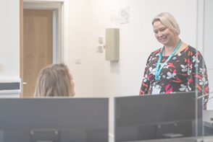



A Scholars Curriculum
drives our shared vision
Striving for Excellence
"Every child in every school has access to excellent education and character development in a secure and caring environment."
Alignment in the Core
Phonics our School follow ELS Accredited program
Maths our Schools follow the Power Maths Scheme
Reading we have worked with Subject leaders and specialists to design our own Scholars curriculum
Writing we have worked with Subject leaders and curriculum specialists to design our own Scholars curriculum
In Science our schools follow the United Learning Science Scheme
Wider Curriculum
Our schools align curriculum where appropriate and we have an element or earned autonomy in our foundation curriculum. Each school must have a clearly mapped curriculum with clear sequences of planning and lessons. We access a range of curriculums such as Kapow, United learning, Primary Knowledge curriculum and the local greed syllabus to support curriculum delivery

Slide 6
Surpass statutory expectations
Statutory Assessment and Reporting of the National Curriculum
Scholars schools will assess and report in line with statutory requirements.
For more information on Primary statutory assessment: https://www.gov.uk/government/organisations/standards-and-testing-agency

Slide 7
Surpass statutory expectations
Published Information (Website)
Scholars schools should publish
  the content of the curriculum your school follows in each academic year for every subject, including for mandatory subjects such as Religious Education even if it’s taught as part of another subject or subjects or is called something else
  The schools approach to the curriculum
  how parents or other members of the public can find out more about the curriculum your school is following:
  Schools will also publish the phonics or reading schemes they are using in key stage 1
For more information on what schools must publish on their website: https://www.gov.uk/guidance/what-academies-free-schools-and-colleges-should-publish-online

Slide 8
Surpass statutory expectations
SEN Code of Practice
This statutory code contains:
  "details of legal requirements that you must follow without exception
  statutory guidance that you must follow by law unless there's a good reason not to"
  It explains the duties of local authorities, health agencies, schools and colleges to provide for those with special educational needs under part 3 of the Children and Families Act 2014.
  In relation to Curriculum it says:
  “All pupils should have access to a broad and balanced curriculum. The National Curriculum Inclusion Statement states that teachers should set high expectations for every pupil, whatever their prior attainment. Teachers should use appropriate assessment to set targets which are deliberately ambitious. Potential areas of difficulty should be identified and addressed at the outset. Lessons should be planned to address potential areas of difficulty and to remove barriers to pupil achievement. In many cases, such planning will mean that pupils with SEN and disabilities will be able to study the full national curriculum.” (p94)
For more information on the SEN Code of Practice click here: https://www.gov.uk/government/publications/send-code-of-practice-0-to-25

Slide 9
Surpass statutory expectations
Pupil Premium
The DfE provide evidence to support leaders' decisions about the most effective ways your school can use the pupil premium.
You do not have to follow their advice, except where there’s a legal requirement, such as:
  regulations
  funding agreements
  the conditions of grant
  reporting
  overpayments
  The National Foundation for Educational Research has recommendations for school leaders on raising disadvantaged pupils’ attainment.
More information can be found here: https://www.gov.uk/guidance/pupil-premium-effective-use-and-accountability#effective-use-of-funding

Slide 10
Surpass statutory expectations
Early Years Foundation Stage Statutory Framework
The Early Years Foundation Stage (EYFS) sets the standards that all early years providers must meet to ensure that children learn and develop well and are kept healthy and safe. It promotes teaching and learning to ensure children’s ‘school readiness’ and gives children the broad range of knowledge and skills that provide the right foundation for good future progress through school and life.
The EYFS specifies requirements for learning and development and for safeguarding children and promoting their welfare. The learning and development requirements cover: (1) the areas of learning and development which must shape activities and experiences for children in all early years settings; (2) the early learning goals that providers must help children work towards (the knowledge, skills and understanding children should have at the end of the academic year in which they turn five); (3) assessment arrangements for measuring progress (and requirements for reporting to parents and/or carers). The safeguarding and welfare requirements cover the steps that providers must take to keep children safe and promote their welfare.
For more information on Early Years Foundation Stage Statutory Framework click here: Early years foundation stage (EYFS) statutory framework - GOV.UK (www.gov.uk)

Slide 11
Surpass statutory expectations
Collective Worship
An academy’s funding agreement is drafted to mirror the requirements in legislation for acts of collective worship in local-authority-maintained schools. Each pupil must take part in a daily act of collective worship unless they have been withdrawn by their parents, or if in the sixth form they have decided to withdraw themselves. This applies to academies with and without a religious designation.
More information can be found here: https://www.gov.uk/government/publications/re-and-collective-worship-in-academies-and-free-schools/religious-education-re-and-collective-worship-in-academies-and-free-schools

Slide 12
Surpass statutory expectations
Religious Education
The funding agreement for an academy without a religious designation states that it must arrange for Religious Education to be given to all pupils in accordance with the requirements for agreed syllabuses that are set out in section 375(3) of the Education Act 1996 and paragraph 5 of schedule 19 to the School Standards and Framework Act 1998. That is, it must reflect that ‘the religious traditions in Great Britain are, in the main, Christian whilst taking account of the teaching and practices of the other principal religions represented in Great Britain’.
An academy may choose to adopt a locally agreed syllabus, but is not required to. It may adopt a different area’s agreed syllabus or develop its own, as long as it meets the requirements for such a syllabus as above. Academies are accountable for the quality of their curricular provision including RE.
More information can be found here: https://www.gov.uk/government/publications/re-and-collective-worship-in-academies-and-free-schools/religious-education-re-and-collective-worship-in-academies-and-free-schools

Slide 13
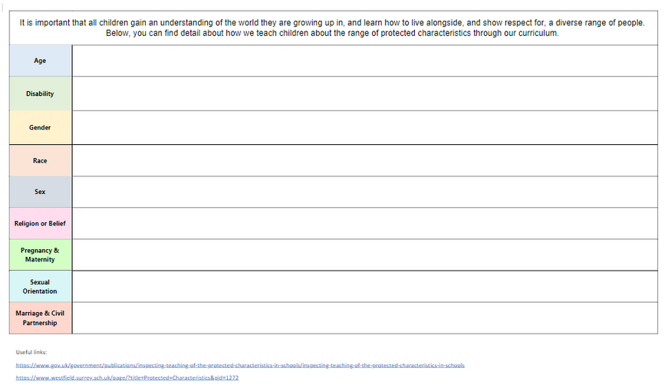
Surpass statutory expectations
Equality Act 2020- Protected Characteristics
Our curriculum promotes and teaches the law in relation to equality and protected characteristics ensures that there is discrimination against anyone because of Scholars schools have a mapped protected characteristics curriculum, which supplements the PSHE delivery.
  age
  gender reassignment
  being married or in a civil partnership
  being pregnant or on maternity leave
  disability
  race including colour, nationality, ethnic or national origin
  religion or belief
  sex
  sexual orientation

Slide 14
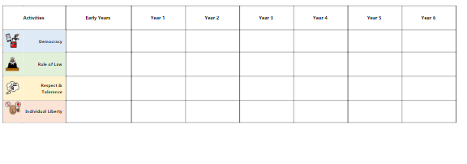
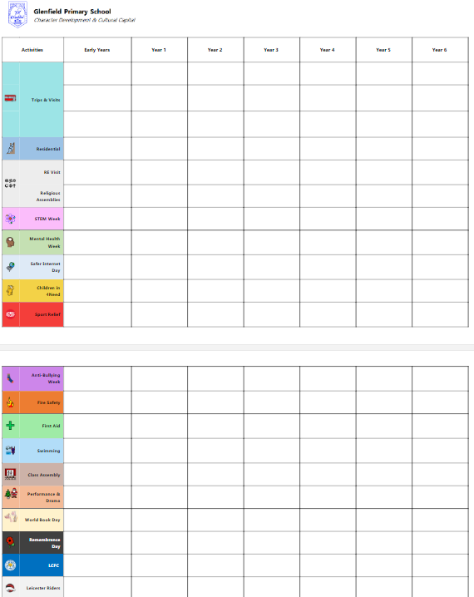
Surpass statutory expectations
Cultural capital, British values and Character Education
Character education, cultural capital and promoting British values is an important part of the scholars curriculum vision. Schools at Scholars teach this through the curriculum and wider curriculum opportunities. All schools have a clearly mapped Character education

Slide 15
Be shaped by and for our communities
We recognise the unique context of each school and celebrates the diversity this brings to our Trust. Each school aims to play a full part in its community and develop its role in both supporting and enhancing the world view and life chances of its students. This is done by close engagement with families and other key stakeholders to ensure all students, including those needing additional support, thrive as emotionally resilient young people who achieve success. A range of enrichment activities support pupils to experience a variety of opportunities and support both emotional and physical health. Engagement with community groups and local initiatives allows for a strong community experience which increases participation and a sense of belonging; all of which are important for success.
A school curriculum which goes beyond the National Curriculum and could include specialisms unique to the context and community
A school curriculum which has extra –curricular opportunities included - mapped, planned and implemented
A school curriculum which supports the needs of specific groups of pupils in your context and community
A school curriculum which reflects and educates Health and social factors in the community
Engagement and support from stakeholders and community groups
Cultural capital - the essential knowledge that pupils need to be educated citizens, introducing them to the best that has been thought and said and helping to engender an appreciation of human creativity and achievement.
A curriculum which reflects the school’s local context by (a) addressing typical gaps in pupils’ knowledge and skills in your context and (b) supporting understanding of local, national and global communities in terms of diversity.

Slide 16
Be informed by evidence
Scholars school leaders and teachers draw on a range of evidence and research when designing and developing their curriculums.
Curriculum Design
Mary Myatt
Christine Counsell
Dylan Wiliam
Tom Sherrington
Jonathan Lear
Ofsted Evidence
Harry Fletcher-Wood
Barry Carpenter
Assessment and Feedback
Daisy Christodolou
Dylan William
Rob Coe
Harry Fletcher-Wood
Pedagogy
Rosenshine
Teaching Walkthrus
Doug Lemov– Teach like a Champion
Metacognition and Self-Regulation
EEF Guidance Report
Barry Hymer
Cognitive Theory and Memory
Ambition Institute Documents
Key Psychologists (to be introduced across 2021-2022)
Remote Education
Ofsted
Eduario
Doug Lemov
EEF Best Evidence on Supporting Students to Learn Remotely
The Home Learning Approaches Planning Framework
John Hattie
Additional Support
Making Best use of Teaching Assistants
EEF Toolkit
Evidence 4 Impact
Raising boys Attainment
Matt Pinkett- Boys Don't Try
Let's Hear it from the Boys - Gareth Wilson

Slide 17
Be informed by evidence
Dylan William – sequenced and structured
In a publication by the SSAT, Dylan Wiliam outlines 7 principles for curriculum design, arguing that an effective curriculum is:
  Balanced – Promotes intellectual, moral, spiritual, aesthetic, creative, emotional and physical development as equally important.
  Rigorous – Seeks to develop intra-disciplinary habits of mind; the subject matter is taught in a way that is faithful to its discipline.
  Coherent – Makes explicit connections and links between the different subjects/experiences encountered.
  Vertically Integrated – Focuses on progression by carefully sequencing knowledge; provides clarity about what “getting better” at the subject means.
  Appropriate – Looks to avoid making unreasonable demands by matching level of challenge to a pupil’s current level of maturity/knowledge.
  Focused – Seeks to keep the curriculum manageable by teaching the most important knowledge; identifies the big ideas or key concepts within a subject.
  Relevant – Seeks to connect the valued outcomes of a curriculum to the pupils being taught it; provides opportunities for pupils to make informed choices
http://www.tauntonteachingalliance.co.uk/wp-content/uploads/2016/09/Dylan-Wiliam-Principled-curriculum-design.pdf

Slide 18
Be informed by evidence
Daisy Christodolou – Assessment of Curriculum Content (1 of 2)
Writing for The Chartered College, Tom Sherrington summarises Daisy Christodoulou’s book Making Good Progress? (2017)
Making Good Progress is an in depth exploration of the two main purposes of assessment:
  Formative assessment should give us information about how students can make further progress, ‘identifying consequences’ so that teachers and students can adjust to learn even more
  Summative assessment should allow us to make meaningful comparisons between a student’s and a larger cohort’s performance against a set of standards. It’s about sampling a knowledge domain without assessment itself becoming the primary focus.
  Christodoulou explores the information that assessments of different kinds give us. She discusses the nature of formative and summative assessment and, with references to the findings from cognitive psychology, argues that the types of assessment we use for the two purposes above should be quite different.
  She references important contributions to educational thinking in her examination of the flaws of descriptor-based assessments, which are widely used, and of the different inferences we can draw from different types of assessment. It’s helpful to understand these between a quality and a difficulty model:
  The quality model covers situations where teachers judge the quality of students’ work or performance against a set of standards or criteria, for example in essays or compositions
  The difficulty model is where the level of challenge is inherent in the questions that are set and students’ success in answering them determines the standards.
  Each type of assessment has different implications for our sense of achievement, progress and standards, and the validity and reliability of the data that we can capture.

Slide 19

Be informed by evidence
Daisy Christodolou – Assessment of Curriculum Content (2 of 2)
Writing for The Chartered College, Tom Sherrington summarises Daisy Christodoulou’s book Making Good Progress? (2017)
What are the main messages for teachers?
  Good formative assessments should be high frequency and low stakes, focusing on specific elements of the curriculum. They should allow for repetition and practice, keeping the results in raw form to track the details of what has been learned and what the next steps might be
  Good summative assessments need to be sat in standard conditions to be reliable, scan a large knowledge domain and ideally use scaled scores rather than grades to allow for meaningful comparisons. These do not need to be very frequent.
  Top Tip
  Think hard about using descriptors to guide your assessment – the chances are you’re not really getting valid information about what your students can do. Use lots of formative tests with raw marks instead.’

Slide 20
Be informed by evidence
Rosenshine - evidence-informed strategies which all teachers should know (1 of 3)
1. Begin a lesson with a short review of previous learning
Reviewing previously learned material strengthen the connections between pieces of knowledge. That is, it enhances understanding. Rosenshine suggests a five to eight-minute review of the previously covered material, including peer marking, asking questions, checking for misconceptions, correcting homework, and others.
2. Present new material in small steps followed by student practice
There is only so much novel information we can process at one time. If you ask students to do too much at the same time, they will probably fail.
3. Ask questions and check answers
To learn something, students need to practice it. Every time students answer a question or solve a problem, they retrieve that information, memory for that information becomes stronger and more last-longing. The more variety of question types, the better.
4. Use models
Concrete examples and models are a good strategy to introduce a new concept. Explicit and detailed explanations and instructions are also recommended.
https://www.aft.org/sites/default/files/periodicals/Rosenshine.pdf
https://www.senecalearning.com/blog/10-principles-of-instruction-helping-teachers-develop-effective-lessons/

Slide 21
Be informed by evidence
Rosenshine - evidence-informed strategies which all teachers should know (2 of 3)
5. Guide practice
Rosenshine recommends that teachers stimulate students to rephrase, elaborate and summarise new material. According to him, successful teachers spend more time asking questions, checking for understanding, correcting errors and guiding students when working out problems.
6. Check for understanding
Constant checking is important to catch misconceptions before they harm learning. It also helps teachers notice if parts of the content need reteaching. Rosenshine suggests that teachers ask direct questions, instead of asking students if they have questions and assuming that silence means a full understanding of the topic.
7. Obtain a high success rate
This principle relates to making sure all students have mastered the current set of lessons before moving on to the next one. It involves checking for misconceptions and asking questions.
8. Provide scaffolds in difficult tasks
When students are completing a hard task, it is important that teachers provide temporary instructional support. These scaffolds can be gradually removed as pupils advance in their understanding and fluency on a particular topic. Rosenshine suggests using cue cards, checklists, worked examples and models as scaffolding. Teachers can also anticipate students’ errors and warn them about them beforehand.

Slide 22
Be informed by evidence
Rosenshine - evidence-informed strategies which all teachers should know (3 of 3)
9. Stimulate and monitor independent practice
Independent practice should be used after guided practice. That is, when students are already very competent in a topic, they can practice independently in order to become fluent and retrieve information automatically. Rosenshine calls this process “overlearning”. Independent practice should cover the same topic covered in guided practice as students need to be fully prepared for it.
10. Conduct weekly and monthly reviews
Similar to Principle 1, Rosenshine advocates for a frequent review of previously learned material in order to help students reconsolidate information and create stronger connections.
https://www.aft.org/sites/default/files/periodicals/Rosenshine.pdf
https://www.senecalearning.com/blog/10-principles-of-instruction-helping-teachers-develop-effective-lessons/

Slide 23
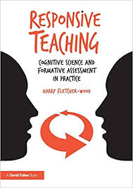
Be informed by evidence
Harry Fletcher-Wood - Formative assessment and cognitive science
In is book ‘Responsive Teaching’ (2018) Harry Fletcher-Wood explores formative assessment and cognitive science, arguing that responsive teaching begins with setting clear goals and planning learning carefully; is informed by identifying what students have understood and what they are struggling with; and should always lead to us responding and adapting our teaching.
His book is useful for considering how careful curriculum design should be translated into effective classroom practice, and how systematic assessment can inform the way in which we adapt sequences of learning.
https://improvingteaching.co.uk/2018/06/03/what-is-responsive-teaching/

Slide 24
Be informed by evidence
Ofsted
This document is useful for exploring the research, evidence and thinking behind the new Ofsted framework.
https://assets.publishing.service.gov.uk/government/uploads/system/uploads/attachment_data/file/813228/Research_for_EIF_framework_100619__16_.pdf

Slide 25
Be informed by evidence
Education Endowment Foundation (EEF)
This website provides a series of useful tools:
Guidance reports on topics such as improving literacy, developing meta-cognition and improving KS2 and KS3 mathematics which can be used to inform curriculum design. https://educationendowmentfoundation.org.uk/tools/guidance-reports/
The Teaching and Learning Toolkit, which provides accessible summaries of international educational research, comparing the cost of different approaches against the measurable impact.
https://educationendowmentfoundation.org.uk/evidence-summaries/teaching-learning-toolkit/

Slide 26
Be informed by evidence
Pedagogy and metacognition - how learners learn/how teachers teach
The Learning Curriculum
This document was written by a team of teacher educators and provides guidance on how best to educate teachers about the science of learning, and its implications for lesson and curriculum design. It can be downloaded here: https://www.ambition.org.uk/research-and-insight/learning-curriculum/
Learning What is it, and how might we catalyse it?
Provides an overview of how learners learn and how teachers should teach and plan their curriculums. It can be downloaded here: https://www.ambition.org.uk/research-and-insight/learning-what-is-it/
Metacognition and self-regulation
This project by the EEF explores how to explicitly teach students to explore how they learn, and develop their metacognition and self-regulation skills: https://educationendowmentfoundation.org.uk/evidence-summaries/teaching-learning-toolkit/meta-cognition-and-self-regulation/

Slide 27
Be delivered by practitioners who are continually learning
Initial Teacher Training
Early Careers Teachers & Mentors
National Professional Qualifications
Practitioner Hubs & Centres of Excellence
Apprenticeships
Induction, to include MBTI
Professional Learning Networks
Lead Learners and Specialists
Specialist School Improvement Groups
On request or by invitation, bespoke, central team or externally commissioned support
Toolkits, standards and frameworks for growth
Strengths Based Approach & Talent Management
Local and National Professional Partnerships
Scholars Developing Great People
Coaching (instructional and facilitative)

Slide 28
Be delivered by practitioners who are continually learning
National Professional Qualifications
“We know that the quality of teaching is the most important factor in improving pupil outcomes, but we also know that this cannot happen in schools without effective leadership. Great leaders create the right conditions for improvement in the classroom and school.”
Scholars supports staff to achieve and develop. We promote the undertaking of NPQ’s
The reformed suite of NPQs will include:
• NPQEL for leaders that are, or aspiring to be, an executive headteacher or Mat CEO role with responsibility for leading several schools.
• NPQH for leaders that are, or are aspiring to be, a Headteacher of head of school with responsibility for leading a school.
• NPQSL for leaders that are, or are aspiring to be, a senior leader with cross—school responsibilities.
and
• NPQ: leading behaviour and culture for teachers who may have responsibilities for leading behaviour and/or supporting pupil wellbeing in their school.
• NPQ: leading teacher development for teachers who may have responsibilities for leading the development of other teachers in their school. They may have responsibilities for the development of all teachers across a school or specifically those who are early in their career.
• NPQ: leading teacher framework for teachers who may have a responsibility for leading teaching in a subject, year group, key stage or phase.
All the NPQs are available with Scholars and blend the required synchronous and asynchronous programme content with local, regional and national participation, within Scholars and beyond.
There will also be a DfE endorsed New Headteacher offer. This will compliment the Scholars New Headteacher Induction package.
Notes:
NPQML
NPQSL
NPQH
NPQEL

Slide 29
Be delivered by practitioners who are continually learning
Practitioner hubs
Scholars schools should seek partnerships with the professional organisations and practitioner hubs which support their improvement needs and provide professional development opportunities.
  The teaching school hub programme will create a national network of 87 ‘centres of excellence’ for teacher training and development, replacing the previous network of around 750 teaching schools. They will be expected to play a significant role in delivering ITT, ECF, NPQs and CPD.
  Launched in 2016, the Research School Network work with schools in their areas to help them use evidence more effectively to inform their teaching through encouraging schools to make use of evidence-based programmes and practices through regular communication and events; and providing training and professional development for senior leaders and teachers on how to improve classroom practice based on the best available evidence.
  English Hubs offer support to local schools, academies and free schools to improve teaching of phonics, early language and reading in reception and year 1.
  Maths Hubs offer support to teachers and schools to improve maths education. There are 37 hubs across England.
  Behaviour Hubs will enable schools trusts with exemplary behaviour cultures and practices to work with those that want to improve their behaviour culture. DfE held application rounds in February 2020 and September 2020 and appointments will be made in Spring 2021.
  Computing hubs offer local, tailored support to schools and colleges, to improve the teaching of computing and increase participation in computer science.
  Whole School SEND, the SEND gateway is an online portal offering education professionals free, easy access to high quality information, resources and training for meeting the needs of children with special educational needs and disabilities (SEND).
  STEM Ambassador Hubs offer a range of support, opportunities and local expertise. They develop links between groups and individuals working to enhance young people's STEM education. Whether you are a teacher, group leader, STEM Ambassador or employer, your local STEM Ambassador Hub is available to support you with anything related to the STEM Ambassador programme.

Slide 30
Be delivered by practitioners who are continually learning
Apprenticeships
As a Multi-Academy Trust, our commitment to lifelong learning extends to our workforce.
Apprenticeships provide entry routes into our organisation, and furthermore, provide opportunities to develop our existing workforce through access to relevant training and qualifications. Having a consistent, collaborative approach to apprenticeships supports recruitment and retention to help meet the current and future needs of the Trust.
Apprenticeships are available for a wide variety of roles across the organisation, and we currently have apprentices employed in disciplines such as Teaching, Early Years, TAs, PE and Sports Coaching, Senior Leadership, Finance/Accounting, HR, ICT and Business & Administration. This list is not exhaustive, and there will be opportunities for CPD for staff employed in any role across the Trust.
Apprenticeship courses are funded via the apprenticeship levy and are a cost-effective method of recruiting new staff and adding CPD to our existing workforce.
As part of our Apprenticeship Strategy, schools are encouraged to:
  actively consider apprenticeships as a recruitment tool and as a source of new talent.
  upskill existing employees in target areas that align with our overall strategic objectives.
  promote apprenticeship opportunities to students in our secondary schools as a route to a job or career.
  We are continually developing our strategy towards apprenticeships and working with a variety of training providers to add more diversity to the training we can offer. We have rolled out schemes aimed at developing Higher-Level Teaching Assistants and are currently in discussions with NCE around rolling out a new Instructional Coaching course for middle and senior leaders.
  If you are interested in finding out more about apprenticeships, please speak to Mark Barrington n the Scholars Central Team – COO@SCHOLARSTRUST.CO.UK

Slide 31

Be delivered by practitioners who are continually learning
Induction
Each SCHOOL will have a robust induction program directed and guided by Scholars Academy Trust

Slide 32
Be delivered by practitioners who are continually learning
Professional Learning Networks
A Professional Learning Network (PLN), which is based on the evidence informed model of Professional Learning Communities, recognises that schools must work together to achieve their collective purpose of learning for all. Therefore, they create structures to promote a collaborative culture. The term is also applied to schools that use small-group collaboration as a form of professional development. The three words explain the concept: professionals coming together in a group—a community or a network —to learn.
Professional learning networks tend to serve two broad purposes:
  Improving the skills and knowledge of educators through collaborative study, expertise exchange, and professional dialogue;
  Improving the educational aspirations, achievement, and attainment of children through stronger leadership and teaching.
  Professional learning networks also function as a way to continually question, re-evaluate, refine, and improve teaching strategies and knowledge. Meetings are goal-driven exchanges facilitated by professionals who have been trained to lead PLNs.

Slide 33
Be delivered by practitioners who are continually learning
Lead Learners and specialists
  Specialist Leaders of Education (SLEs)
  Pupil Premium reviewers
  Scholars Lead Learners
  National Leaders of
  Education NLEs
  Local Leaders of
  Education LLEs
  Subject Specialists in the PAG
More information on NLEs, LLEs, SLEs and Pupil Premium Reviewers please go to Teaching schools and system leaders: get support for you and your school - GOV.UK (www.gov.uk)
“

Slide 34
Be delivered by practitioners who are continually learning
Professional Development Standards
Scholars advocates the standards set out in the DfE Standards for Teachers Professional Development
Effective teacher professional development is a partnership between:
  Headteachers and other members of the leadership team;
  Teachers; and
  Providers of professional development expertise, training or consultancy.
  In order for this partnership to be successful:
  1. Professional development should have a focus on improving and evaluating pupil outcomes.
  2. Professional development should be underpinned by robust evidence and expertise.
  3. Professional development should include collaboration and expert challenge.
  4. Professional development programmes should be sustained over time.
  And all this is underpinned by, and requires that:
  5. Professional development must be prioritised by school leadership.
  https://www.gov.uk/government/publications/standard-for-teachers-professional-development
To support the development of this in Scholars schools we work with the Teacher Development Trust, growing our strength and impact through The 7 Domains of People Powered School Improvement
https://tdtrust.org/

Slide 35
Be delivered by practitioners who are continually learning
Mentoring and Coaching
The development of coaching and mentoring for teachers and senior leaders is a key part of the Developing People strand of the Trust Development Plan. A working group has been established to help lead Phase One to help shape a coaching pathway for Trust schools. This will include coaching and mentoring training opportunities through a professional pathway.
Purposeful, skilful conversations that effectively support performance, growth and development
  For performance
  For Development
  For Transformation
  For Induction

Slide 36
Be delivered by practitioners who are continually learning
Strengths based approaches
“The best opportunity for individual development lies in investing in people’s strengths, not in managing their weaknesses”
Miglianico et al., 2020
Our approach to development people is based on the premise that all employees in an organisation have special qualities, and that each of them can contribute to high performance in their own unique manner (Gelens et al., 2013; Swailes, Downs and Orr, 2014). Davies and Davies (2010), writing in the context of multi-academy trusts, adds that this becomes possible when each employee holds the position that allows their talent to be exercised (Davies and Davies, 2010). This talent management approach highlights equal treatment of employees and encourages the adoption of practices such as employee development, engagement and retention (Glenn, 2012; Thunnissen and Buttiens, 2017).
It is noted in the literature that most organizations take employee strengths for granted and tend to focus on minimising perceived weaknesses instead (Buckingham and Clifton, 2001). Luthans (2002) points out that managers often focus on deficits by seeking to correct employees’ dysfunctional skills, abilities, attitudes or behaviours (Luthans, 2002). However, developing a better understanding of strengths seems to be beneficial for employees and organisations, as exercises and developing strength has a positive impact on wellbeing and performance (Dubreuil et al., 2016)

Slide 37
Be delivered by practitioners who are continually learning
Scholars Professional Development
Great teams
ECF for ECTs and mentors
NPQs
Hubs and Centres of Excellence
Apprenticeships
LGB series
Great leadership
Great education
Developing Great People
A place to thrive
Assessment PD including moderation
E-Learning Platform
PLNs
Led by specialist groups (SEND, VPAC etc)
Talent Management
Great thinking
Great partnerships
Great impact
Wellbeing
MBTI
Coaching
Headteacher Development Days
Leadership Seminar Series
Leadership series
Curriculum leadership
CTM and science of learning
TDT and effective CPD
Bespoke development opportunities

Slide 38
Enable excellence
Our schools will deliver the full National Curriculum, with regard to the following Trust Quality Standards
All our pupils, including pupils with SEND, are entitled to a broad and balanced curriculum throughout KS2 The curriculum will not be unnecessarily narrowed for these pupils.
Schools will create inclusive, flexible and modified curricula to meets both the needs and aspirations of pupils
Schools will ensure that no group of pupils is further disadvantaged by curriculum design, implementation and practice.
The following elements will be mapped, planned and implemented through our schools
SMSC
Our curriculum includes an explicit focus on rich language development, vocabulary and communication, linked to age appropriate and aspirational reading, and exposure to rich learning experiences.
British Values
Character Education
Protected characteristic
An Scholars curriculum celebrates racial diversity and seeks to broaden horizons and view points

Slide 39
Enable excellence
Our schools will deliver the full National Curriculum, with regard to the following Trust Quality Standards
The national curriculum sets out the programmes of study and attainment targets for all subjects at all 4 key stages.
For more information: https://www.gov.uk/government/collections/national-curriculum

Slide 40
Enable excellence
  All our pupils, including pupils with SEND, are entitled to a broad and balanced curriculum throughout all key stages. The curriculum will not be unnecessarily narrowed for these pupils.
  Schools will create inclusive, flexible and modified curricula to meets both the needs and aspirations of pupils
  Schools will ensure that no group of pupils is further disadvantaged by curriculum design, implementation and practice.
All our pupils are entitled to at least a broad and balanced curriculum offering a solid foundation of knowledge and experience to deepen their understanding and support their personal growth.
In key stage 1 our curriculum enables pupils to read, write and use mathematical knowledge, ideas and operations so they are able to access a broad and balanced curriculum at key stage 2. This approach continues into KS3 and beyond, where effective catch-up programmes are used to ensure all students can access this broad curriculum.

Slide 41
Enable excellence
Our curriculum includes an explicit focus on rich language development, vocabulary and communication, linked to age appropriate and aspirational reading, and exposure to rich learning experiences.
If pupils cannot read, they will not be able to access the curriculum, and will be disadvantaged for life. Early deficits in reading and vocabulary development typically continue to impact on children throughout their education. That is why our Trust Quality Standard emphasises this so strongly.
Reading in Scholars schools is prioritised to enable pupils to access the full curriculum offer. Our rigorous and sequential approach to the reading curriculum develops pupils’ fluency, confidence and enjoyment in reading. There is a sharp focus on ensuring that younger children gain phonics knowledge and language comprehension necessary to read, and the skills to communicate, gives them the foundations for future learning. Our teachers read to children in a way that excites and engages them, introducing new ideas, concepts and vocabulary. All our teachers support students to read independently; we develop children’s love of reading and encourage pupils to use subject-specific, professional and technical vocabulary well in their speaking and written work.
More information can be found here, on p19-22: https://assets.publishing.service.gov.uk/government/uploads/system/uploads/attachment_data/file/813228/Research_for_EIF_framework_100619__16_.pdf

Slide 42
Enable excellence
Schools make their own decisions about which phonics programme or reading scheme they use (using the DfE recommended list). However we reserve the right to intervene if results are poor.
Information to help schools select an effective phonics programme and research on phonics strategies for teachers can be found here: https://www.gov.uk/government/collections/phonics
The DfE provides schools and early years settings support in choosing effective systematic synthetic phonics teaching materials. They have published core criteria that define the key features of an effective systematic synthetic phonics teaching programme. This can be found here: https://assets.publishing.service.gov.uk/government/uploads/system/uploads/attachment_data/file/298420/phonics_core_criteria_and_the_self-assessment_process.pdf

Slide 43
Enable excellence
SMSC will be mapped, planned and implemented through our schools
The Department for Education (DfE) says that every school must offer a curriculum that is balanced and broadly based, and which:
  Promotes the spiritual, moral, cultural, mental and physical development of pupils at the school and of society
  Prepares pupils at the school for the opportunities, responsibilities and experiences of later life
  All National Curriculum subjects provide opportunities to promote pupils' spiritual, moral, social and cultural (SMSC) development. Explicit opportunities to promote pupils' development in these areas are provided in religious education and in personal, social and health education (PSHE) and citizenship.
  SMSC should be woven through everything you do to teach children well, and mapped, planned, implemented and evaluated.

Slide 44
Enable excellence
British Values will be mapped, planned and implemented through our schools
As part of a broad and balanced curriculum, our schools celebrate racial diversity and look to broaden viewpoints in a way that does not prioritise one demographic. This happens alongside promoting the spiritual, moral, cultural, mental and physical development of all pupils at the school and of society. The DfE’s non-statutory guidance on promoting British values in schools outlines the understanding and knowledge expected of pupils as a result of schools meeting the standard to respect ‘fundamental British values’. These include:
  An understanding of how citizens can influence decision-making through the democratic process
  An understanding that the freedom to choose and hold other faiths and beliefs is protected in law
  An understanding of the importance of identifying and combating discrimination
  It also sets out actions that schools can take to promote British values.
  Schools need to ensure they are promoting British values, such as respecting other faiths and beliefs, to all children, even those who are withdrawn from RE and collective worship. Teaching pupils to respect other faiths and beliefs should not be limited to RE or collective worship sessions. British values and SMSC should be embedded throughout a broad and balanced curriculum, as well as in the school’s ethos and vision, and should be taught within curriculums which actively work to celebrate all backgrounds and cultures and question unconscious bias.
More information can be found here:
https://www.gov.uk/government/publications/promoting-fundamental-british-values-through-smsc

Slide 45
Enable excellence
Character Education will be mapped, planned and implemented through our schools
This DfE have provided guidance is for school leaders and teachers about the rationale for character education and personal development.
In Scholars we believe that the development of character is integral to the work of excellent schools. In our view there is no tension between a rigorous and stretching academic education on the one hand and outstanding wider personal development on the other.
The guidance provides schools with 6 benchmarking questions to support reflection and the self-evaluation of current provision.
For more information and to read the DfE Guidance click here: https://assets.publishing.service.gov.uk/government/uploads/system/uploads/attachment_data/file/849654/Character_Education_Framework_Guidance.pdf
https://schoolleaders.thekeysupport.com/curriculum-and-learning/curriculum-guidance-all-phases/structuring-curriculum/anti-racism-how-review-and-re-frame-your-curriculum/

Slide 46
Enable excellence
An Scholars curriculum celebrates racial diversity and seeks to broaden horizons and view points
  We value and celebrate all our students and families by designing programmes of study which do not privilege, appeal to or conform to a historically favoured demographic of people.
  We work together to design our curriculums in a way that addresses unconscious bias, misrepresentation and inaccessibility
  This means that Scholars students are empowered to become critical and reflective citizens who have the knowledge and skills to challenge racist or discriminatory ideologies and practices
Useful Links and Further Reading
The Key: Anti-racism: how to review and re-frame your curriculum
The Black Curriculum Report 2021: Black British History in the National Curriculum

Slide 47

Curriculum Questions for Leaders?

Slide 48
Curriculum content
Are the knowledge, skills and understanding you want pupils to gain clearly laid out in your curriculum map and/or long-term plan?
Where the National Curriculum (or equivalent) doesn’t describe in detail ‘what’ you should teach, so you have flexibility, have you made your choices clear? For example: What texts pupils will read in English? What knowledge you’ll include in a unit about the Vikings? What ‘local history’ project you’ll undertake? Which artists or designers you’ll study?
Are pupils able to build links between elements of learning?
Do you choose your content from a range of contexts and options? (E.g. fiction texts, international artists, historical time periods, different authors, opportunities to apply mathematical knowledge)
How does your curriculum add to pupils' cultural capital?
A place to thrive
Notes:
Resource to support 'Our Own Schools'
50

Slide 49
Cognitive challenge and ambition
Do your plans take into account pupils’ prior knowledge and understanding?
Do you give opportunities for pupils to apply skills and knowledge to complex and sometimes multi-disciplinary problems?
Would you like to be a pupil in your subject (at any unit of work or year group)?
Are there perceived limitations in what your pupils can achieve?
Does your curriculum enable pupils to create work that allows them to reach a high standard? Is there enough time for them to redraft, fail, have partially successful attempts and build their skills?
A place to thrive

Slide 50
Vision, values and context
How are your units of work and your long and medium-term plans associated with your school’s vision? (E.g. if your vision emphasises ‘exploration’, does geography emphasise fieldwork? If your vision emphasises ‘diversity’, does geography emphasise human geography?)
How do you take into account your school’s vision when making curriculum decisions? (E.g. allocating time and resources, emphasising particular elements, and making choices about what to teach)
How does your curriculum address gaps that pupils in your context are likely to have? (E.g. English as an additional language, lack of cultural capital, etc.)
How does your curriculum take into account the context of the community you serve?
Does your curriculum remove gaps and barriers?
A place to thrive

Slide 51
Pedagogy and assessment
Do staff understand what makes something cognitively more challenging? Can they explain the cognitive challenge in a unit of work?
Can staff talk confidently about the pedagogical content knowledge that aids successful delivery of the curriculum?
Can staff explain how they’re achieving breadth and why they’ve chosen certain content?
Can staff explain the common gaps in skills, knowledge and understanding that pupils have when they come to your school?
Can staff articulate the end-of-Key-Stage expectations?
Do staff use their knowledge of what pupils already know and understand to pitch the curriculum plan at the right level?
Do you use assessment to identify curriculum areas that need strengthening?
A place to thrive

Slide 52
Links and sequencing
Do you know why units of work are organised the way they are?
Does your topic sequencing help pupils learn new knowledge or skills? Are pupils able to understand the knowledge and skills in each unit based on what they’ve been taught before?
Are you teaching concepts in a logical order?
Are you promoting deeper pupil learning by making links across subjects and time?
Do you teach similar or linked content across subjects at the same time?
A place to thrive

Slide 53
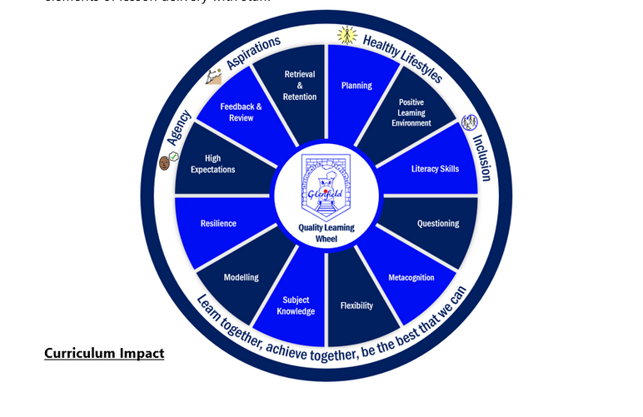

Classroom implementation
Systematically check pupil understanding, quickly identify misconceptions and address them effectively?
Select analogies, examples and models that support pupils to grasp complex concepts and processes?
Use assessment to check pupils’ understanding, helping pupils to embed knowledge into long-term memory and use knowledge fluently (rather than memorising disconnected facts)?
Set challenging tasks with a clear learning purpose?
Do teachers …
Understand the intent of the plan and what pupils should learn by the end of each unit (including in years before or after the one they’re teaching)?
Sequence pupil learning appropriately, lesson-by-lesson, so that they’re building on what has been taught before and working towards clearly defined end points?
Achieve depth in their teaching, moving beyond surface-level explanations and examples?
Know which aspects of the subject might be hardest to understand due to its complexity, and plan lessons accordingly?
​
A place to thrive

