Slide 1

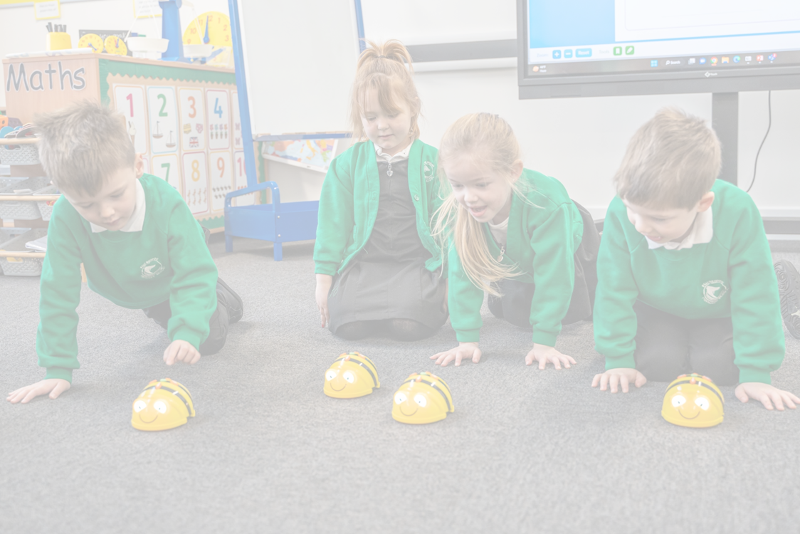


Scholars Safeguarding Strategy
“Every child, in every school, has the right to an excellent education and the opportunity to develop character in a secure and caring environment.”
November 2023

Slide 2


Key Components:
  Annual Safeguarding Audits:
  Child Protection Policy and DSL Meetings:
  Safeguarding Approaches:
  Support and Training:
  Site Walks and Governance:

Slide 3
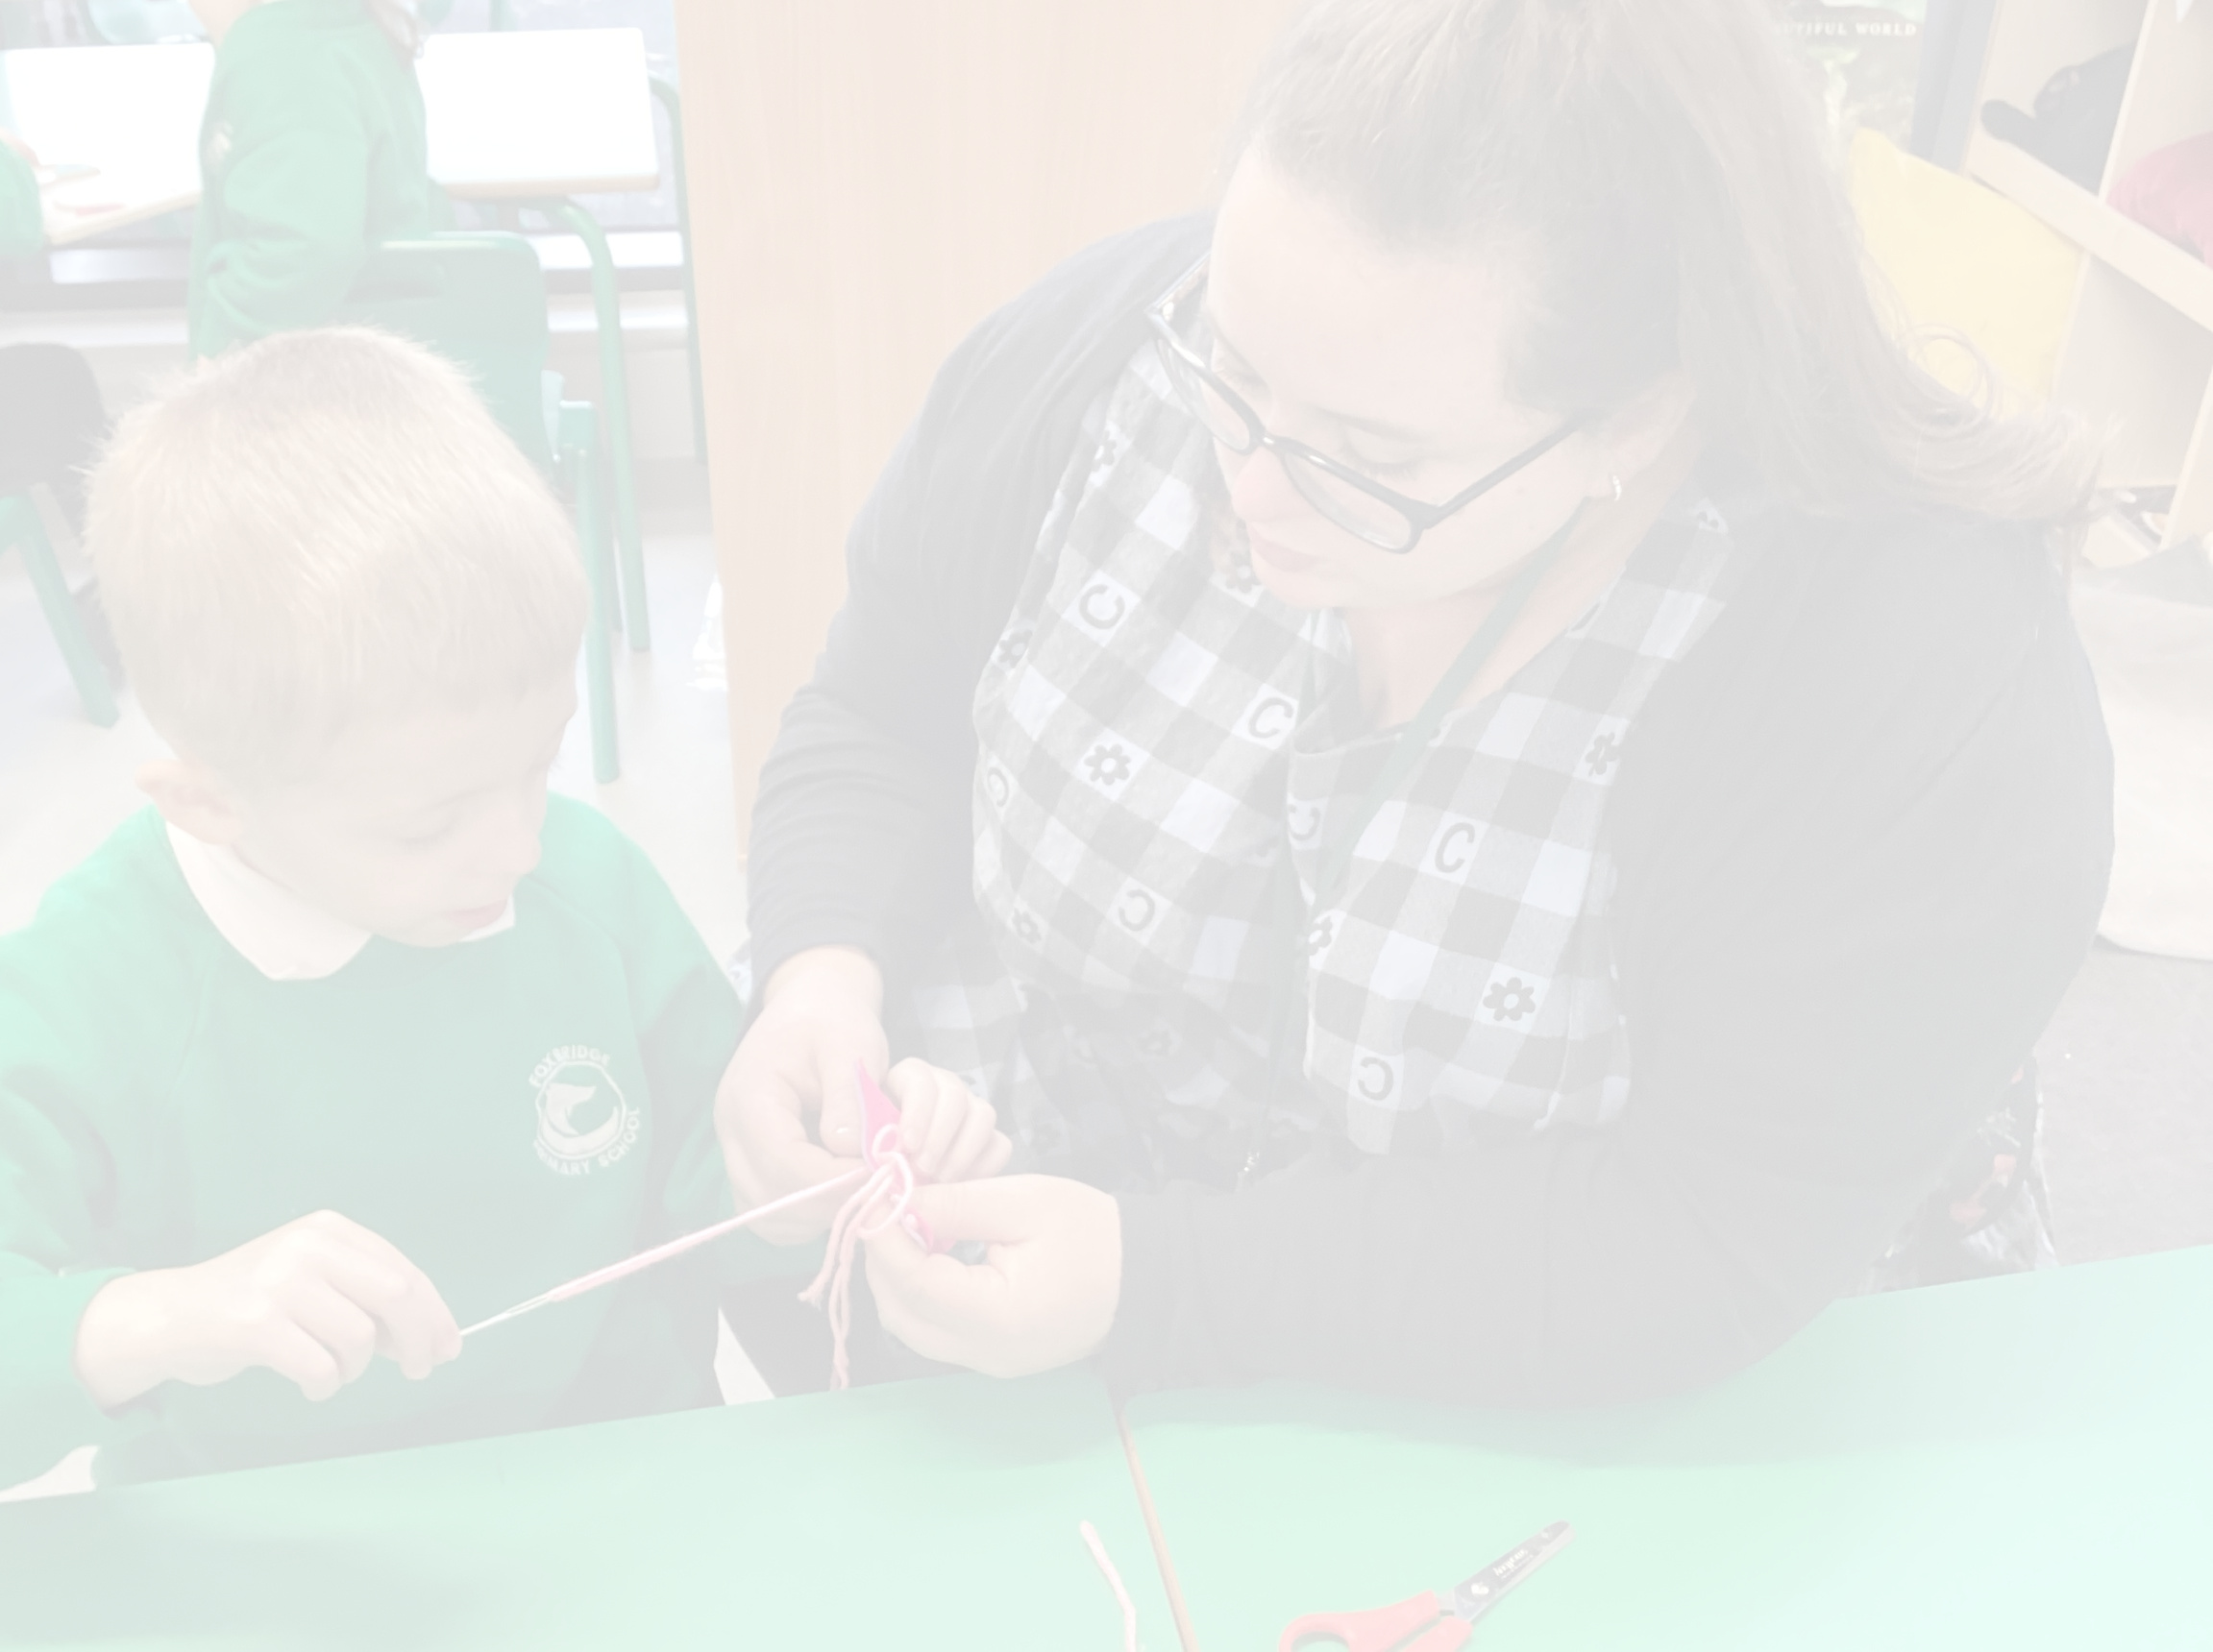
  Annual Safeguarding Audits
  Charlotte Harrison, the retained Safeguarding Trust Lead (STL), conducts annual audits. This will include the SCR, personnel files, personal development and safeguarding culture.
  An action plan is devised based on audit findings for leaders to implement and manage.
  Regular monitoring visits check progress and adherence to the safeguarding action plan.
  Findings are shared with Trustees and Governors for transparency and accountability.

Slide 4


II. Child Protection Policy and DSL Meetings:
  The Trust lead drafts a comprehensive Child Protection Policy which is localised where appropriate by DSLs.
  The Child Protection Policy is reviewed and ratified by Trustees and reviewed by Local Governors.
  Designated Safeguarding Leads (DSLs) meet with the CEO and Safeguarding Trust Lead (STL) termly for updates and scenario training to stay updated with evolving needs needs.

Slide 5
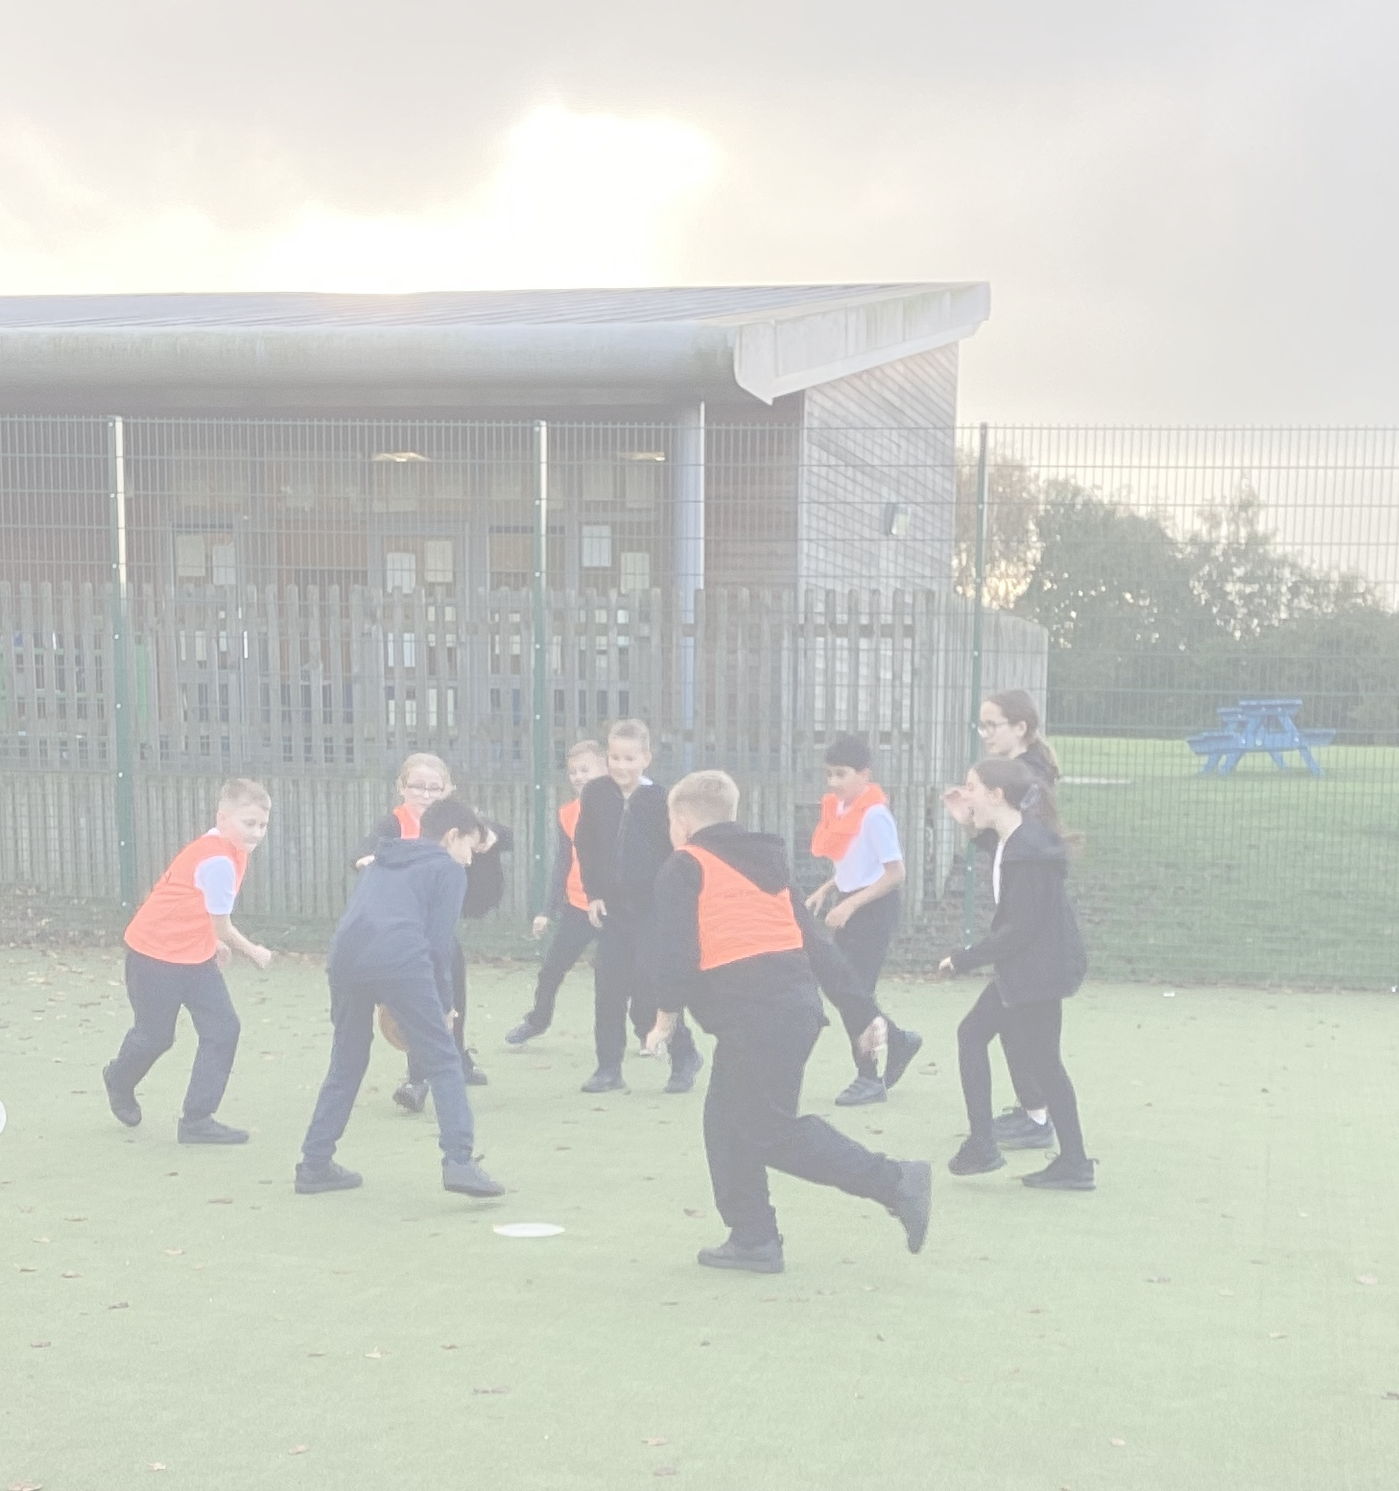
III. Safeguarding Approaches :
  All Trust schools use CPOMs for recording concerns and incidents.
  All schools use the Green Safe lanyards and this is explicitly taught to children.
  All SCRs are held centrally using the trust template, with audit tabs for regular review and feedback which forms part of the trust monitoring cycle using the trust template, with audit tabs for regular review and feedback which forms part of the trust monitoring cycle..

Slide 6
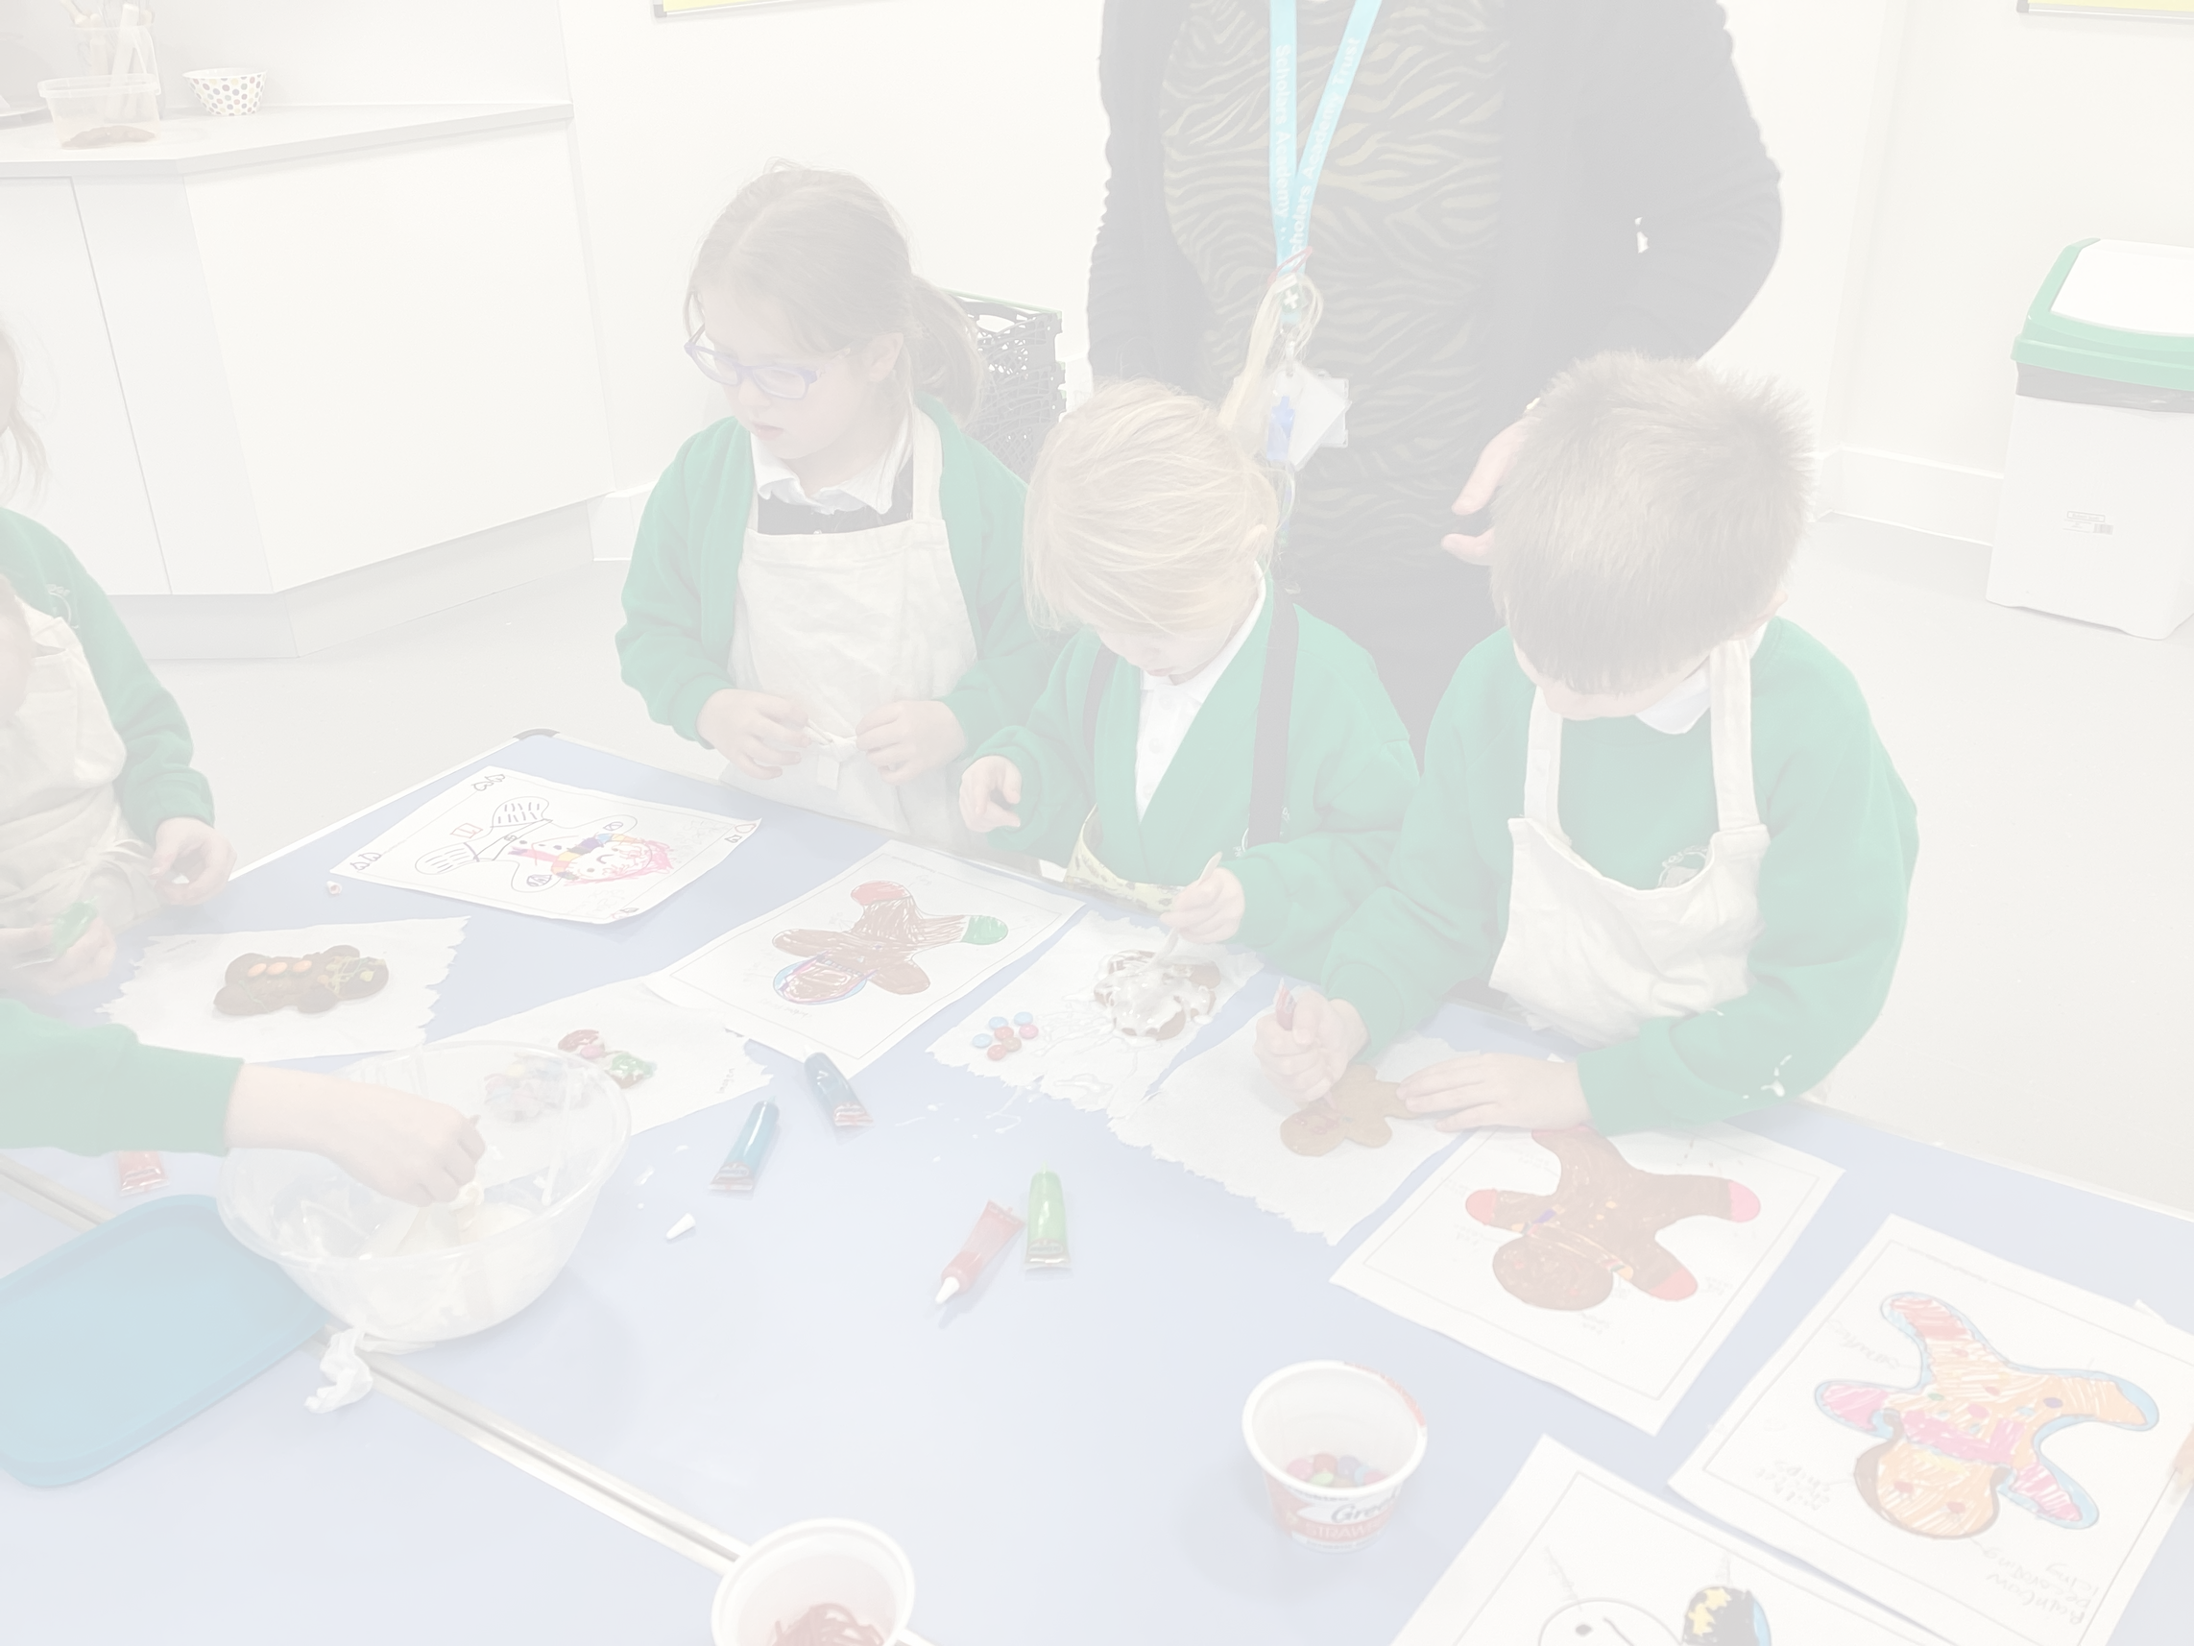
IV. Support and Training:
  Headteachers are mandated to maintain a 2-year safeguarding training strategy adaptable to contextual changes.
  Trust leader remains available for guidance and support on any safeguarding queries or issues.
  Annual training for all staff followed by regular dip testing throughout the year. This is completed through the use of Quiz's, safeguarding boards in staff rooms and through briefing. New starters will receive training as part of their induction process.
  Staff are asked probing safeguarding training questions during visits by trust leaders.
  Regular training is provided for SCR compliance and employment checks by TSL.

Slide 7
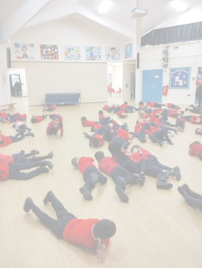
V. Site Safety and Governance
  Chief Operating Officer (COO) conductS biannual site walks with site managers to ensure physical safety measures.
  Governors and Trustees receive comprehensive training sessions by the Trust Safeguarding Lead.
  Post-visit audits are sent to Governors and Trustees for review, ensuring transparency and accountability.

Slide 8
Goals:
  Provide a secure and caring environment for every child.
  Ensure a safeguarding culture through continuous training and support.
  Maintain compliance with evolving safeguarding standards and best practices.

Slide 9
Measures for Success:
  Regular monitoring and review of safeguarding practices.
  High staff compliance with training and reporting protocols.
  Positive feedback and outcomes from audits and site visits.
  External reviews demonstrate strong compliance and excellent safeguarding cultures

