Slide 1
Solvers 2025/2026
Classroom Adults:
Mr Squires
Mrs Chalmers – 5 days a week
Ms Evans – 3 days a week
Mrs Howarth – every other Monday
Mrs Thomson – every Wednesday afternoon

Slide 2

Solvers Key Term

Slide 3

Individual Speech and Language Support
Regular speech and language support according to EHCP
Robyn in every Thursday
Support followed up by Mrs Evans, Mrs Chalmers and Mrs Doshi
Social communication groups
‘The Art of Conversation’ – communication games
Every lesson taught has a focus on spoken language

Slide 4

Curriculum
National Curriculum
Following the Year 3 mainstream topics for this year, with activities adapted for each child.
Individualised planning for each child
All areas of the curriculum taught weekly, with high levels of focus on oracy.
Specific topics can be found on the curriculum leaflet sent out at the start of each activity.

Slide 5

Reading
Whole school focus to improve reading this year
Belief as a school that every child can learn to read well
Daily whole class reading lessons in schools – 5 times a week
Daily one-to-one reading in school – each pupil will be heard read at least once a week
Important to continue reading at home
Questioning
Reading role-models

Slide 6

Writing
Daily writing lessons
Skills developed through independent grammar lessons.
Analyse model text → identify features of good writing → grammar lessons → plan their own writing → draft their writing → edit → publish
Independent writing opportunities
Individualised support from adults where needed
3x spelling lessons a week – followed by a Friday test
2x handwriting lessons a week

Slide 7

Maths
Daily maths lessons
Power maths scheme to follow
Opportunities to work independently and with small groups on activities following the lesson
Use of manipulatives

Slide 8
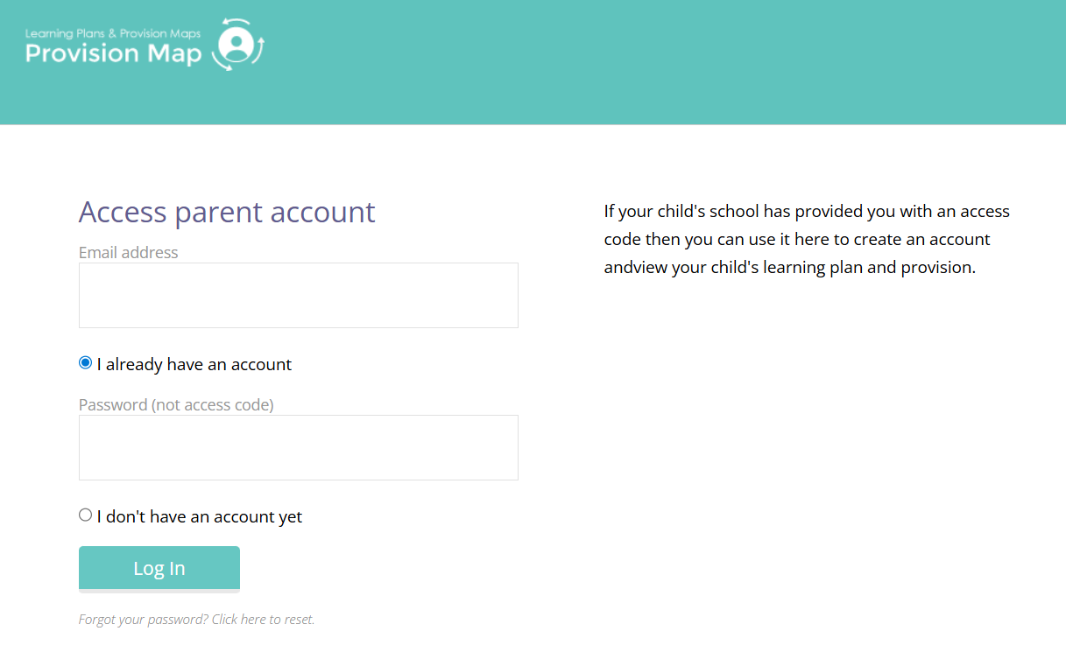
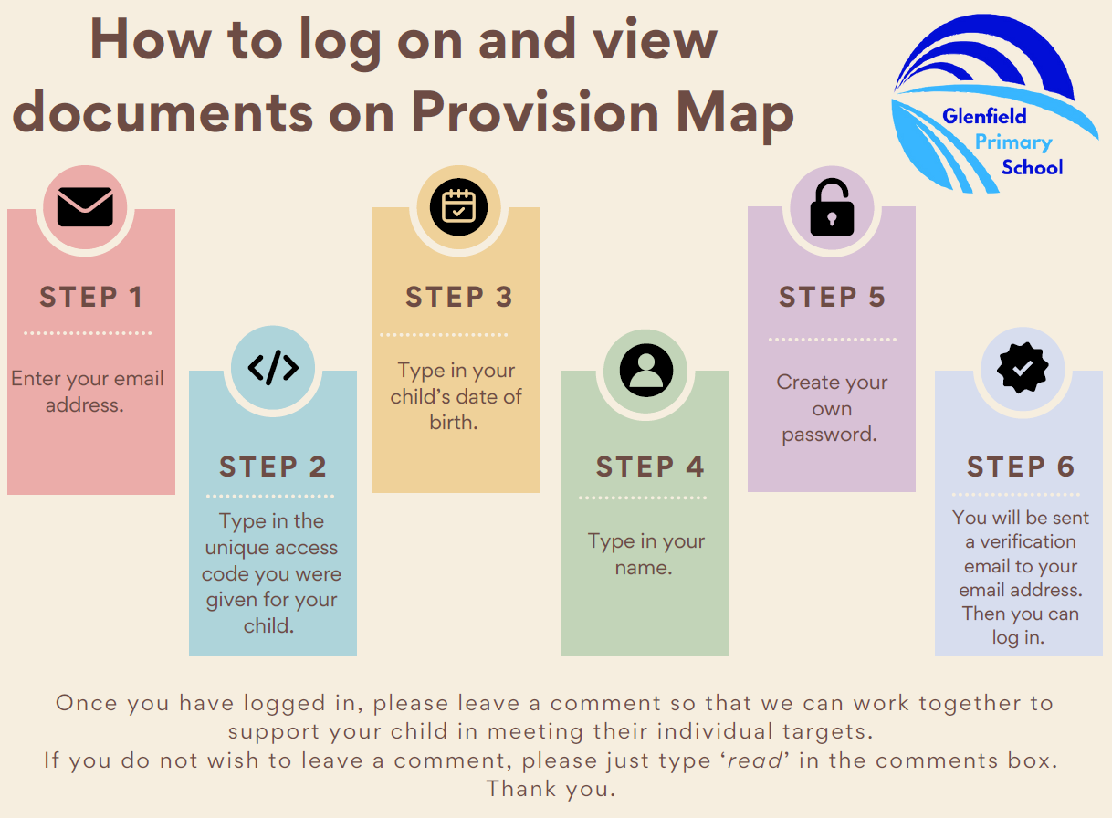
Edukey – online provision mapping
Individual passport targets can be viewed online instead of the paper copies that were previously printed out.

Slide 9

Zones of Regulation

Slide 10
Annual Reviews
Y6: September/October – invites already gone out
Name one or more transfer school for Y7 on return paperwork
Y5: Between January and March
Will be talking about starting to look for a transfer school for Y7
Invites will be sent out in good time prior to the date
Paperwork will be sent home two weeks before the date

Slide 11
Integration
Children will be integrating into mainstream
Maths
Pupils integrating into Solvers from Thinkers for writing and maths.
PE lessons
Assemblies
Break time and lunchtime

Slide 12

Communication
splprovision@glenfield.leics.sch.uk
Class dojo
Phone

Slide 13
Any questions???

