Slide 1





YEAR ONE

Slide 2





The Team
Detectives
Mrs Baugh
Mrs Howarth
Mrs Sidwell & Miss Hands (1:1)
Discoverers
Ms James
Mrs Akhtar & Miss Hands (1:1)

Slide 3

The jump from Early Years
📅 More structured timetable (less free play)
🧸 Play-based learning → ✏️ More formal teaching
🌱 EYFS framework → 📚 National Curriculum
🤝 Adult support → 🚶 Greater independence
🔤 Early literacy focus → 📝 Clear subject outcomes
🏠 Play-based classrooms → 🪑 Desk-based learning
📸 Observations → ✅ Formal assessments
🐢 Slower pace → 🐇 Faster pace & challenge

Slide 4

Daily Routines
📖 Morning phonics and Writing lessons
🔢 Daily Maths session
🧑‍🔬 Science, History, Geography and creative subjects
🏃 PE twice per week
📚 Reading lessons and sharing a story
Assemblies

Slide 5

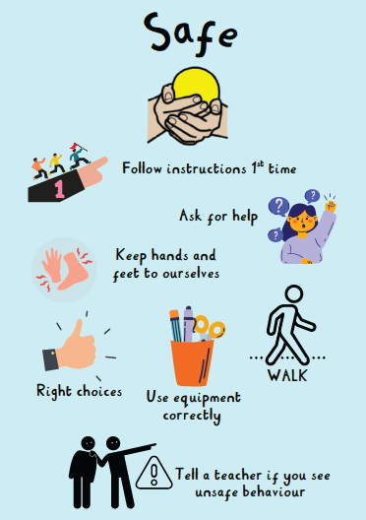


What we expect of our pupils

Slide 6


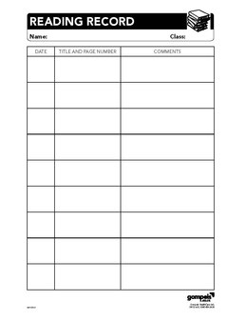


Bits to remember
Book bag with reading record every day
PE Kit - Monday and Friday
Homework - out on Friday

Slide 7




Phonics Screening Check
Essential Letters and Sounds (ELS)
40 words (2 sections x 20)
Mix of real and pseudo (‘alien’ words)
Identify progress/additional support
Phonics Meeting for more information

Slide 8

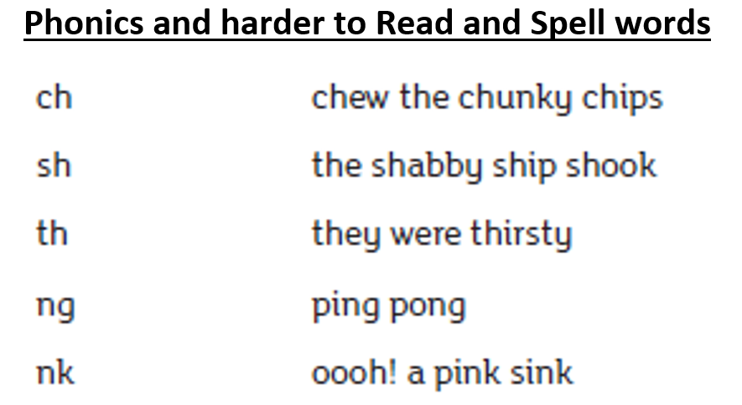
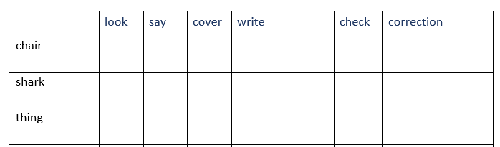
Homework

Slide 9





Supporting your child at home
Read every day
Reinforce our school values
Practise counting in different ways and starting on different numbers (forwards and backwards)
Encourage completion of homework on time

Slide 10


Dates for your diary
Botanical Gardens Trip
Thursday 25th September
Phonics Workshops
Monday 29th & Tuesday 30th September
Harvest Assembly
Thursday 9th October

Slide 11


Let’s have a great year!

