Slide 1

Year 4
Parents’ Meeting
2025 – 2026
Miss Kirby – Analysers
Mr Chamberlain - Innovators

Slide 2
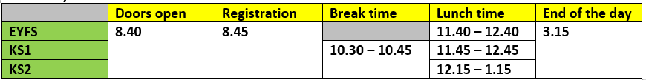
Our school day
Gates open 8:30, Doors open at 8:40, Registration at 8:45
Break time is 10:30-10:45
If parents/carers are late collecting their child, the teacher will take children to the office at 3.25pm
At break, children are only to have fruit or water.
Please ensure your child has a water bottle every day.
Also, no birthday sweets/presents should be given out during the school day please.

Slide 3
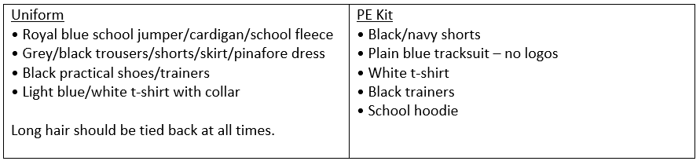
Uniform & PE kit reminder
Our PE days – Wednesday (outdoor) & Thursday (indoor)
No jewellery is allowed to be worn during PE lesson.
Ideally, please leave jewellery at home on PE days.
Notes:
We have the coach on Wednesdays

Slide 4
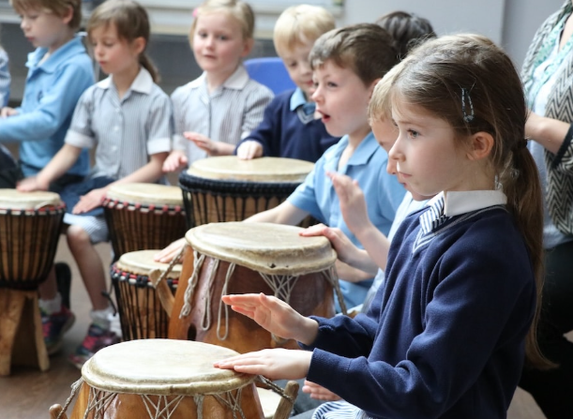
Music
In addition to our usual music lessons, the children will be taught djembe drumming every Wednesday afternoon during the Autumn and Spring terms!
Notes:
We have the coach on Wednesdays

Slide 5
Autumn overview
Autumn 1 | Autumn 2
English: Rumaysa Maths: Place Value, Addition & Subtraction Science: Classifying Organisms History: Ancient Rome Art: Drawing: Power prints Computing: Coding (Game Design) PSHE: Families & Friendships / Safer relationships PE: Indoor – Dance / Outdoor – Invasion games RE: What does it mean to be Hindu in Britain today? French: Presenting Myself | English: The Tin Forest & The Lost Thing Maths: Multiplication & Division, Fractions Science: Food & Digestion Geography: The Alps Music: Body and Tuned Percussion (Rainforests) Computing: Software and Hardware PSHE: Safer relationships / Respecting ourselves and others PE: Indoor – Gym / Outdoor – Invasion games RE: What do Hindus believe God is like? D&T: Mechanical systems: Making a sling shot vehicle

Slide 6
Parents' Evenings
Report cards, summarising progress and effort, are sent home towards the end of the autumn term, along with an end of year report in the summer.
Face-to-face meetings with parents are arranged in the first half of the Autumn and Spring terms.

Slide 7
Homework
All children will be given a sheet of maths homework and a sheet of English homework.
Homework will be given out on a Friday. It is expected that this is returned by the following Wednesday.

Slide 8
Writing - ‘Pen to Paper’ Curriculum
Foster enjoyment of writing
Create competent, confident writers
Provide breadth of experience – writing for different audiences and purposes
Broaden vocabulary
Ensure a good understanding of grammar, spelling and punctuation
“We want them to write clearly, coherently and creatively and to enjoy writing expressively, imaginatively and informatively.”
– Jez Smith (2022) (in ‘Primary Huh’ - Mary Myatt & John Tomsett, 2022)

Slide 9
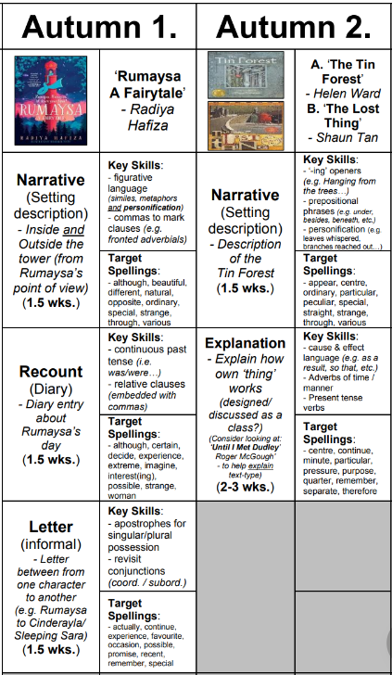


Slide 10
Reading
Our reading lessons focus on…
Exploring quality texts
Time for discussion
Questioning
Working on reading skills
Completing a range of activities
Notes:
Out of 50
Pass mark for 2019 was 28
1 hour

Slide 11


Introduce the text & NHTW
Vocabulary
Retrieval
Inference
Prediction, Explaining, Summarising/Sequencing

Slide 12

Reading at home
Reading for pleasure
Range of reading – fiction, non-fiction, poetry, picture books…
Audio books
Reading records – please complete (either child or adult)
Ask the child questions about what they have read
Library visits if possible
Reading books and reading records to be in school everyday
Year 4 children should be reading for at least 10 minutes every day.

Slide 13
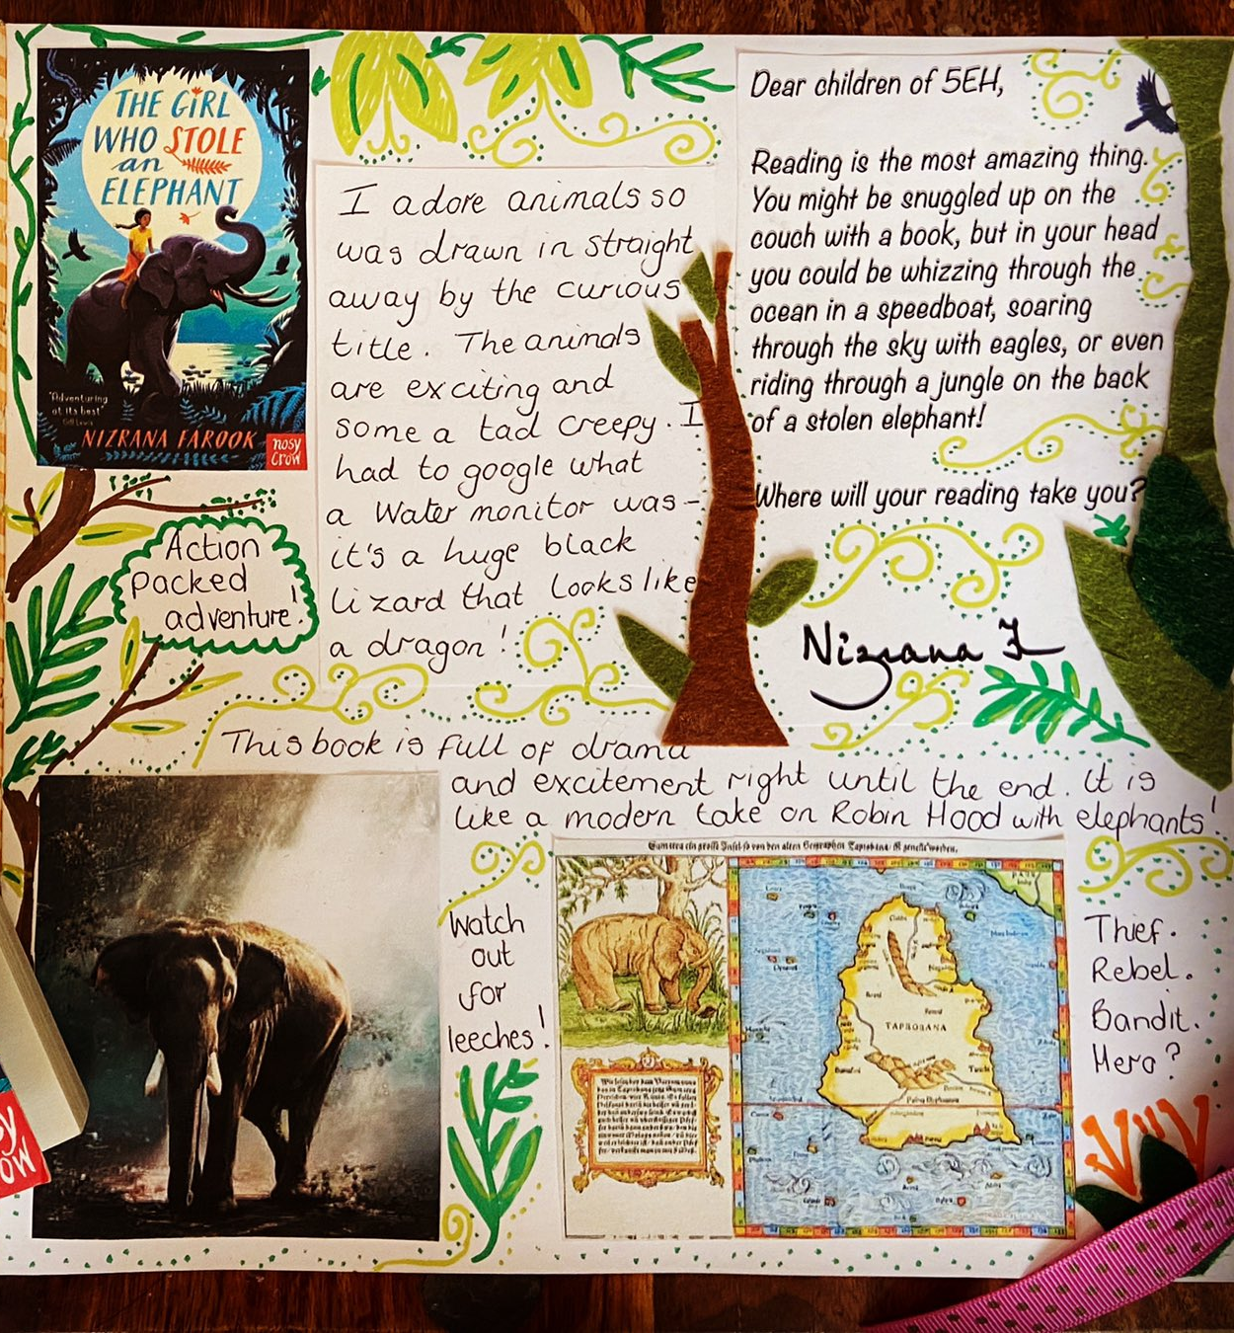
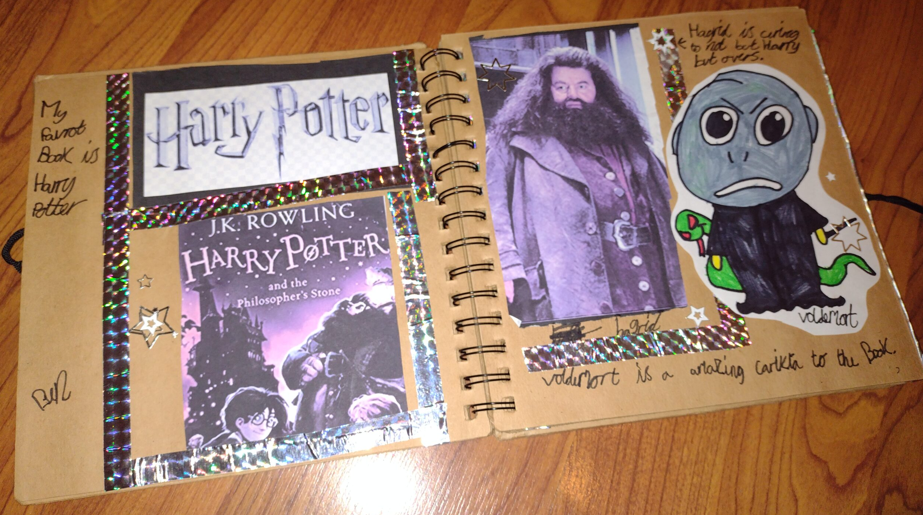
Reading Scrapbook
The idea is that the child who has the scrapbook will tell us about a book they have enjoyed reading. It could be a book review, illustrations, character descriptions, their favourite part/chapter - anything they want to share about the book!

Slide 14

Maths
​ | Autumn 1​ | Autumn 2​ | Spring 1​ | Spring 2​ | Summer 1​ | Summer 2​
Year 4​ | Number and Place Value ​ ​ Addition and Subtraction ​ | Area​ ​ Multiplication and Division ​ ​ ​ ​ ​ ​ | Perimeter ​ ​ Fractions ​ | Decimals ​ ​ ​ | Multiplication – Ready for MTC​ ​ Money ​ ​ Time​ ​ | Angles and 2D Shape​ ​ Statistics ​ ​ Position and Direction ​
The key aims of Power Maths: Keeping the whole class progressing together and providing rich problem solving to challenge every child.
It is built on a growth mindset and problem-solving approach.

Slide 15

Times Table Rockstars!
Your child should have their log-in for their TTRS account. These were given out at the start of term and stuck into Reading Records for safe keeping.
Please encourage your child to access the practice games regularly, we will include lots of inter-class and inter-year group battles!

Slide 16
MTC Checks
Your child should have their log-in for their TTRS account. These were given out at the start of term and stuck into Reading Records for safe keeping.
Please encourage your child to access the practice games regularly, we will include lots of inter-class and inter-year group battles!

Slide 17

Year group assembly – 10th October, 9am and 2.45pm
Multiplication Check – June 2026
Hindu Temple 15 September
Djembe drumming: Parent Lesson: 8 October, Performance 3 December
Residential – Pioneer Centre, 20-22 April
Christmas performance TBC
Birmingham Think Tank TBC

Slide 18
Curriculum information
We will be sending out our Year 4 curriculum leaflet shortly for the Autumn Term.
In the meantime, you can find further information on the school website...
https://www.glenfield.leics.sch.uk/curriculum

Slide 19

Questions

