Slide 1

Welcome to Year 2…
With Miss Johnson and Miss Kaur

Slide 2

Reading…
At least 10 minutes every day
Write in their reading journal – should be in school everyday.
Sounding out and blending using ELS techniques
Questioning
Use picture cues
Oxford Owl

Slide 3
Reading…
Bedtime bear – Given out on a Friday and due back in on a Thursday.
Add pictures of your child reading with him and get them to write about the book that was read.

Slide 4

Reading…
I read flying a kite with Bedtime Bear and my Daddy. My favourite part was when Daddy Pig fell in the mud. My favourite character from the book is Mummy Pig because she is funny.

Slide 5
Writing…
Capital letters and full stops
Spellings: Think, say, write, check, games, els strategies.
Conjunctions: and, but, so, that, because, when, if, or
Expanded Noun phrases: adjective, adjective noun
Adverbs: Often end in –ly e.g. happily, sadly, carefully
Use of phonics to support spelling
Cursive handwriting
Suffixes

Slide 6
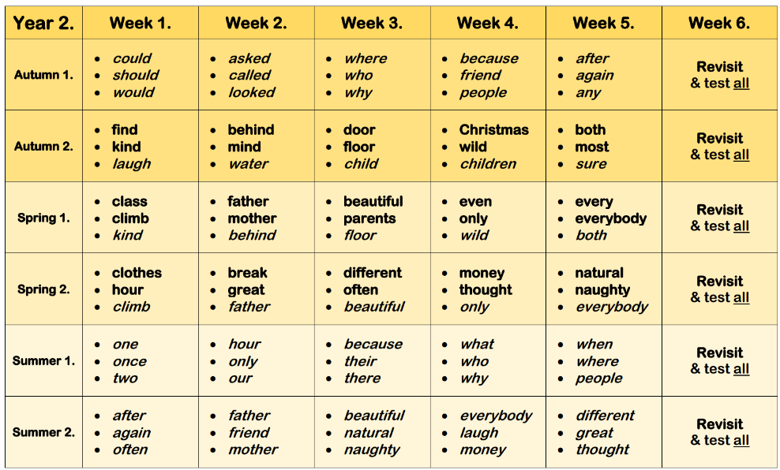
Spelling…

Slide 7
Maths…
Counting in 2s, 5s and 10s leading to times tables
Number bonds to 10 and 20
Addition and subtraction to 100 – using dienes and number lines – no column method
14 + 15 = 29
+ =
Notes:
We follow power maths, it has a strict structure and the children respond well to this. Talk through the things on the slide

Slide 8
Maths…
Measuring – time, capacity, temperature, height and length
Time to the nearest five minutes – please practise at home!
Fractions: halves, thirds and quarters
Fluency, reasoning and problem solving
TTRS

Slide 9
Homework…
2 activities per week – maths and then alternating reading/grammar
Neat presentation using a pencil
Homework given on a Friday and collected by Wednesday every week.

Slide 10
Thank you!
Any questions?

