Slide 1


Slide 2

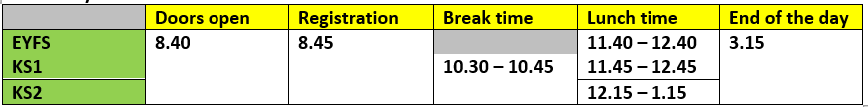
Our School Day…
Gates open 8:35, Doors open at 8:40, Registration at 8:45
Break time is 10:30-10:45
If parents/carers are late collecting their child, the teacher will take children to the office at 3.25pm
At break, children are only to have fruit or water.
Please ensure your child has a water bottle every day.
Also, no birthday sweets/presents should be given out during the school day please.

Slide 3
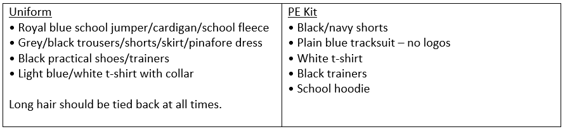
PE Uniform
Our PE days – Monday & Friday
No jewellery is allowed to be worn during PE lesson.

Slide 4

Behaviour

Slide 5
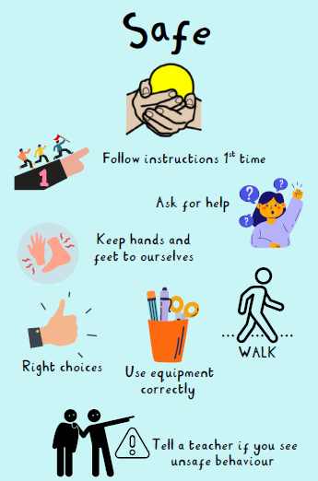



Slide 6
Autumn 1 | Autumn 2
English: The Golden Horsemen of Baghdad Maths: Place Value, Addition & Subtraction Science: Separating mixtures History: Victorians Art: Portraits: Painting and mixed media Computing: Designing own games PSHE: Families & Friendships / Safer relationships D&T: Structures PE: Tennis and Cricket RE: Judaism French: I have a pet | English: Shackleton's Journey & Race to the Frozen North Maths: Multiplication & Division, Fractions Science: Energy Geography: Why are the rainforests important to us? Music: History of the Blues Computing: Databases & Online Safety PSHE: Safer relationships / Respecting ourselves and others PE: Indoor – Gym / Outdoor – Invasion games RE: French: Set curriculums during PPA

Slide 7

English
Foster enjoyment of writing
Create competent, confident writers
Provide breadth of experience – writing for different audiences and purposes
Broaden vocabulary
Ensure a good understanding of grammar, spelling and punctuation
“We want them to write clearly, coherently and creatively and to enjoy writing expressively, imaginatively and informatively.”
– Jez Smith (2022) (in ‘Primary Huh’ - Mary Myatt & John Tomsett, 2022)

Slide 8
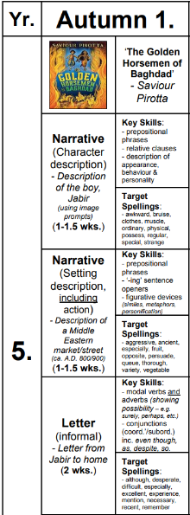
English

Slide 9
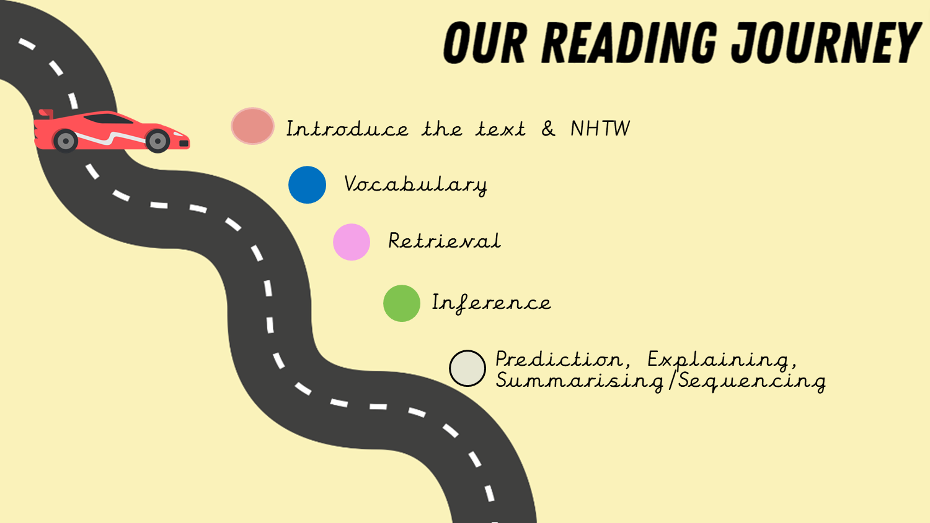

Slide 10

Reading
Reading for pleasure
Range of reading – fiction, non-fiction, poetry, picture books…
Audio books
Reading records – please complete (either child or adult)
Ask the child questions about what they have read
Library visits if possible
Reading books and reading records to be in school everyday
Year 5 children should be reading for at least 10 minutes every day.

Slide 11
Reading Scrapbook
This year, we are introducing a Reading Scrapbook in KS2 (KS1 will be doing something a little different).
The idea is that the child who has the scrapbook will tell us about a book they have enjoyed reading. It could be a book review, illustrations, character descriptions, their favourite part/chapter - anything they want to share about the book!
The class teacher will do an example first and then we will ask children who would like to take it home to complete an entry (we won't try to force it, but children who haven't had it will be encouraged to take it home too)
Here are some examples of what it could look like...

Slide 12
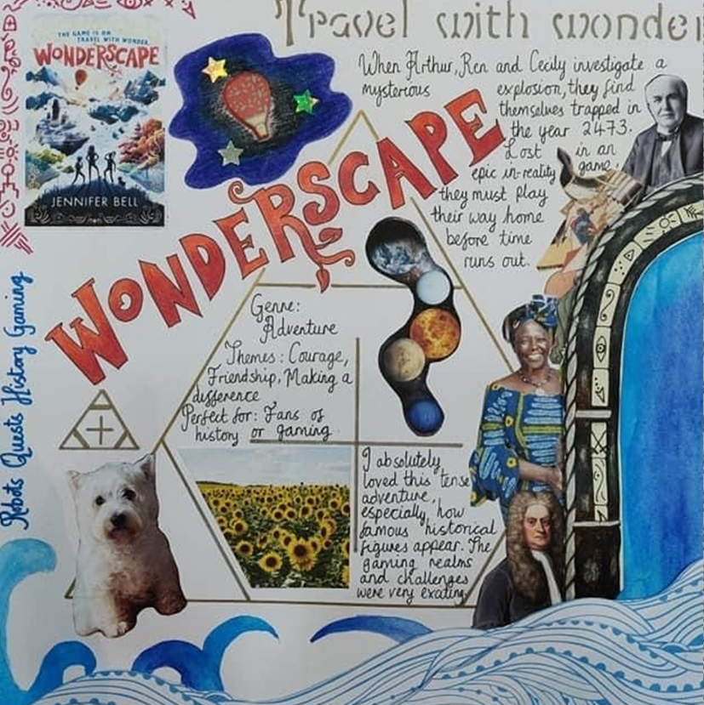
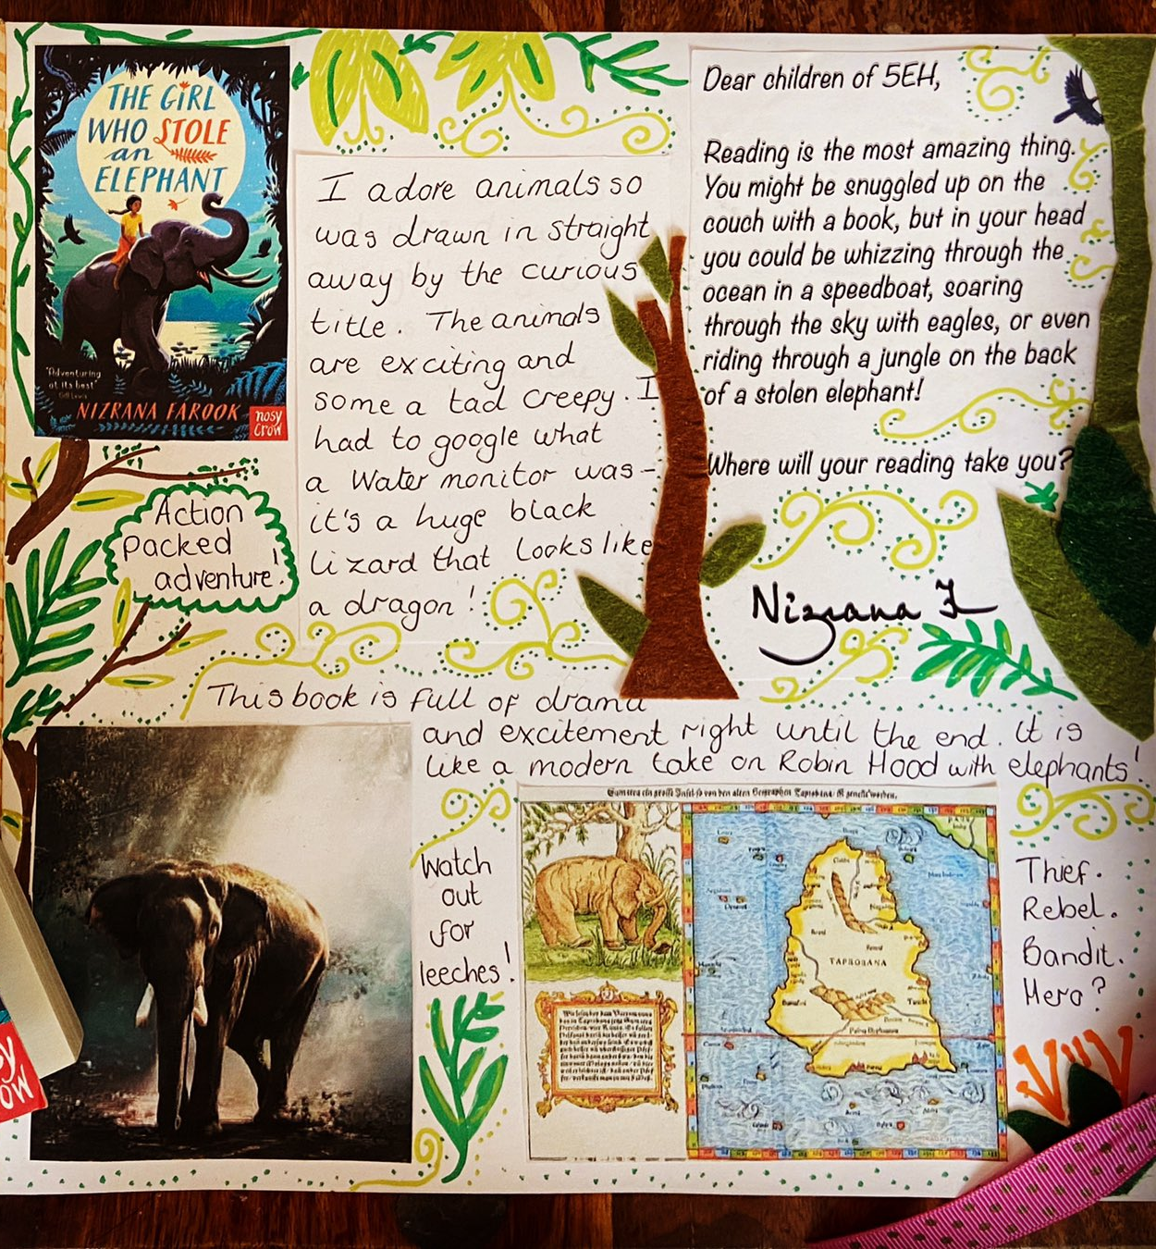
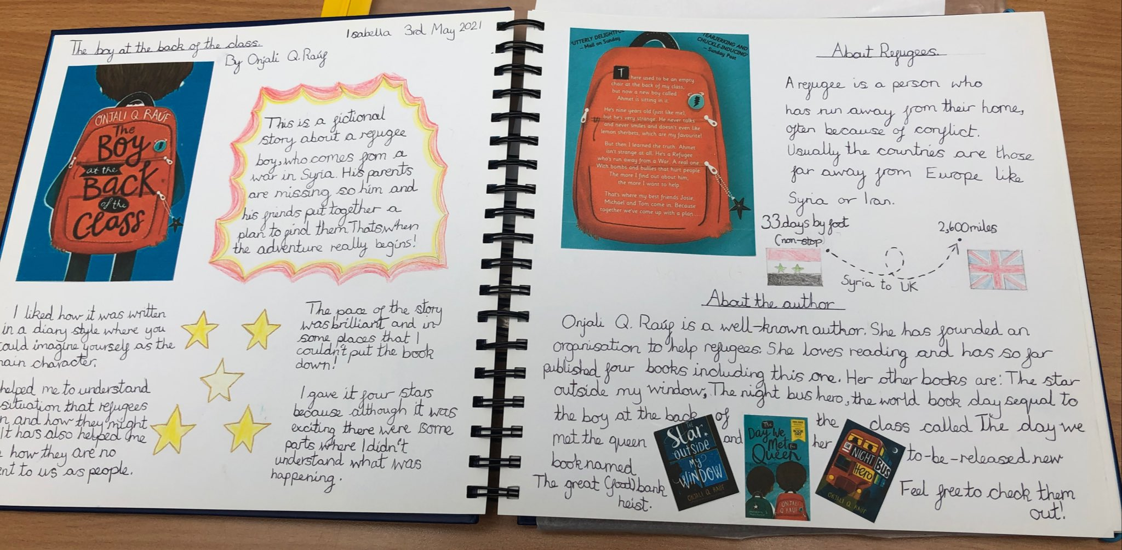
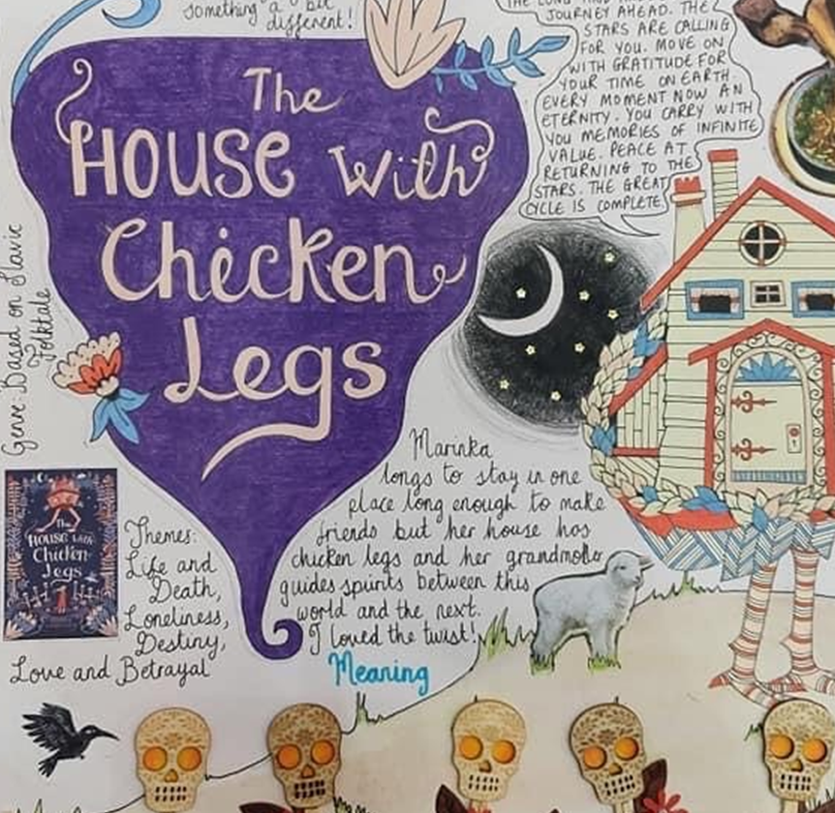
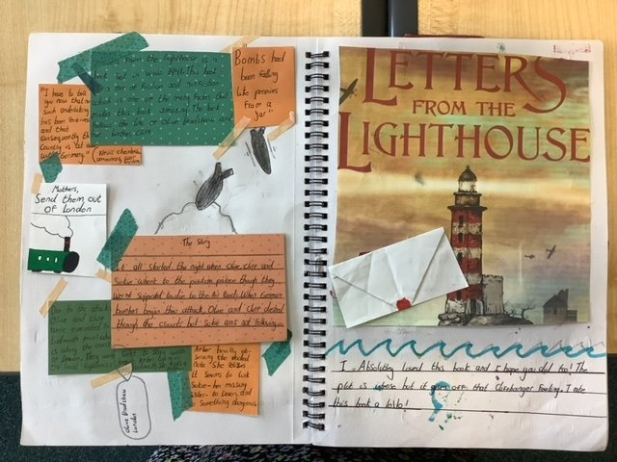
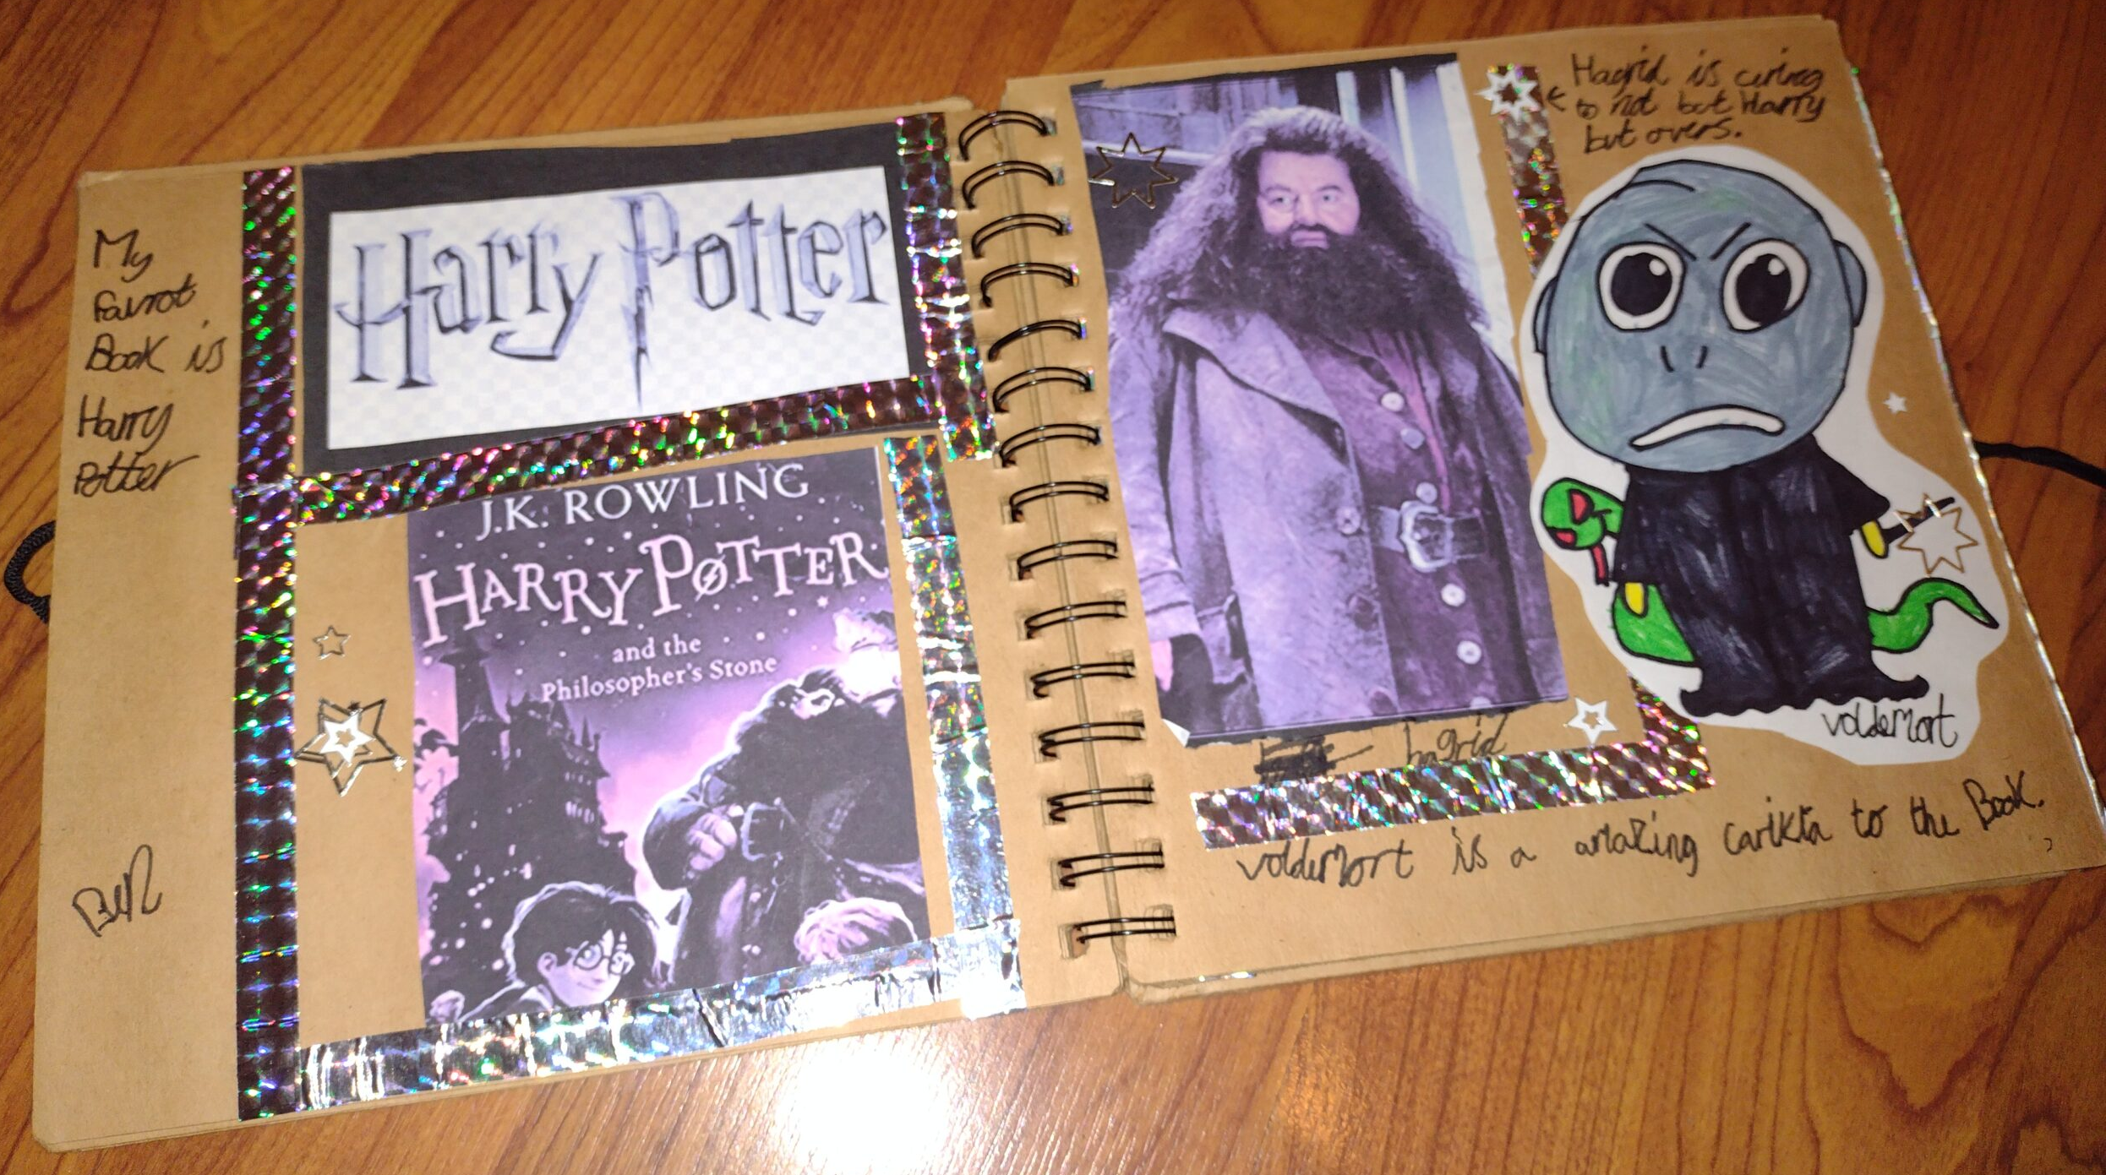
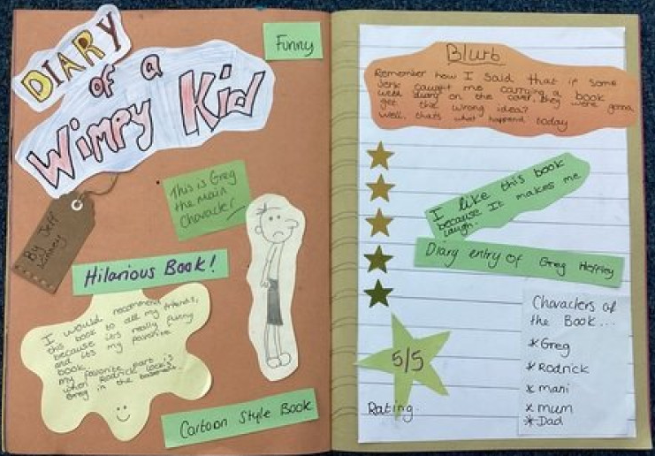
Reading Scrapbook

Slide 13
Maths
Place value - children this term will be exploring numbers up to 1,000,000. Practise saying hundred thousand and ten thousand numbers at home to support place value knowledge.
Multiplication and division knowledge - continue to play TTRS to support times table fact knowledge. This is incredibly important in Year 5 as they use this knowledge to support their Maths learning.

Slide 14
Homework
Homework is given out each Friday.
One Maths sheet and a reading/grammar sheet.
Independently if possible.
Handed in the following Wednesday

Slide 15

TTRS
Support times tables
Different game modes
Ensure heat maps are fully green.
Leaderboards updated every Monday.

Slide 16
Assemblies
Rosh Hashanah assembly on 26th September.

Slide 17


