Slide 1




Slide 2
Curriculum
Curriculum:
Following the Year 1 mainstream topics for this year, with activities adapted for each child.
Using the EYFS and Year 1 books as a stimulus for our writing lessons.
Individualised planning for each child
All areas of the curriculum taught weekly, with high levels of focus on oracy.
Lots of learning through play opportunities across the curriculum and continuous provision everyday.

Slide 3
Writing
Daily writing lessons based on a book.
Independent writing opportunities cross-curricular.
Guided and small group writing opportunities.
Focus on oracy and lots of discussion of ideas.
Daily phonics lessons to support spelling.
Daily fine motor skills practice or handwriting.

Slide 4







Slide 5






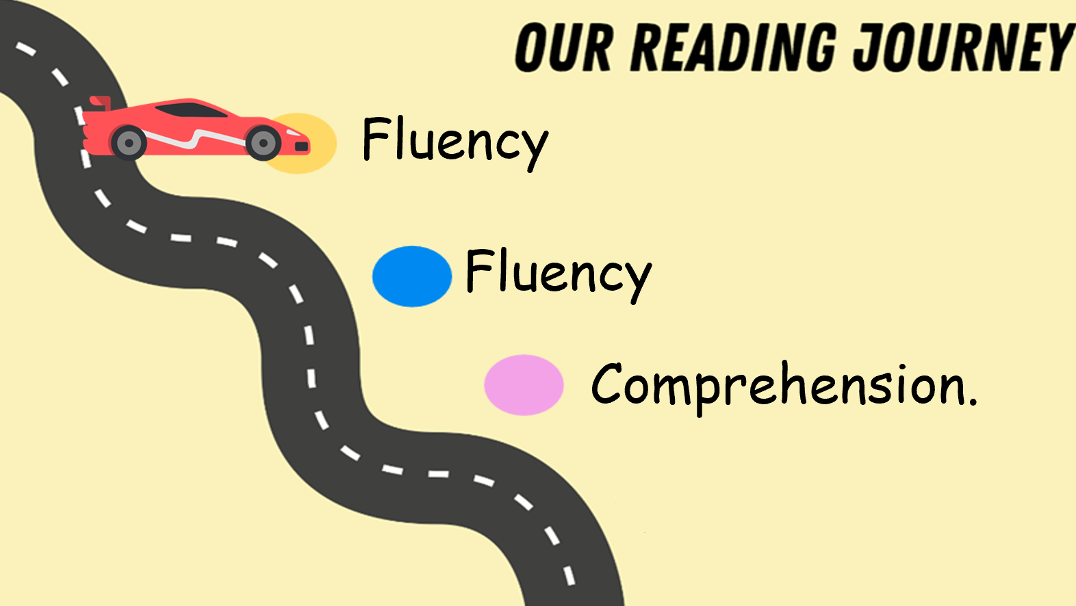
Structure of lessons.

Slide 6

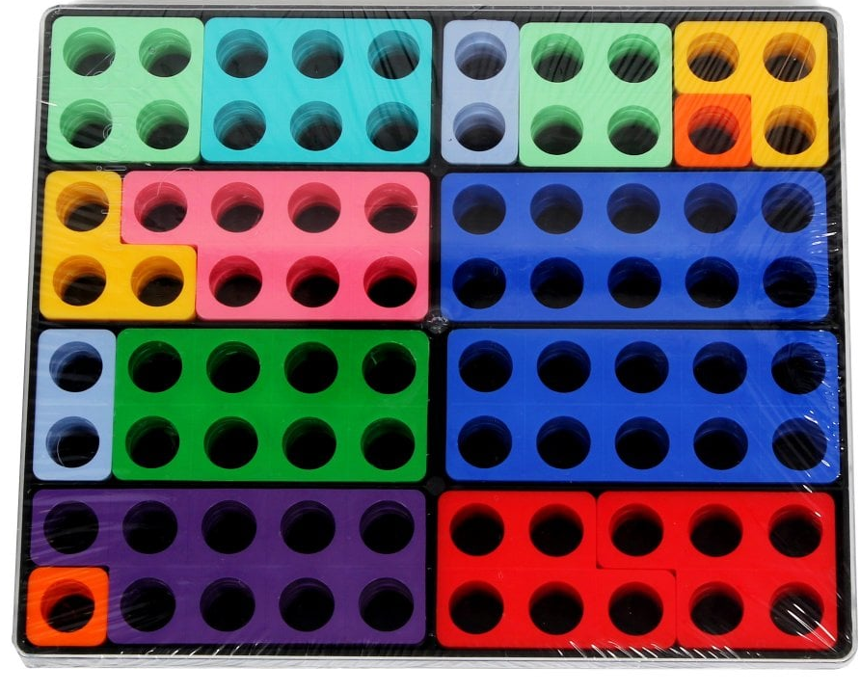
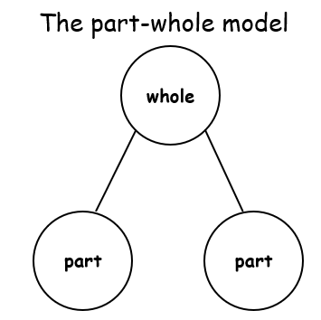


Maths
Daily maths lessons
Opportunities to work independently and with small groups on activities following the lesson
Lots of physical objects to help

Slide 7
Reading in School:
Daily phonics lessons, using whole school scheme
Whole class reading lessons 3 times a week supported by guided reading sessions.
Weekly one-to-one reading of reading books.
Daily reading within a variety of lessons and cross-curricular.
Reading corner accessible during free choice time.

Slide 8
Reading at home:
Important to continue reading at home and filling in the reading record so we can reward the children in school.
It can be helpful to encourage the child to read their phonics book to you as well as you reading a book of their choice to them to encourage a love of reading.
Oxford Owls – free to access for parents with a range of books available to access.

Slide 9

PE
PE days are Monday and Tuesday.
Monday – integrating with year 1 outside
Tuesday – indoor pe.
Children to come to school in PE kit on those days.

Slide 10



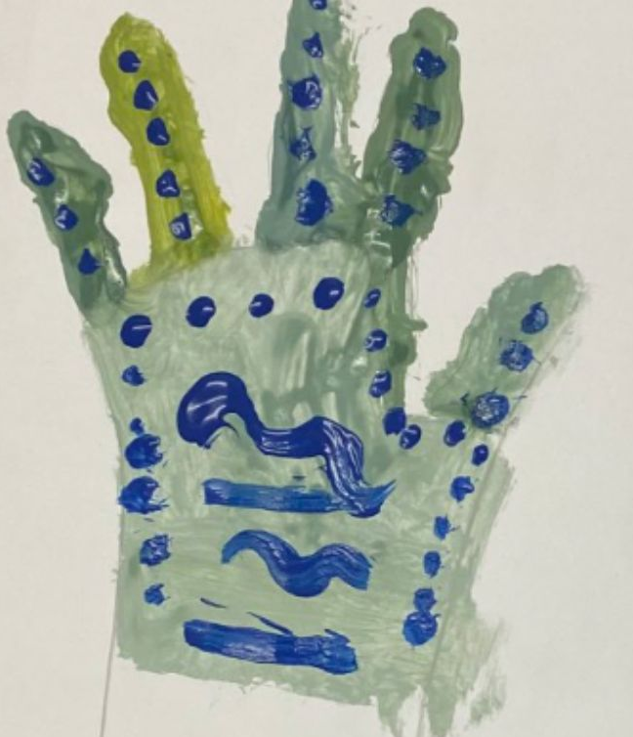

Topics:

Slide 11
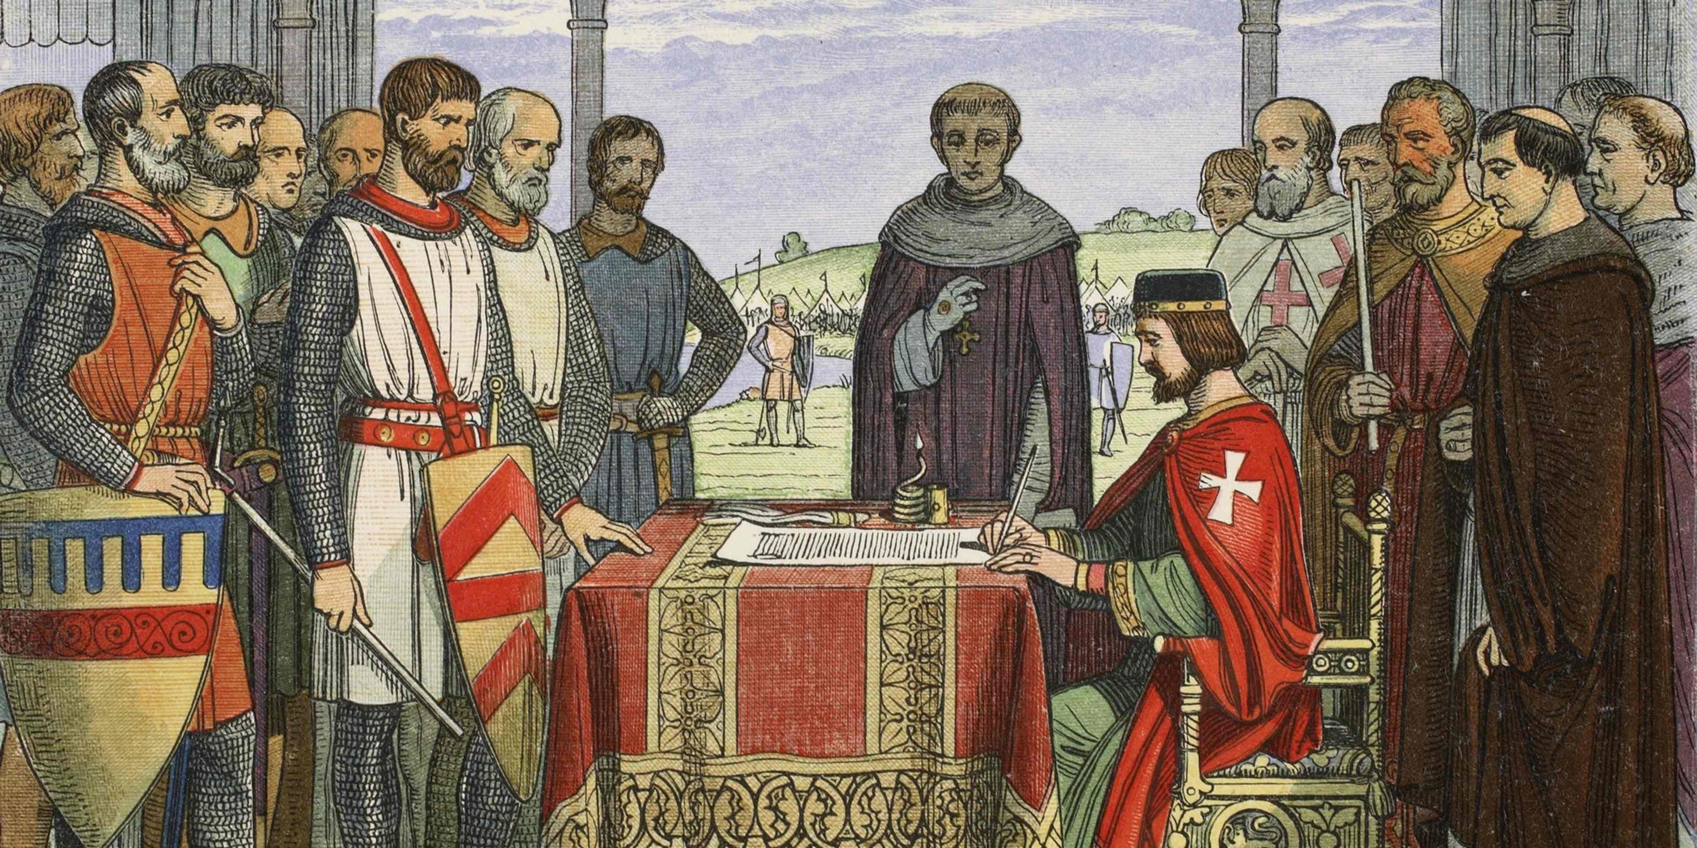
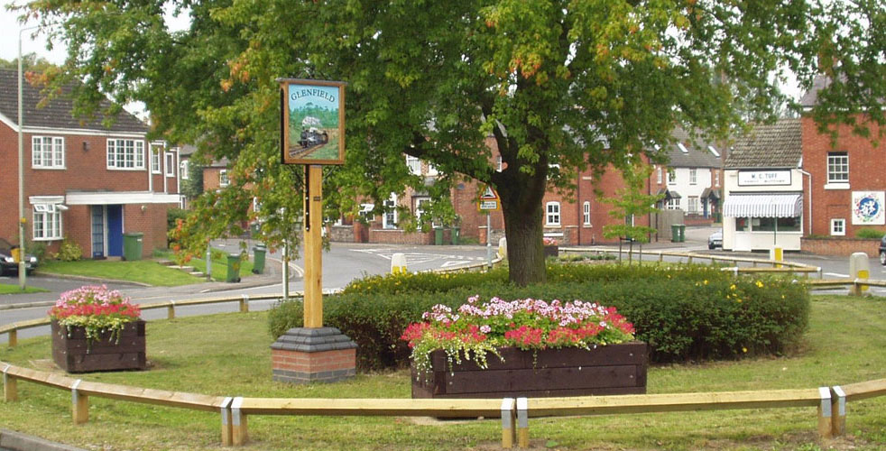

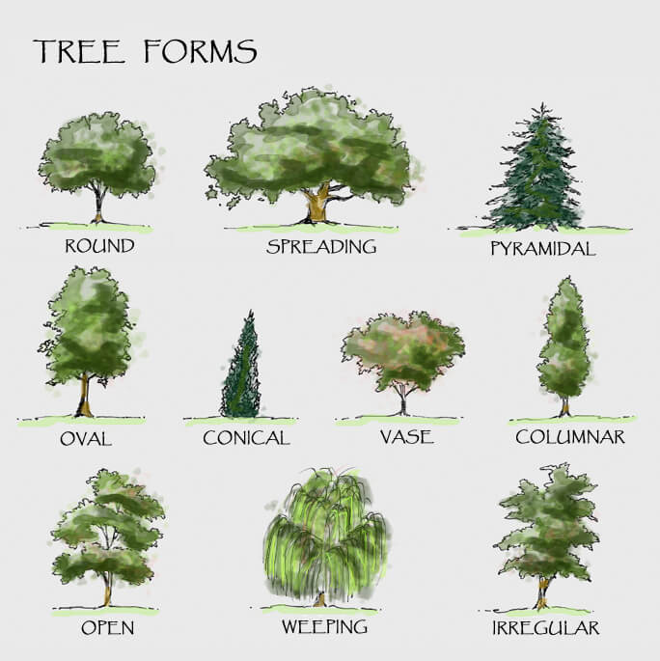
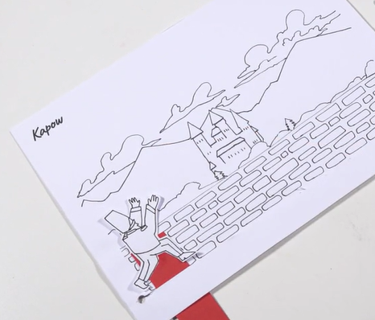
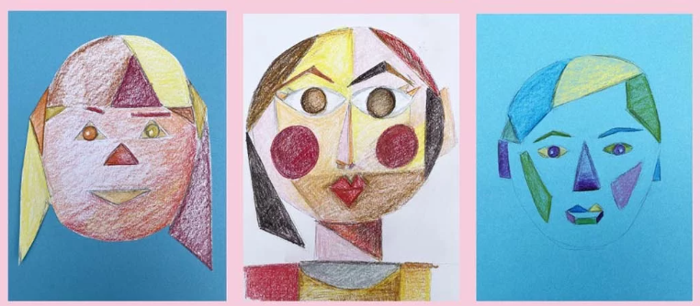
Topics:

Slide 12






Topics:

Slide 13
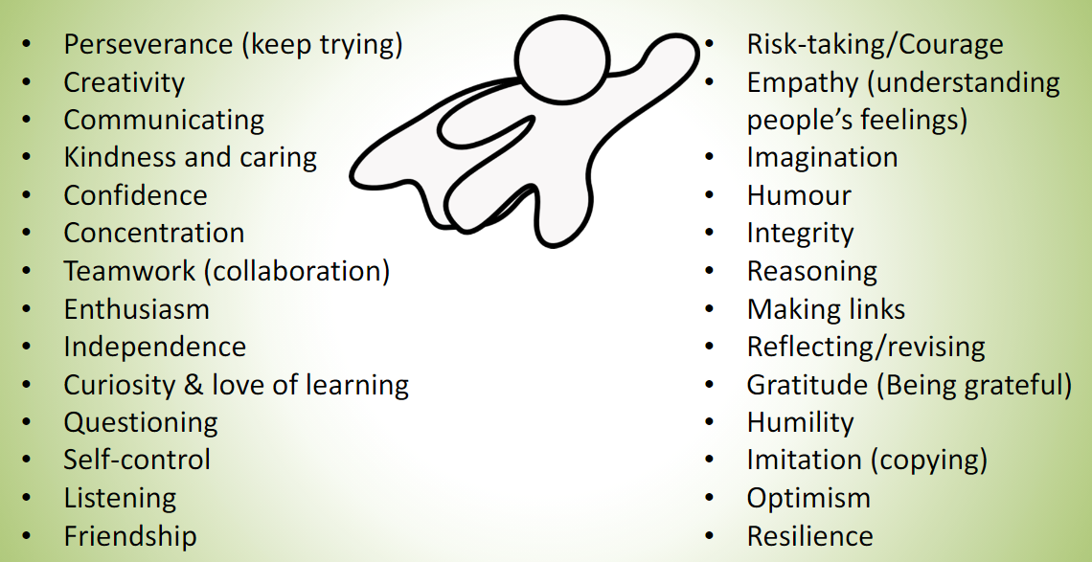
Route to Resilience
Children will receive certificates for these in achievement assemblies. Assemblies will be based around these.

Slide 14

Zones of Regulation

Slide 15
Annual Reviews
Most of the Annual reviews will be completed after Easter.
Invites will be sent out in good time prior to the date
Paperwork will be sent home two weeks before the date

Slide 16
Integration
Children will be integrating into mainstream for:
PE lessons – Year 1
Assemblies – KS1
Break time and lunchtime – KS1

Slide 17
Individual Speech and Language Support
Regular speech and language support according to EHCP.
Speech and Language Therapist in once a week, followed up by classroom support.
Encouragement to speak in full sentences.
Lots of opportunities for oracy throughout the day.

Slide 18
Communication
splprovision@glenfield.leics.sch.uk
Home-school diaries
Phone
Class Dojo – story and individual messages.
Edukey – SEND Passport and Targets.
School Newsletter.

Slide 19
Homework
Practise spellings in preparation for a test on Friday.
Read reading book at home.
Numbots or TT Rockstars.
Sheets sent home to support children to achieve individual targets.

Slide 20
Key Dates
Thursday 9th October – 9am and 2:45pm – Harvest Assembly with year 1.
Monday 13th, Tuesday 14th, Wednesday 15th October – Parents Evening – sign up nearer the time.
Tuesday 16th December – Craft and Cake – 2-3pm.

Slide 21
Any questions???

