Slide 1
Healthy Bladder, Healthy Bowel
Parent/Carer Information Session

Slide 2
Welcome
Aim of today’s session is:
To look at daytime, night-time wetting, constipation and soiling.
To provide information and awareness to help you support your child.
Notes:
Welcome
Introduce Self and session
Explain where toilet is
Explain re: fire evacuation procedures
Staff will be available at the end of the session for any questions or to go through again any part of session
Session will be divided looking at day time & night time wetting and constipation/soiling. Sometimes these can be linked and may not have been noticed as being an issue.
2

Slide 3
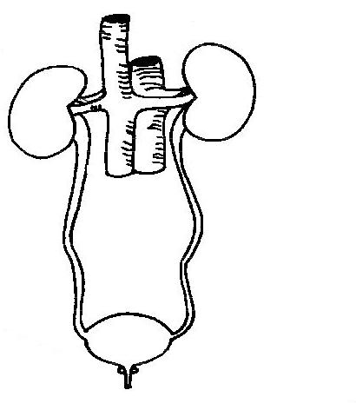
Information on the kidneys and bladder

Slide 4
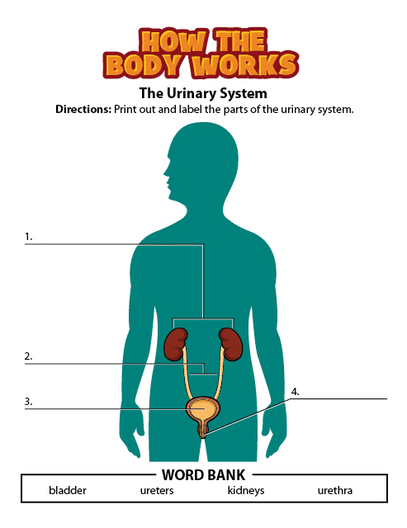
How the kidneys and bladder work
Kidneys
Ureters
Urethra
Bladder
Notes:
Can use a torso to help demonstrate.
The urinary tract is the body system of eliminating some of the body’s waste.
Kidneys – filter the waste products from the bloodstream and makes urine (wee).
Ureters – are tubes that carry urine from the kidneys to the bladder.
Bladder – stores urine until it is passed out of the body – it expands as it fills with urine. When the bladder is about half full a message is sent to the brain to go to the toilet.
Urethra – this tube allows urine to exit from the bladder.
Between the bladder and the urethra is the sphincter muscle. This muscle prevents urine from leaving the bladder until you go to the toilet - when you relax the muscle it allows the urine to flow out.
4

Slide 5
General information about the bladder
Between age 2 – 3 bladders mature and children can become dry
Urine is usually passed 6 – 8 times a day
Urine should be pale yellow in colour
How much the bladder holds depends on the age of the child
Over 80% of children are dry at night by the age of 7 years
Notes:
Most children should be introduced to toilet training from the age of 2 - 3. At this age the bladder and brain start to work together. For children with additional needs it may take a little longer for them to develop toileting independence.
Pass urine 3 – 4 hourly.
Urine is usually a pale yellow, although sometimes can be darker with the first wee of the day or when not had much to drink.
Amount Bladder holds (bladder capacity) – the amount it can hold is dependent on age (see following slides for how bladder works and capacity).
5

Slide 6

How the bladder works
Notes:
The bladder is a muscular sac – like a stretchy, crumpled bag with lots of creases. Its muscle walls relax to allow it to fill with urine. When the bladder is full a message is sent to the brain to signal it needs to empty.
When urine is passed the bladder is relaxed and contractions squeeze out the urine.
Drinking regularly through the day can help to increase how much the bladder can hold. Going to the toilet too frequently can reduce the efficiency of the bladder.
6

Slide 7

How much a bladder can hold
Age | Bladder Capacity
5 | 180mls
6 | 210mls
7 | 240mls
8 | 270mls
9 | 300mls
10 | 330mls
11 | 360mls
12 | 390mls
Once children reach puberty the bladder capacity is calculated by body weight
Notes:
Can use a container to show how much a bladder can hold.
Bladder capacity = age x 30 + 30
A Healthy Bladder:
Should not be aware of its presence until it is nearly full
It should give timely reminders of the need to empty, allowing plenty of time to access a toilet
It should not leak!
It should fully empty
7

Slide 8
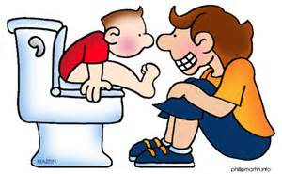
Daytime Wetting
Notes:
1 in 75 children above 5 years of age experience day time wetting (Paediatric Urology UK 2017)
Q: What’s missing from this picture??? (step – child is unable to place feet on floor)
8

Slide 9
Causes
Not drinking enough fluids regularly throughout the day
The types of fluids consumed
Water infections (UTI)
Constipation
Delay in emptying the bladder
Overactive/twitchy bladder
Small bladder size
Physical/learning/ sensory/medical needs
Notes:
Fluids – restricting fluids will make the symptoms worse as urine becomes more concentrated, which can irritate the bladder.
Everyone needs to drink between 6 – 8 glasses of water based drinks. Reduce caffeine drinks e.g., tea, coffee, cola, energy drinks and alcohol especially in the evening as these can increase the production of urine.
Fizzy (carbonated) and dark coloured drinks e.g., berries and cherries drinks can also irritate the bladder.
UTI – increases the feeling of needing to empty the bladder more
Constipation - a full or impacted bowel presses on the bladder causing the bladder to leak/empty.
Delay in emptying usually because the child is distracted by something else which then results in wetting.
Some children rush and do not always fully empty their bladder so a small amount of urine can leak.
Overactive Bladder - uncontrolled contraction of the bladder wall where the bladder contracts before it is full. Symptoms can include urinary frequency, urgency, and sometimes daytime wetting.
Small bladder capacity – can be caused by an overactive bladder or not drinking enough fluids
Physical/learning/sensory/medical needs – these children may take longer to become dry.
9

Slide 10
How you can help
your child…

Slide 11
Increase fluids gradually
Ensure your child drinks fluids at regular intervals throughout the day. Water being the best drink!
Avoid drinks that are dark in colour, fizzy or contain caffeine
Encourage your child to take a drink to school – talking to your child’s teacher may be helpful
Notes:
Increase fluids - need to drink between 6 – 8 glasses of water based drinks – diluted squash and fresh juices. They can have ice lollies, ice cubes in their drinks, soups and smoothies etc.
Spread drinks throughout the day, one at each meal, and one in between each meal: mid morning, mid afternoon and mid evening. This may have to be gradual if child is used to drinking very small amounts. Talk to school for support and use water bottles to aid with monitoring – mark these up into portions.
Use visual aids to demonstrate volumes
As a guide:
Children aged 5 – 7 require each drink to be 175mls
Children aged 7 – 11 require each drink to be 250mls
Children aged 11 and older require each drink to be 300mls minimum.
Reduce dark drinks - makes you urinate more.
11

Slide 12
Encourage your child to go to the toilet at regular intervals throughout the day. Using a reminder may be helpful
Encourage your child to empty their bladder fully
See your GP to rule out any medical causes of wetting
Avoid constipation
Notes:
Opportunity and access to the toilet - on an ‘as needed’ basis, not ‘when convenient’ whenever possible
-Relax on the toilet avoid tensing as this will stop the bladder emptying fully – deep breathing may be useful
-Allow sufficient time to empty the bladder completely and not to be rushed
-Aim for your child to use the toilet every 3-4 hours
-Use a reminder e.g. alarm clock/alarm on phone or watch/IPad; visual timetable/signs and symbols
-Counting can prompt emptying the bladder fully – count up to 20 (can count 1 elephant, 2 elephant, 3 elephant etc.) or sing a song.
See GP – e.g., UTI, bladder instability and constipation
Avoid constipation – balanced diet that includes fruit, vegetables and fibre based cereals

Slide 13
Use of praise and rewards
Put your child in easily removable clothing
Stay calm and relaxed
Give your child the opportunity to use the toilet when needed
Notes:
Praise and Rewards – to aid motivation. Praise and reward any successes or small step progress
Easily removable clothing – avoid belts, buckles and dungarees
Opportunity to use the toilet – parent/carer may need to speak to class teacher

Slide 14
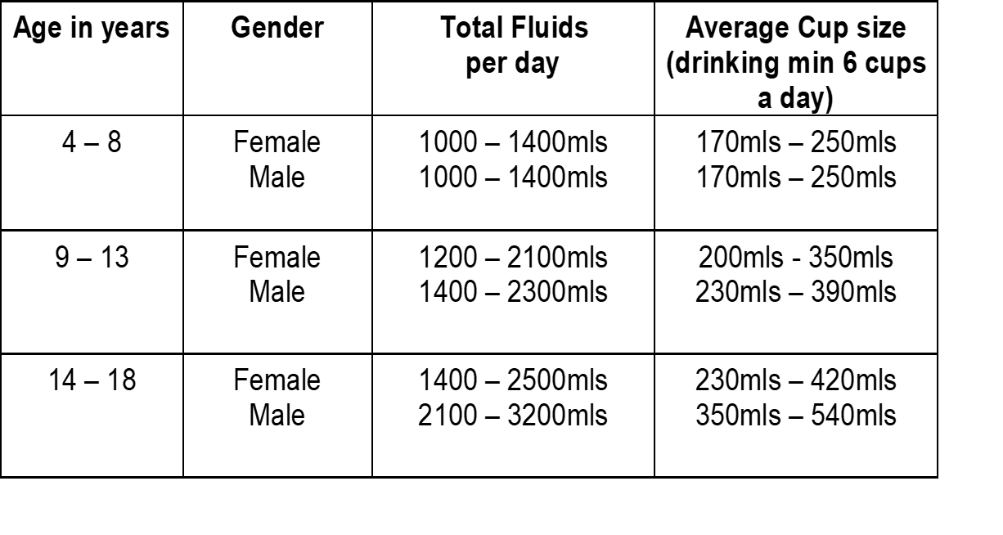
Recommended
Fluid Intake

Slide 15
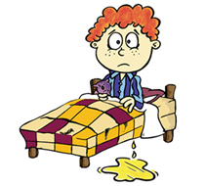
Night-time Wetting
Notes:
1 in 10 five to six year olds wet the bed - this decreases with age (NHS UK)
Known as nocturnal enuresis
15

Slide 16
What can cause night-time wetting
Not drinking the right amount and type of fluids
Rousability – not waking to the signal of needing to empty the bladder
Lack of vasopressin
Constipation
Overactive bladder – twitchy bladder
Hereditary
Notes:
The reason for night-time wetting is not fully understood. It is not due to laziness. There may be more than one cause for bed wetting.
Fluids – cutting back on fluids will make symptoms worse as urine becomes more concentrated, which irritates the bladder. Can limit bladder capacity – so bladder is unable to hold larger amounts of urine overnight. Restricting fluids in the evenings can also cause the urine to become more concentrated and irritate the bladder. Children should be able to drink up until they go to bed.
Rousability – is the inability of the brain to recognise and react to the signals from the bladder when it needs to empty during sleep.
Lack of vasopressin – The body produces a hormone at night called vasopressin – this slows urine production overnight. Some children may not produce enough of this hormone.
Hereditary – Likelihood there is a family history of bedwetting.
16

Slide 17
How you can help
your child with night-time wetting…

Slide 18

Treat day time wetting and constipation first if indicated
Ensure your child drinks fluids at regular intervals throughout the day
Your child should avoid drinks that are dark in colour, fizzy or contain caffeine
Double Voiding - encourage your
child to use the toilet twice before
settling to sleep
Notes:
Treat day wetting & constipation – as this will impact on night-time wetting.
Double voiding - Encourages bladder to fully empty before bed. Needs to become part of bedtime routine.
18

Slide 19
Be mindful of access to the toilet
Do you need a night light?
Do not lift your child
Encourage your child to help with changing wet bedding and clothing
Give praise
Notes:
Easy access to toilet & night light – imagine house from your child’s point of view. Can be afraid to get up because too dark/cold/noisy etc. Avoid scary books/films prior to bed time. Your toilet may not be on the same floor as the bedrooms!
Do not lift – lifting encourages child to continue to wee in their sleep as they are not fully awake when lifted.
Changing bedding & clothing – this will give the child some ownership for their bed wetting and won’t be seen to be only the parent/carers responsibility
Praise – Remember the child is not wanting to wet the bed, so parents need to stay calm and avoid chastisement! Should not use systems that penalise or remove previously gained rewards. Praise for increasing fluid intake, double voiding, help with changing the bed and clothing and small step progress.

Slide 20

Constipation
Notes:
20

Slide 21
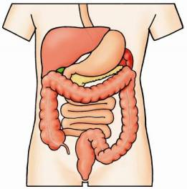
How the bowel works
Stomach
Large Intestine
Small Intestine
Rectum
Notes:
Food enters the stomach, churns the food, adds gastric juices to make a liquid.
This enters the small intestine where nutrients are absorbed.
The large intestine transports the waste products (poo) to the rectum where a soft formed stool is passed via the anus.

Slide 22
Constipation
Signs and symptoms of constipation are often difficult to recognise.
Signs could include:
- small or large hard stools
- opening bowels less than three times a
week
- stomach pains
- pain/straining when opening the bowels
Notes:
One episode of pain can cause a child to become afraid of going to toilet.
This avoidance can lead to a build up in bowel and then becomes even harder to pass.
Children are regularly admitted to hospital due to constipation.

Slide 23
- overflow soiling
- excessive wind
- general lethargy
- poor appetite
- disturbed sleep
- changes in behaviour
- night-time soiling

Slide 24


Bristol Stool Chart
Which one is the ideal poo?
Notes:
Type 1 - has spent the longest time in the bowel. They are hard to pass and often requires a lot of straining.
Type 7 – has spent the least time in the bowel. Has the need to pass urgently and accidents may happen.
Ideal poo is 4.

Slide 25
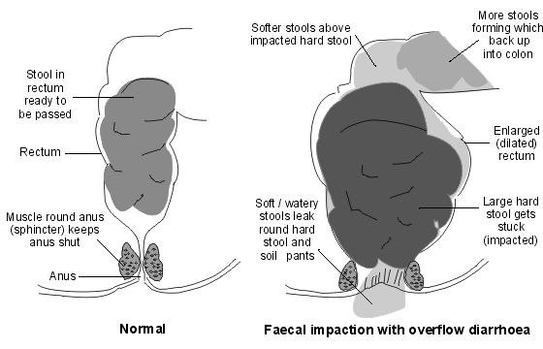
What happens when your child is constipated
Notes:
Cause of constipation – poor diet; poor fluid intake; lack of exercise; avoidance in passing stool (poo); medical condition; can be unknown.
Constipation can become a problem over many months and years. It can take a long time resolve.
An impacted bowel works less efficiently as the nerve endings are damaged and the signals to the brain can be disrupted. Children will often have no sensation that they need to do a poo until it is too late and has soiled. It is not their fault!!

Slide 26
How you can help
your child with constipation…

Slide 27
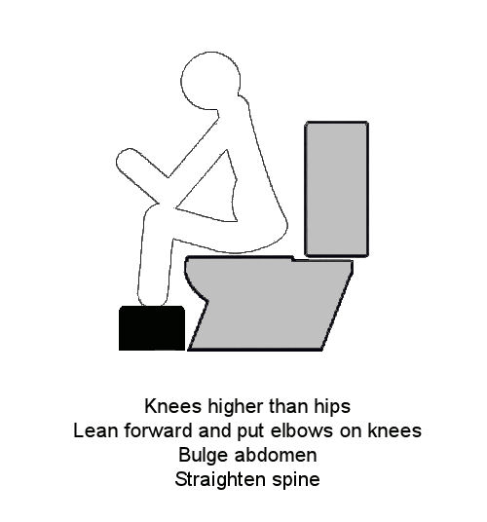
Encourage regular exercise
Offer a healthy diet
Encourage fluids
Establish a toileting routine
Ensure toilet area is comfortable
Be mindful of your child’s position
on the toilet – do they need a foot stool
and/or an insert seat?
Remember praise and rewards
Notes:
Exercise – helps with movement of bowel
Diet – Healthy diet with 5 portions of fruit and vegetables; higher fibre type foods. Avoid too many bananas and excessive amounts of milk.
Fluids – 6-8 glasses. For those reluctant to drink, fluids can be made up of jelly, ice lollies, sauces, custards, smoothies etc.
Toilet routine – encourage your child to sit on the toilet 20 – 30 minutes after meals and praise for trying
Toilet Comfort – it needs to be an environment that encourages the child to sit and stay. Can offer books, puzzle books.
Position on toilet – see chart above. Use balloons/bubbles, deep breathing and rocking to and fro.
If avoiding / in nappies – will need step by step progress (never force onto toilet); always put nappy on/sit on potty in toilet area and stay whilst having poo (this is place to go); Involve child in stool being emptied in toilet and flushed; Child to flush toilet; Gradual progress to child sitting on toilet e.g. with nappy on/ sitting on toilet with hole in nappy/ Nappy removed. Teach to clean themselves & wash hands – make fun with wipes and smelly soap.
Give lots of praise for compliance. Can use reward system e.g. silver star for sitting on toilet, gold star for doing a poo with an agreed number of gold stars earned to result in a SMALL treat.
Medication – should be given to clear bowel. It is important medication is given regularly and continued even after bulk of poo has gone. This is to help keep poo soft and easy to pass. Follow doctors instructions and stop only on advice of doctor.
All this to continue even during holidays. May take some time so be patient.

Slide 28
Macrogols
Macrogols are prescribed by GPs to break up hard lumps of poo and make them softer and easier to pass.
Each sachet is mixed with 62.5mls water and should be stirred until the water is clear
If adding flavour, ensure this is added AFTER the sachet has been mixed with water and turned clear
Notes:
Just one painful experience of pooing can make a child strain to stop poo coming out. This actually makes the issue worse
The physical and psychological issues associated with constipation can last for years
Poo can be hard and painful to pass. Macrogols break down the poo and ensure poo is soft so that it is easier to pass
If the sachet is not mixed with water before adding flavour, it will not work properly

Slide 29
Macrogols should be used within 24 hours of mixing with water
They can be taken at any time of day
If splitting doses, the full amount should be given within a 12 hour period
A stimulant laxative is also needed by a small number of children. Talk to your GP if you think this applies to your child
Notes:
Macrogols are a type of osmotic laxative such as laxido, Movicol and Cosmocol
Stimulant laxatives such as sodium picosulphate or senna help the muscles of the wall work better to move poo

Slide 30
Chronic Constipation
Where a child regularly becomes constipated, they can take a maintenance dose to prevent this occurring
Child’s Age | Recommended daily dose | Paediatric or Adult
1-6 years | 1-4 sachets | Paediatric
6-12 years | 2-4 sachets | Paediatric
12-18 years | 1-2 sachets | Adult
Notes:
A maintenance dose is what we use to describe the long term use of macrogols to prevent constipation occurring
Speak to your GP about a recommended maintenance dose
It’s important to not change doses more than every 3-4 days to give the macrogols time to work
You should, with tweaking of the doses, find one that allows your child to have a type 4 or 5 poo every 24 hours easily
If your child passes type 1-2 poos, you may need to increase the maintenance dose for 3-4 days. Seek medical advice
A maintenance dose may be needed for 3-6 months
School will be able to support administering macragols if needed to be taken during school hours as they are a prescribed medication

Slide 31
Faecal
Impaction
If your child has faecal impaction, they may need high doses of macrogols to clear out their bowel. We call this disimpaction
Age | Day 1 | Day 2 | Day 3 | Day 4 | Day 5 | Day 6 | Day 7
1-5 years | 2 | 4 | 4 | 6 | 6 | 8 | 8
5-12 years | 4 | 6 | 8 | 10 | 10 | 12 | 12
12-18 years (adult) | 4 | 6 | 8 | 8 | 8 | 8 | 8
Notes:
If a child is so impacted with poo, they will need help to clear it all out to stop soiling accidents occurring
Always seek medical advice before beginning a disimpaction regime
You will know your child is no longer disimpacted when they start to pass poos with no lumps
Type 4-5 poos should be passed 1-3 times most days after disimpaction, but it may take 3-4 days to achieve this
You may find it easier to keep you child off school during some/all of the disimpaction regime as they will pass motions frequently. They may need cleaning as this becomes looser and more fluid like
If after 2 weeks disimpaction has not cleared the issue a stimulant laxative may be required – see your GP
Do not continue a disimpaction regime for more than 2 weeks without a medical professionals advice
Your medical practitioner will advise how to reduce from the disimpaction regime back to a maintenance dose
It will be necessary to go to a maintenance dose after disimpaction – don’t just stop taking macrogols

Slide 32
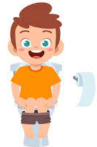

Do not stop taking macrogols until your GP tells you to. This could be a few weeks or months down the line
Notes:
Speak to your GP about stopping macrogols and/or stimulant laxative. Stopping too early may make the issue return
Reduction of macrogols should happen very slowly
Keep a note of how often they are pooing and the type of poo – you may need to give additional laxatives
Children should ideally poo every day
If they need extra laxatives more than once a week, increase their dosage for 4-6 weeks before reducing again
Ensure children regularly drink the recommended fluid intake for their age to give the bowel the best chance

Slide 33
Lets talk about nappies/continence products
These can give your child permission to use them rather than the toilet
Children may not feel wet or soiled when wearing them
Nappies/products are not recommended for the management of night-time wetting, constipation and soiling
Notes:
As recommended by NICE Guidance
If you have an issue or a concern regarding your child’s toileting please speak to a member of Healthy Together.

Slide 34
Next steps…
Now it’s time to put the information from today into practice.

Slide 35
If after 4 weeks your child still requires support please contact your local Healthy Together (School Nursing) Team to arrange further support or a clinic appointment
If after 6 weeks we have had no contact from you it will be assumed your child’s continence needs have resolved

Slide 36
If further support is needed from Healthy Together, you will be required to complete continence charting prior to any continence clinic assessment.
Examples of charting…

Slide 37



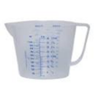


Chart for your drinks and wees
(Please complete for 4 days)
Day 1 Date: |  |  |  | Day 2 Date:
Time | Size of drink in mls | Time | Size of wee in mls | Time | Size of drink in mls | Time | Size of wee in mls
 |  | 7am | 200ml
7:30am | 200ml Orange juice | 8am | 100ml
10am | 200ml Water | 10:30am | 170ml
12pm | 200ml Orange squash | 12:30pm | 190ml
2pm | 100ml Water
3:30pm | 150ml Milk | 3:40pm | 170ml
5pm | 200ml Fruit shoot | 5:30pm | 100ml
7pm | 100ml water | 7:30pm | 150ml

Slide 38




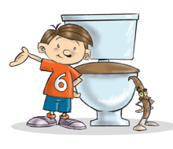

Baseline Assessment Chart for Nocturnal Enuresis
(To be completed for 2 weeks)
Date | What was the last drink of the day in mls & what time? | What time did you go to bed? | What time did you go & check to see if they were wet? | When you checked were they Wet Dry | Did your child have a dry bed in the morning Yes No | If wet, what was the size of the wet patch Small Medium Large | Has your child had their bowels open during the day? Please describe using the Bristol Stool Chart
1/1/22 | 7pm 100ml water | 7:30pm | 10pm | Wet | Yes | - | 3
2/1/22 | 7:15pm 100ml Water | 7:45pm | 10:15pm | Dry | No | Medium | 4
3/1/22 | 7:05pm 100ml Water | 7:30pm | 10pm | Wet | No | Small | 4
4/1/22 | 7:20pm 150ml Orange squash | 7:50pm | 10:45pm | Wet | No | Small | 3

Slide 39

Bowel Record Chart
This chart is designed to give a good idea of your child’s bowel habits. Please fill in the chart every day
(referring to the Bristol Stool Chart
Date | Time | Type of stool (use number from the Bristol Stool Chart) | Quantity of stool Large Medium Small None | Pain and distress when passing stool Yes Some No | Where was the stool passed? Toilet Nappy Other | Pants soiled?
 |  |  |  |  |  | Yes/No | Type of soiling Stained Loose Solid
1/1/22 | 10am | 3 | L | No | Toilet | No
2/1/22 | 10:30am | 4 | M | No | Toilet | No
2/1/22 | 5pm | 3 | S | Some | Pants | Yes | Solid

Slide 40
Further Sources of Information
www.eric.org.uk
www.bbuk.org.uk
www.healthforunder5s.co.uk
www.healthforkids.co.uk
www.healthforteens.co.uk
NICE Guidance
- CG111 (Enuresis)
- CG99 (Constipation)
Text Parent/Carer ChatHealth: 07520 615382 (County 0-11)
Contact your local Healthy Together Team or your child’s GP
Notes:
Inform how parent/carer can access their School Nurse

Slide 41
Name of Originator/Author: | Alison Barlow
Updated by: | Johanna Broad Stephanie Cave Craig Stephen
Date Reviewed: | February 2024

