Slide 1



Year 4
Parents Meeting
Analysers – Miss Kirby
Innovators – Miss Dholakia

Slide 2

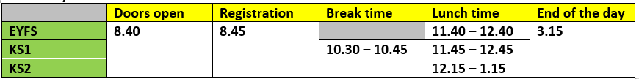
Our School Day
Gates open 8:30, Doors open at 8:40, Registration at 8:45
Break time is 10:30-10:45
If parents/carers are late collecting their child, the teacher will take children to the office at 3.25pm
At break, children are only to have fruit or water.
Please ensure your child has a water bottle every day.

Slide 3
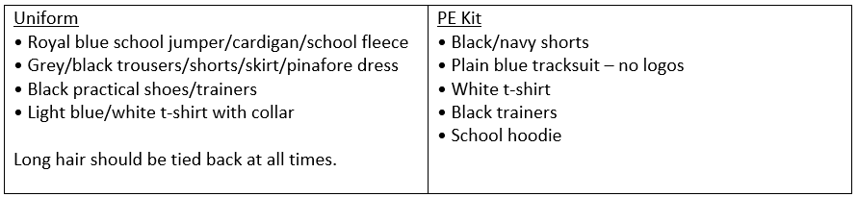
Uniform and PE Kit
Our PE days – Tuesday (outdoor) & Wednesday (indoor)
No jewellery is allowed to be worn during PE lesson.
Ideally, please leave jewellery at home on PE days.

Slide 4
Autumn Overview
Autumn 1 | Autumn 2
Writing: Rumaysa Maths: Place Value, Addition & Subtraction Science: Electricity Computing: Search engines & Online safety PSHE: Families & Friendships / Safer relationships PE: Indoor – Dance / Outdoor – Invasion games RE: Hinduism French: Presenting Myself | Writing: The Tin Forest & The Lost Thing Maths: Multiplication & Division, Fractions Science: Living things & their habitats Computing: Coding PSHE: Safer relationships / Respecting ourselves and others PE: Indoor – Hockey / Outdoor – Basketball RE: Christianity D&T: Adapting a recipe (Baking)
Enquiry (History & Geography) How do past decisions shape the future?

Slide 5
Parents Evenings
  Report cards, summarising progress and effort are sent home towards the end of the autumn term, along with an end of year report in the summer.
  Face-to-face meetings with parents are arranged in the first half of the Autumn and Spring terms.

Slide 6
Homework
  All children will be given a sheet of maths homework and a sheet of English homework.
  Homework will be given out on a Friday. It is expected that this is returned by the following Wednesday.
  Additionally, children in year 4 should be practicing TTRS 20 minutes a week

Slide 7


Slide 8

Lesson Design

Slide 9
Writing - ‘Pen to Paper’ Curriculum
  Foster enjoyment of writing
  Create competent, confident writers
  Provide breadth of experience – writing for different audiences and purposes
  Broaden vocabulary
  Ensure a good understanding of grammar, spelling and punctuation
  “We want them to write clearly, coherently and creatively and to enjoy writing expressively, imaginatively and informatively.”
  – Jez Smith (2022) (in ‘Primary Huh’ - Mary Myatt & John Tomsett, 2022)

Slide 10
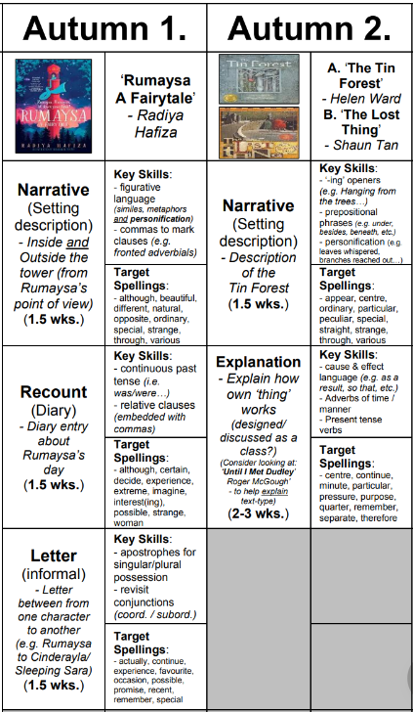


Slide 11
Reading
  Our reading lessons focus on…
  Exploring quality texts
  Time for discussion
  Questioning
  Working on reading skills
  Completing a range of activities

Slide 12
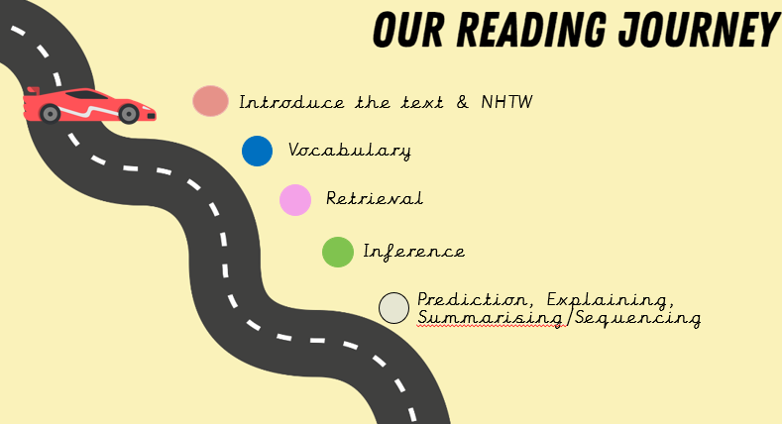

Slide 13
Maths
​ | Autumn 1​ | Autumn 2​ | Spring 1​ | Spring 2​ | Summer 1​ | Summer 2​
Year 4​ | Number and Place Value ​ ​ Addition and Subtraction ​ | Area​ ​ Multiplication and Division ​ ​ ​ ​ ​ ​ | Perimeter ​ ​ Fractions ​ | Decimals ​ ​ ​ | Multiplication – Ready for MTC​ ​ Money ​ ​ Time​ ​ | Angles and 2D Shape​ ​ Statistics ​ ​ Position and Direction ​
  The key aims of Power Maths: Keeping the whole class progressing together and providing rich problem solving to challenge every child.
  It is built on a growth mindset and problem-solving approach.

Slide 14
MTC Checks
  Your child should have their log-in for their TTRS account. These were given out at the start of term and should be memorised pupils.
  Please encourage your child to access the practice games regularly, we will include lots of inter-class and inter-year group battles!

Slide 15
Calendar Dates
  Residential Meeting – 23rd September
  Hindu Temple – 8th October
  Diwali assembly – 13th November (9:00 & 2:45)
  Year 4 residential – April 2027
  MTC Check – Summer 2027

Slide 16
THANK YOU
Any questions?

