Slide 1
Welcome
to Year 3
Communicators: Mrs Setchfield
Achievers: Miss Marsh

Slide 2
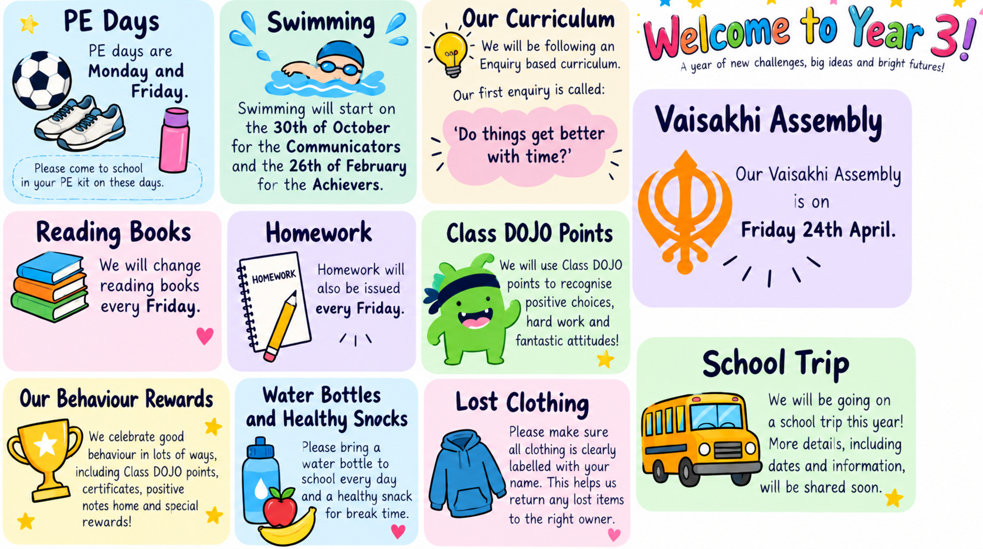

Slide 3

Reading
Reading for pleasure
Range of reading – fiction, non-fiction, poetry, picture books…
At least 10 minutes every day
No reading records
Reading books to be in school everyday

Slide 4
Reading scrapbook
Given out on a Friday and due back in the following Friday.
Feel free to draw or write lots about your favourite book ☺

Slide 5

TTRS
Play regularly to support the learning of the 3, 4 and 8 x table!
Collect your child’s log in if you don’t have it ☺

Slide 6

Enquiry

Slide 7
Homework
Homework is given out each Friday.
One Maths sheet and a reading/grammar sheet.
Handed in the following Friday

Slide 8
Swimming
We go on Friday mornings to Braunstone Leisure centre.
We leave at 9:00am on a bus and sign in.
We get changed on one side of the changing room and our swimming teachers will teach us in groups.
Please talk to your child about getting dressed etc
The pool can be cold!

Slide 9
Any questions?

