Slide 1






Solvers parent meeting

Slide 2
Speech and language support
Regular speech and language support according to EHCP​ ​
Robyn in every Thursday​
Additional sessions by Mrs Chalmers
​
Communication and social skills built into the timetable each day.
Every lesson taught has a focus on spoken language​ and opportunities to develop language.

Slide 3
Communication
Time built into the curriculum to develop social skills and how to communicate effectively with others.
Turn taking games, question cards, would you rather cards, inference cards and memory games to support working memory

Slide 4
Our curriculum
Writing - colourful semantics, high interest texts, large focus on sentence structure. Small group work to support.
Spelling - ELS- suffixes and spelling rules and how to apply them. Individual spellings with practice 3 times a week and test on a Friday afternoon.
Handwriting - three times a week to support letter formation, hand strength and motor skills.

Slide 5
Our curriculum
Maths - following year 3 power maths with scaffolds and additional rehearsal lessons with concrete resources, reasoning problems built into every lesson to deepen understanding and provide challenge.

Slide 6
Our curriculum
Reading - Taught everyday focusing on reading comprehension skills and understanding a text (Vocabulary, retrieval, inference, sequencing, summarising)
Time for reading for pleasure and 1:1 reading with adults 3 times a week.

Slide 7
Enquiry
New way of teaching foundation subjects where we are focused on a question.
It allows children to understand how different topics link together in the real world. More hands on learning to support memory.
How do past decisions shape the future? - History focus (Romans) with Geography elements

Slide 8
EHCP targets
Worked on with an adult 3 times per week, per pupil.​
Regularly adapted and updated throughout the year​
Focused tracking completed to ensure they can be met prior to annual reviews.​
Targets built into reading, writing and maths lessons to provide additional practice and fluency.

Slide 9
Annual reviews
Y6: September/October
Y5: January
Y4: April
Invites will be sent out in good time prior to the date
Paperwork will be sent home two weeks before the date
Planned for a Wednesday afternoon at 1.30pm, if you have a request, please let me know in plenty of time.

Slide 10
Year 6 SATs
Individual conversations about the year 6 SATs will take place within annual reviews.
Low pressure, try your best attitude, exposing them early to reduce the fear of the unknown. Additional allowances to reduce stress and pressure e.g. extra time, smaller groups, increased adults in room.

Slide 11
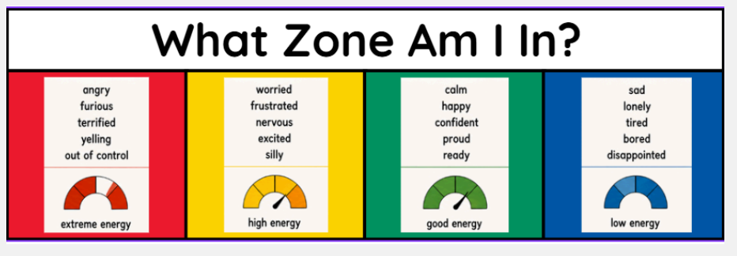
Zones of regulation

Slide 12


Slide 13
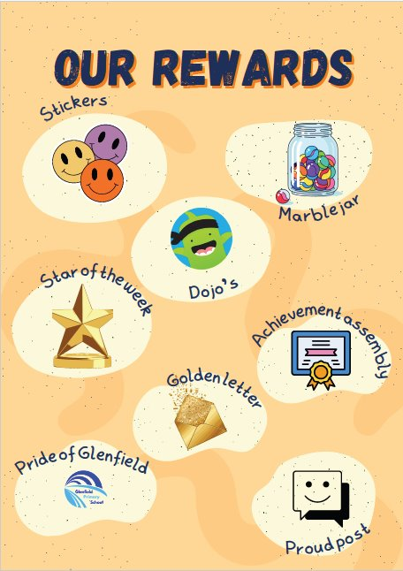

Slide 14
Any questions?

