Slide 1
Thinkers 2026/2027
Classroom Adults:
Mr Squires
AM – Miss Hill and Miss Gohel
PM – Miss Russell and Miss Kulik

Slide 2

Individual Speech and Language Support
Regular speech and language support according to EHCP
Zoe in every Tuesday
Robyn in every Thursday
Support followed up by Miss Hill
My Communication lessons built into timetable, twice a day
Every lesson taught has a focus on spoken language

Slide 3

Curriculum
Changes to the way that the curriculum is being delivered across the school and in the Provision.
Core subjects: phonics (5), writing (4), maths (5), guided reading (3), handwriting/fine motor development(5)
Equals curriculum: World about Me, My Communication, My Creativity, My Independence, My Physical Wellbeing, My Sensory Play.
Enquiry curriculum.
Continuous Provision activities.
Small group teaching based on target setting from what each child needs to learn.

Slide 4

Reading
Whole school focus to improve reading this year
Belief as a school that every child can learn to read well
Reading with an adult 1:1 at least three times a week per pupil
Important to continue reading at home
Questioning

Slide 5

Writing
Skills developed through independent grammar lessons.
Analyse model text → identify features of good writing → grammar lessons → plan their own writing → draft their writing → edit → publish
Independent writing opportunities within a two week cycle and built into continuous provision
Individualised support from adults where needed
2x handwriting lessons a week
Spelling practice built into every phonics lesson

Slide 6

Maths
Daily maths lessons
Opportunities to work independently and with small groups on activities following the lesson
Use of manipulatives
Maths activities practice built into continuous provision

Slide 7
EHCP Targets and SEND support plans
Worked on with an adult 3 times per week, per pupil.
Regularly adapted and updated throughout the year
Focused tracking completed to ensure they can be met prior to annual reviews.

Slide 8
Annual Reviews
EYFS and Y2: September/November
Y5: January
Y1, 2, 3, 4: May/June
Invites will be sent out in good time prior to the date
Paperwork will be sent home two weeks before the date
Planned for a Wednesday afternoon at 1.30pm, if you have a request, please let me know in plenty of time.

Slide 9
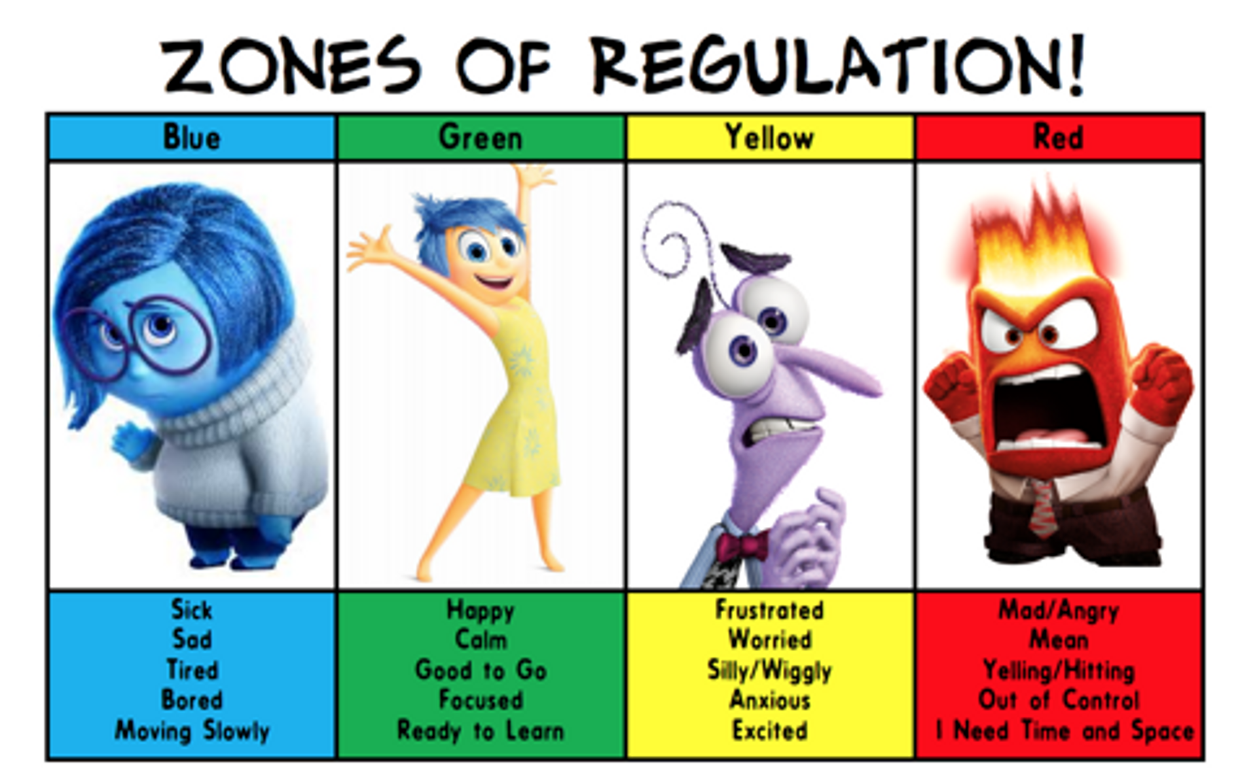
Zones of Regulation

Slide 10


Slide 11


Slide 12


Slide 13

Communication
splprovision@glenfield.leics.sch.uk
Class dojo
Phone

Slide 14
Any questions???

