Slide 1
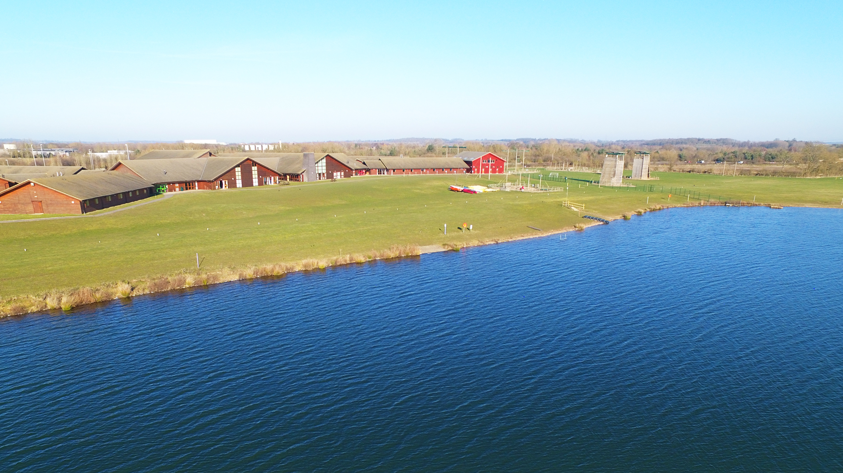

Year 4
Monday 19th - Wednesday 21st April
Residential Trip
Whitemoor Lakes
Youtube Videos:
Whitemoor Lakes Residential Trips
Activities at Whitemoor Lakes
This PowerPoint will be sent out to parents after the meeting, so no need to write anything down!

Slide 2
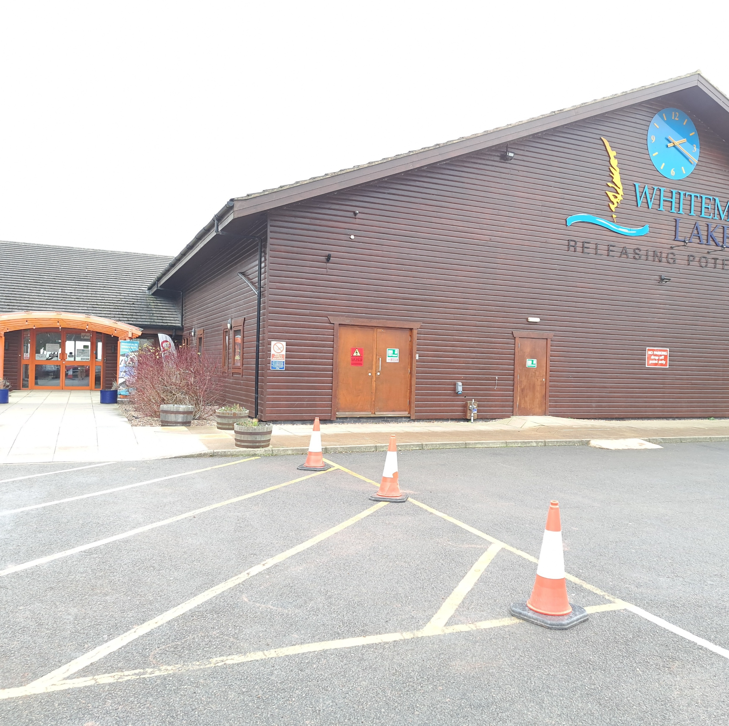
Departure Day to Whitemoor Lakes
Monday 19th April
Arrive onsite at approximately 11:30am, leave school at around 10am. Suitcases should be left near yellow wall outside the school office entrance.
You can return to the school to wave your child off for 10am.
Medication will need to be handed in to the adult in charge of the trip with completed medical consent form and details of when and how much should be administered.
On arrival to Whitemoor, schools will be greeted by some of the activity instructors who will:
Help us off the coach and take us to our lodge.
Staff will then have a liaison talk whilst instructors take pupils and staff on a Site Tour, to help you familiarise yourself with the centre.
Shown to bedrooms, where pupils can unpack and make their own bed (bedding is provided by Whitemoor Lakes).
Packed lunch for Monday lunch – please provide in throw away containers, with a refillable water bottle.
First activity will begin at 2:00pm

Slide 3
Return Day from Whitemoor Lakes
Wednesday 21st April
Leave the site between 12.30 and 1pm, we will be back before the school day finishes.
Lunch provided before we leave.
Pupils will be expected to pack their own suitcases, so please make sure they know what they brought!
All dorms will be checked for any spare clothes and brought back to the school, so if anything is lost it can be collected from the Thursday.
Messages will be sent from the office to inform you of our journey back and any unforeseen changes that may happen.

Slide 4
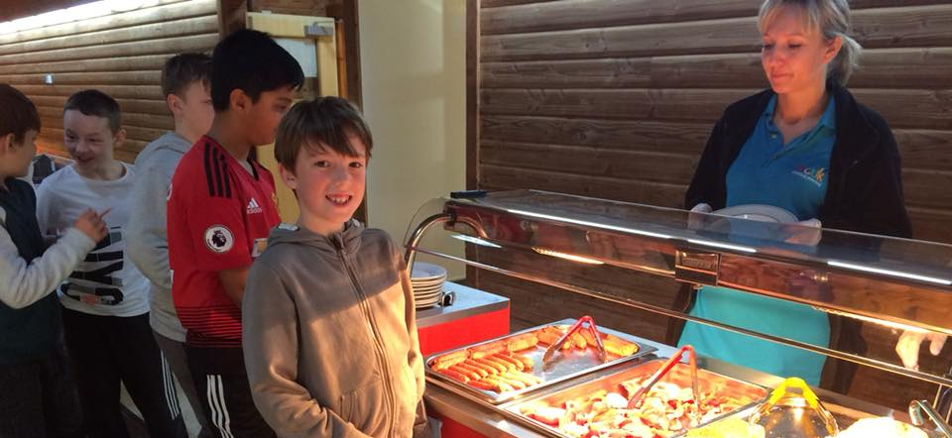
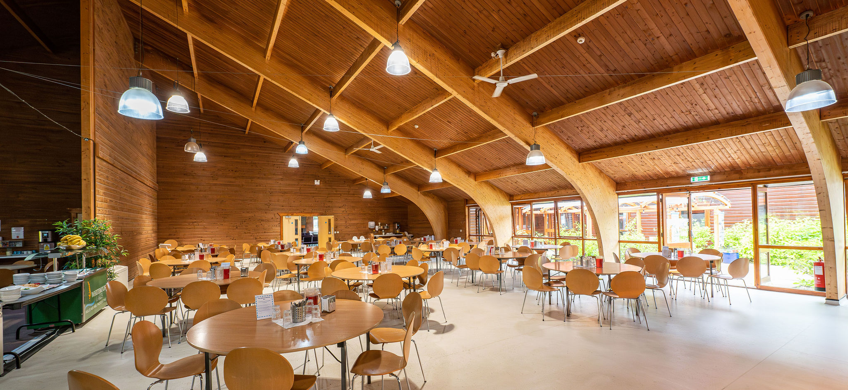
The Dining Room
Each school will have their own allocated tables and a serving point.
Any dietary requirements / allergies will be catered for if pre-arranged.
Children with dietary requirements / allergies will be given their own meal ticket to present in the dining room to make sure we get them the correct meal.
Hot and cold breakfast, hot lunch and hot dinner all included, 2 courses.

Slide 5
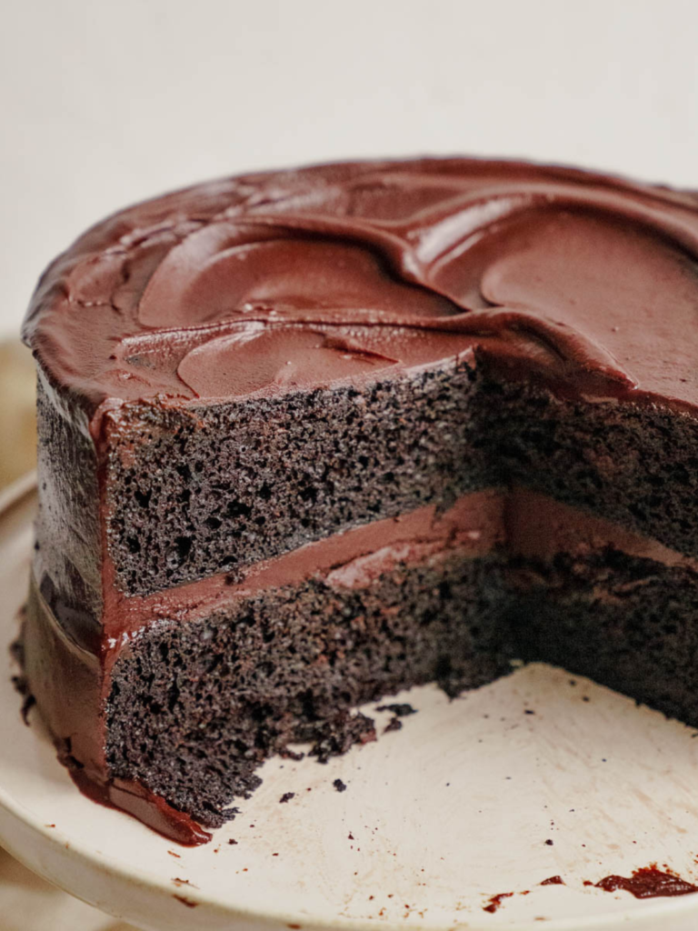
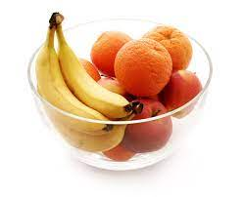

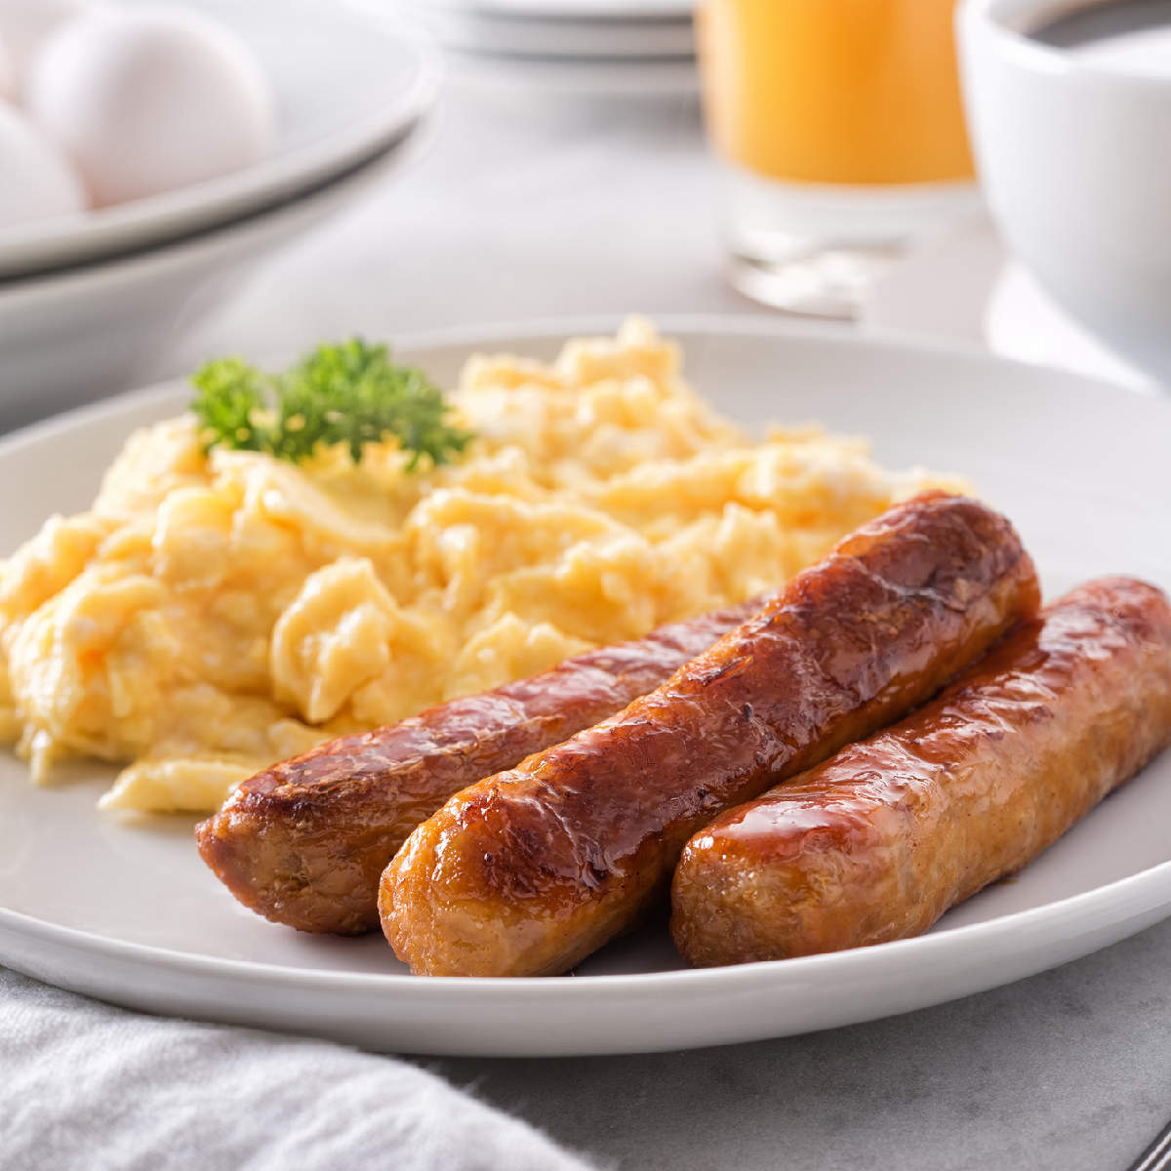
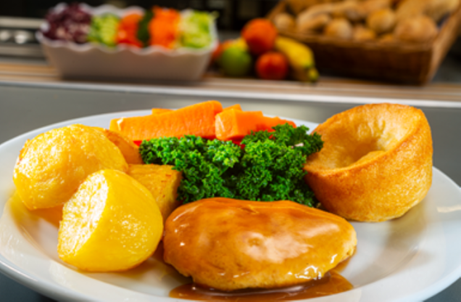
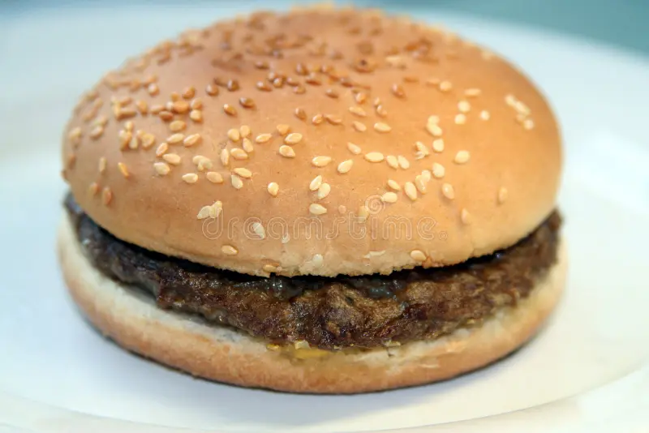
Sample Menu
Departure Day
Breakfast:
Bacon, Sausage, Spaghetti Hoops, Hash browns, Toast
Cereals, Yoghurts and Fresh Fruit
Lunch:
Chicken Nuggets, Chips and Peas
Salad Bar and Sandwich Station also available.
Pudding: Chocolate Cookies
Arrival Day
Lunch:
Own Packed Lunch
Dinner:
Roast Chicken, Roast Potatoes, Carrots, Broccoli, Stuffing Ball and Gravy
Pudding: Chocolate Fudge Cake
(Fresh Fruit available)
Day 2
Breakfast:
Bacon, Sausage, Baked Beans, Waffles, Toast
Cereals, Yoghurts, and Fresh Fruit.
Lunch:
Beef Burger, in a bun, with Potato Wedges and Onion Rings.
Salad Bar and Sandwich Station also available.
Pudding: Homemade Honey Cake
Dinner:
Meatballs, Pasta, Tomato Pasta Sauce and Garlic Bread
Pudding: Strawberry Mousse
(fresh fruit available)

Slide 6
The Activities
(An example)

Slide 7
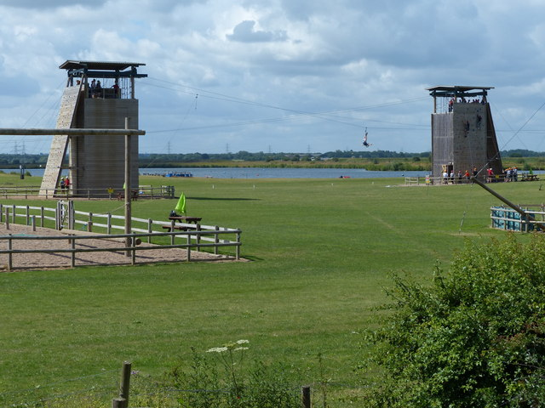
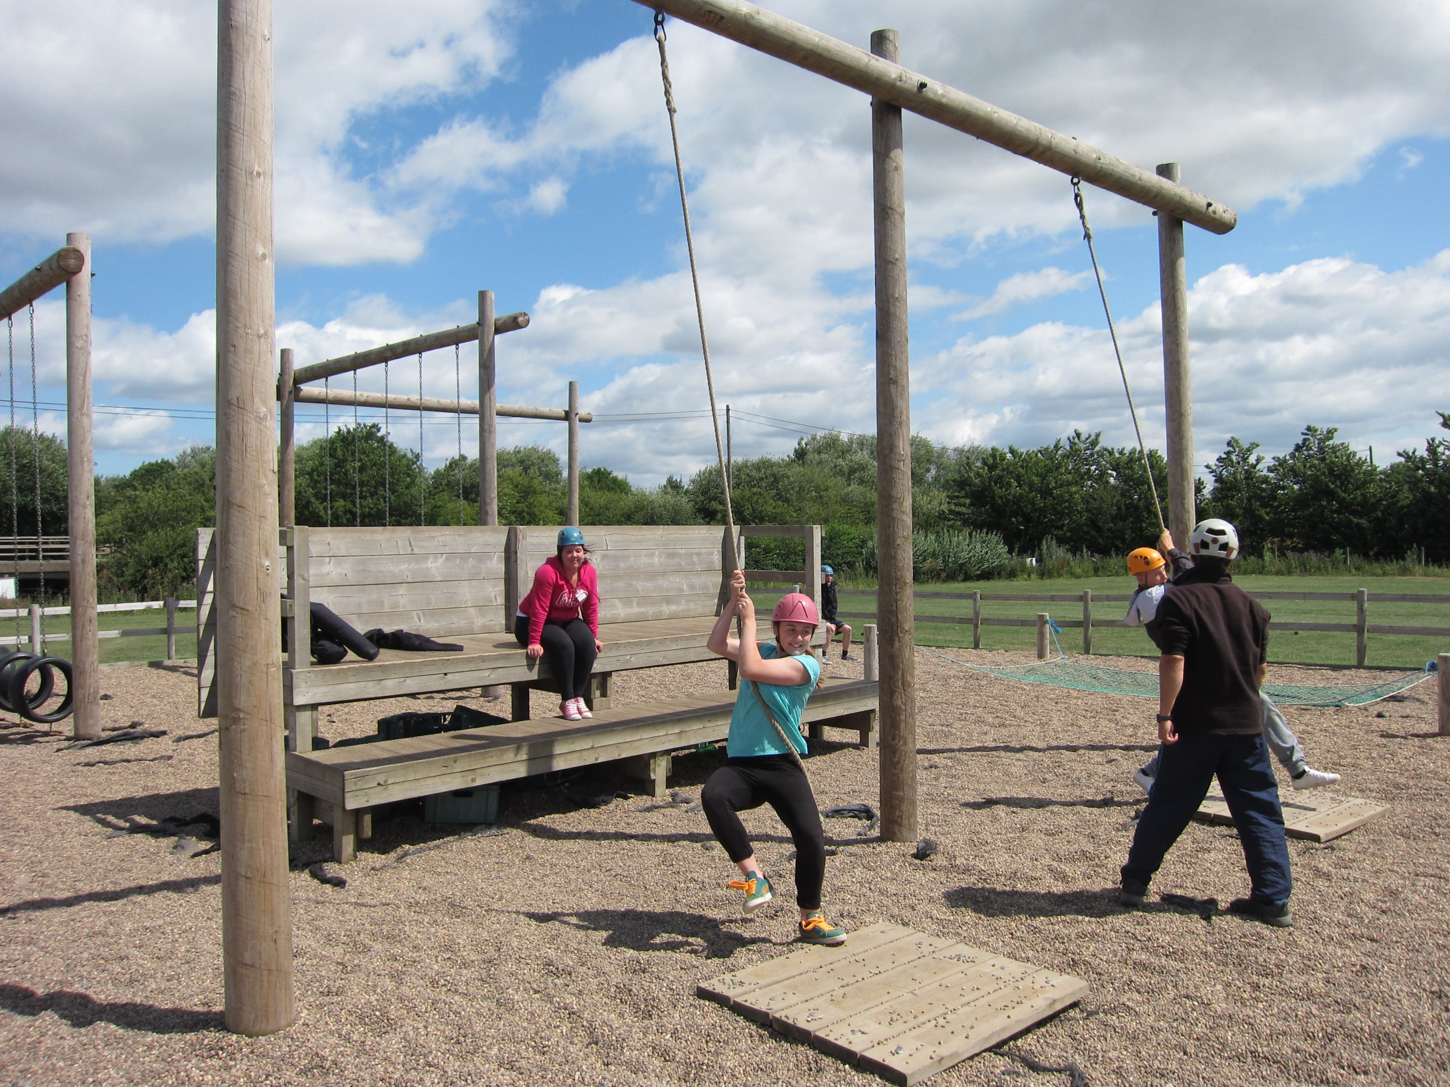
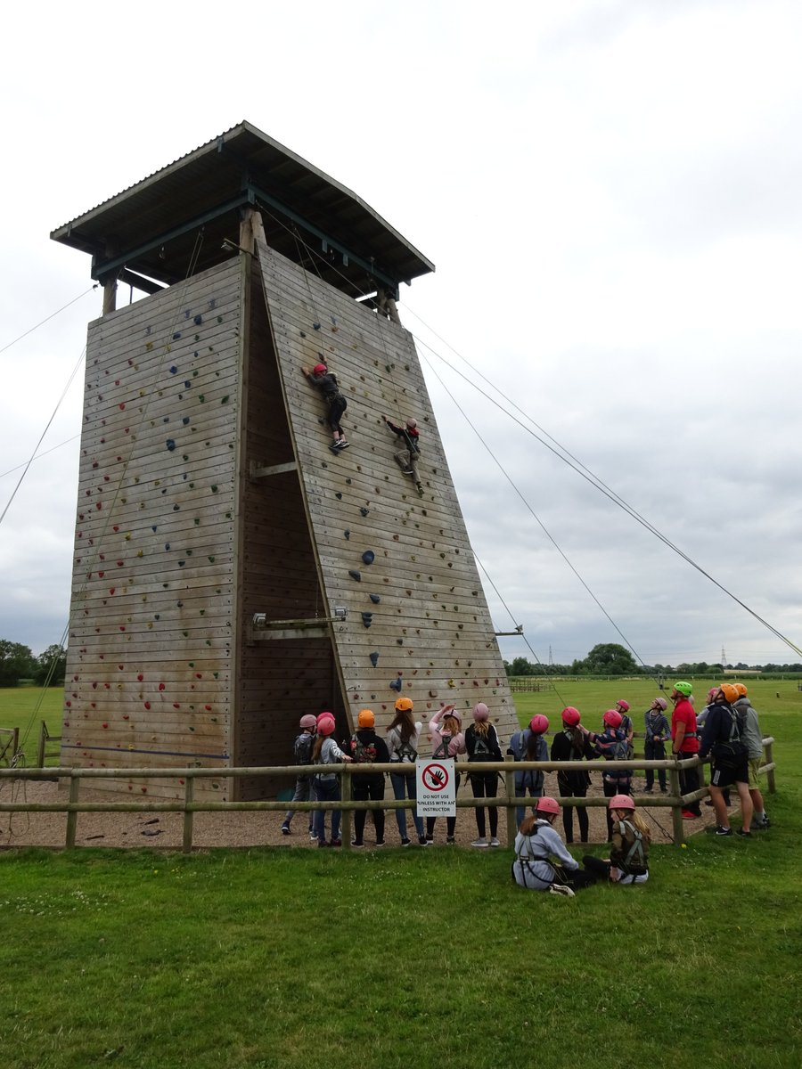
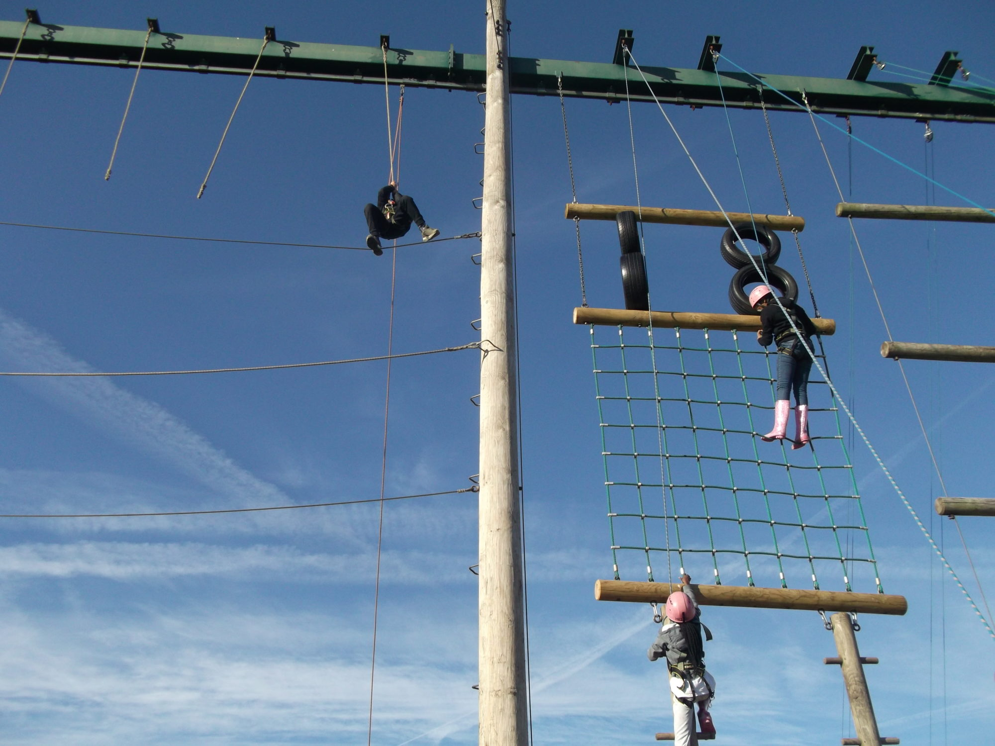
The Activities
Zip Wire
Challenge Course
Climbing
High Ropes

Slide 8
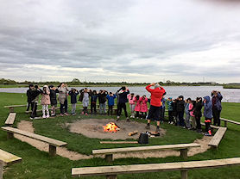
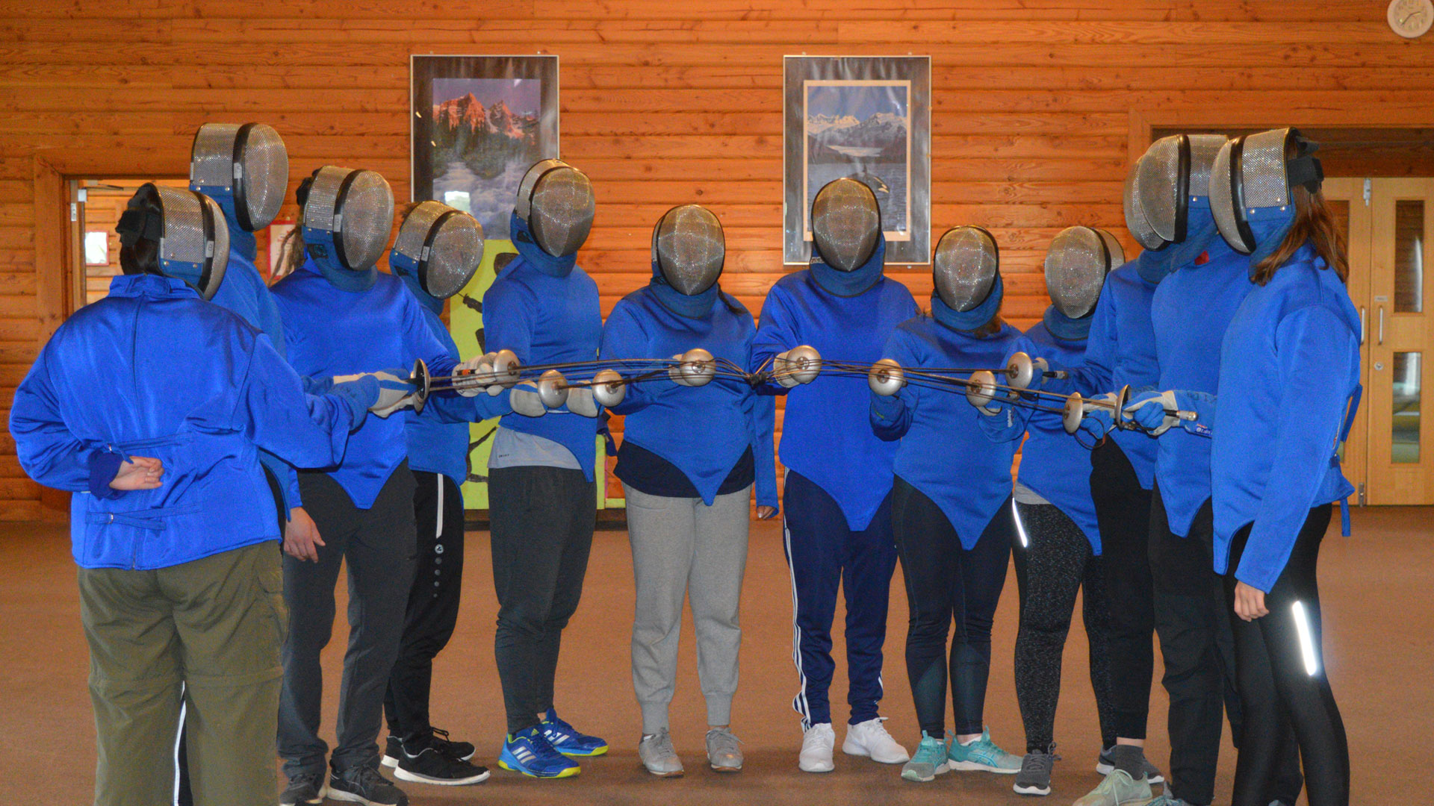
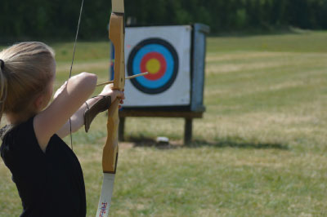
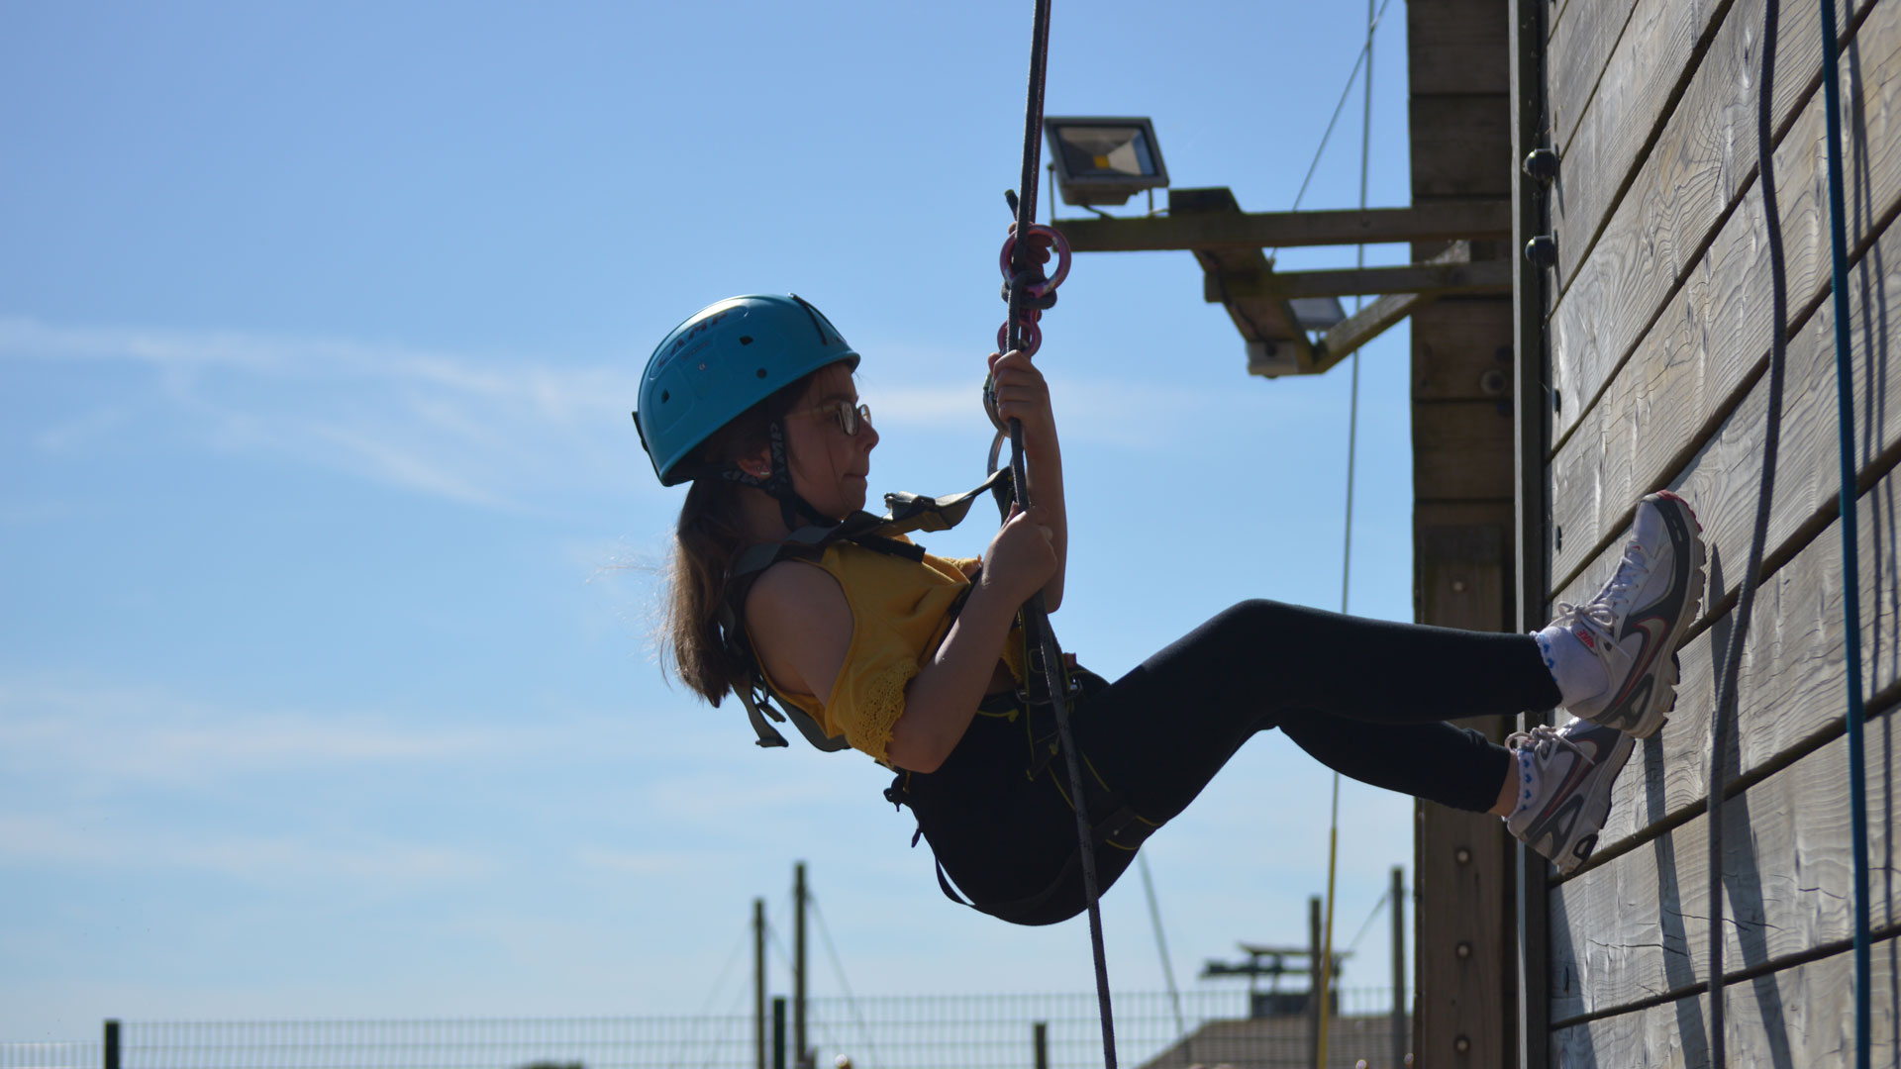
The Activities
Campfire
Fencing
Archery
Abseiling

Slide 9
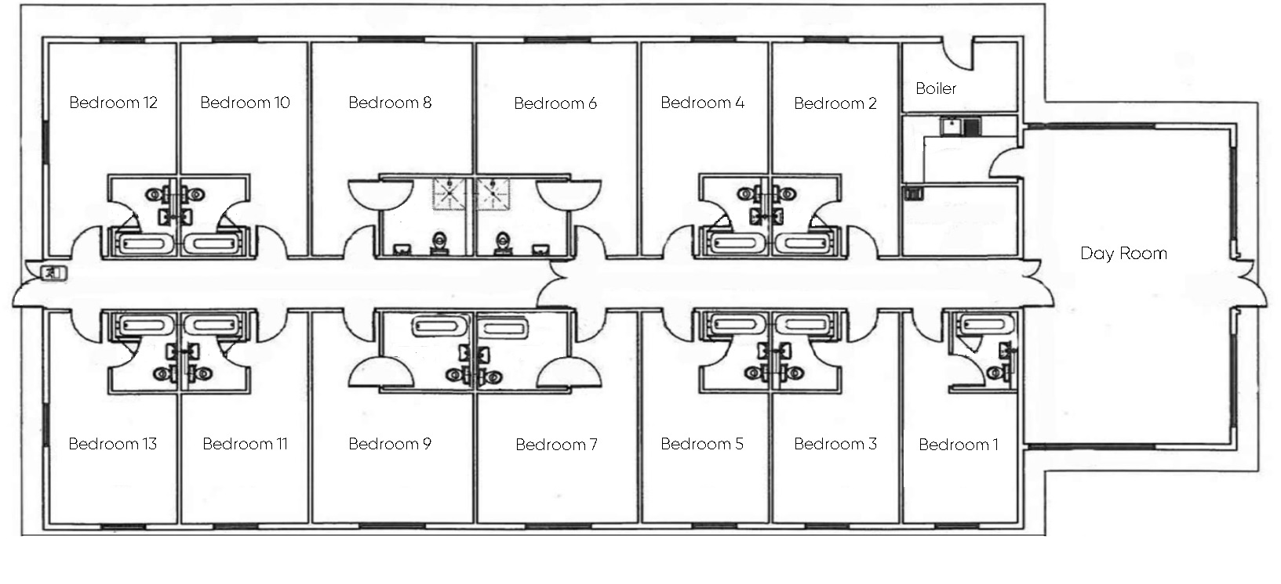
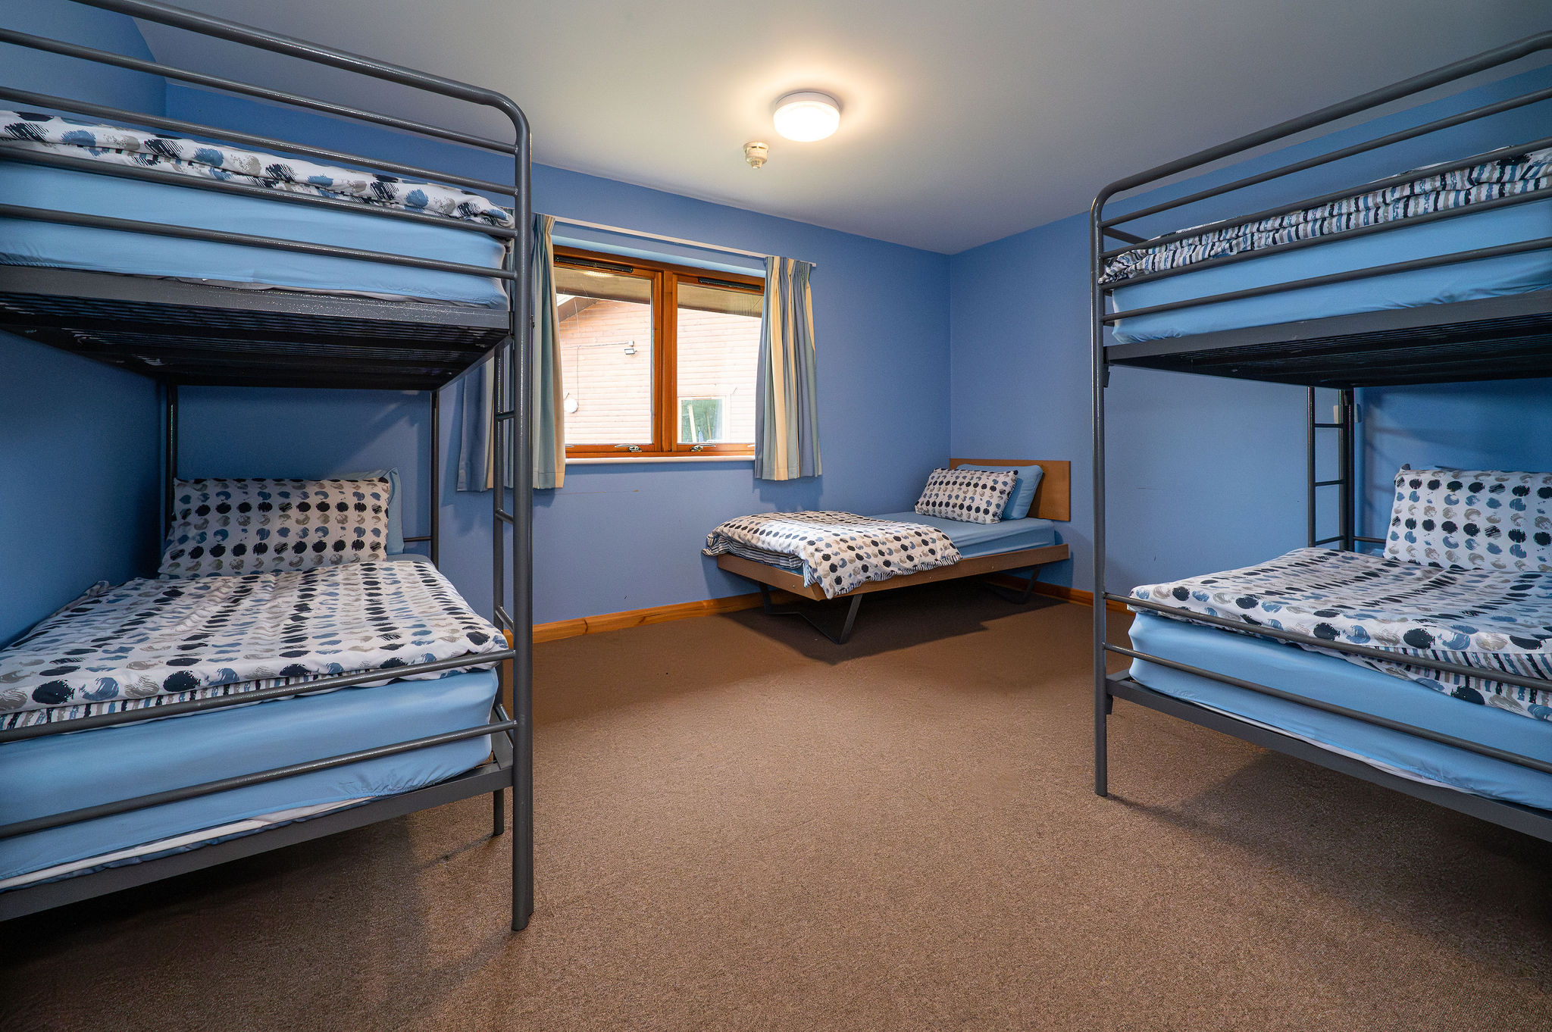
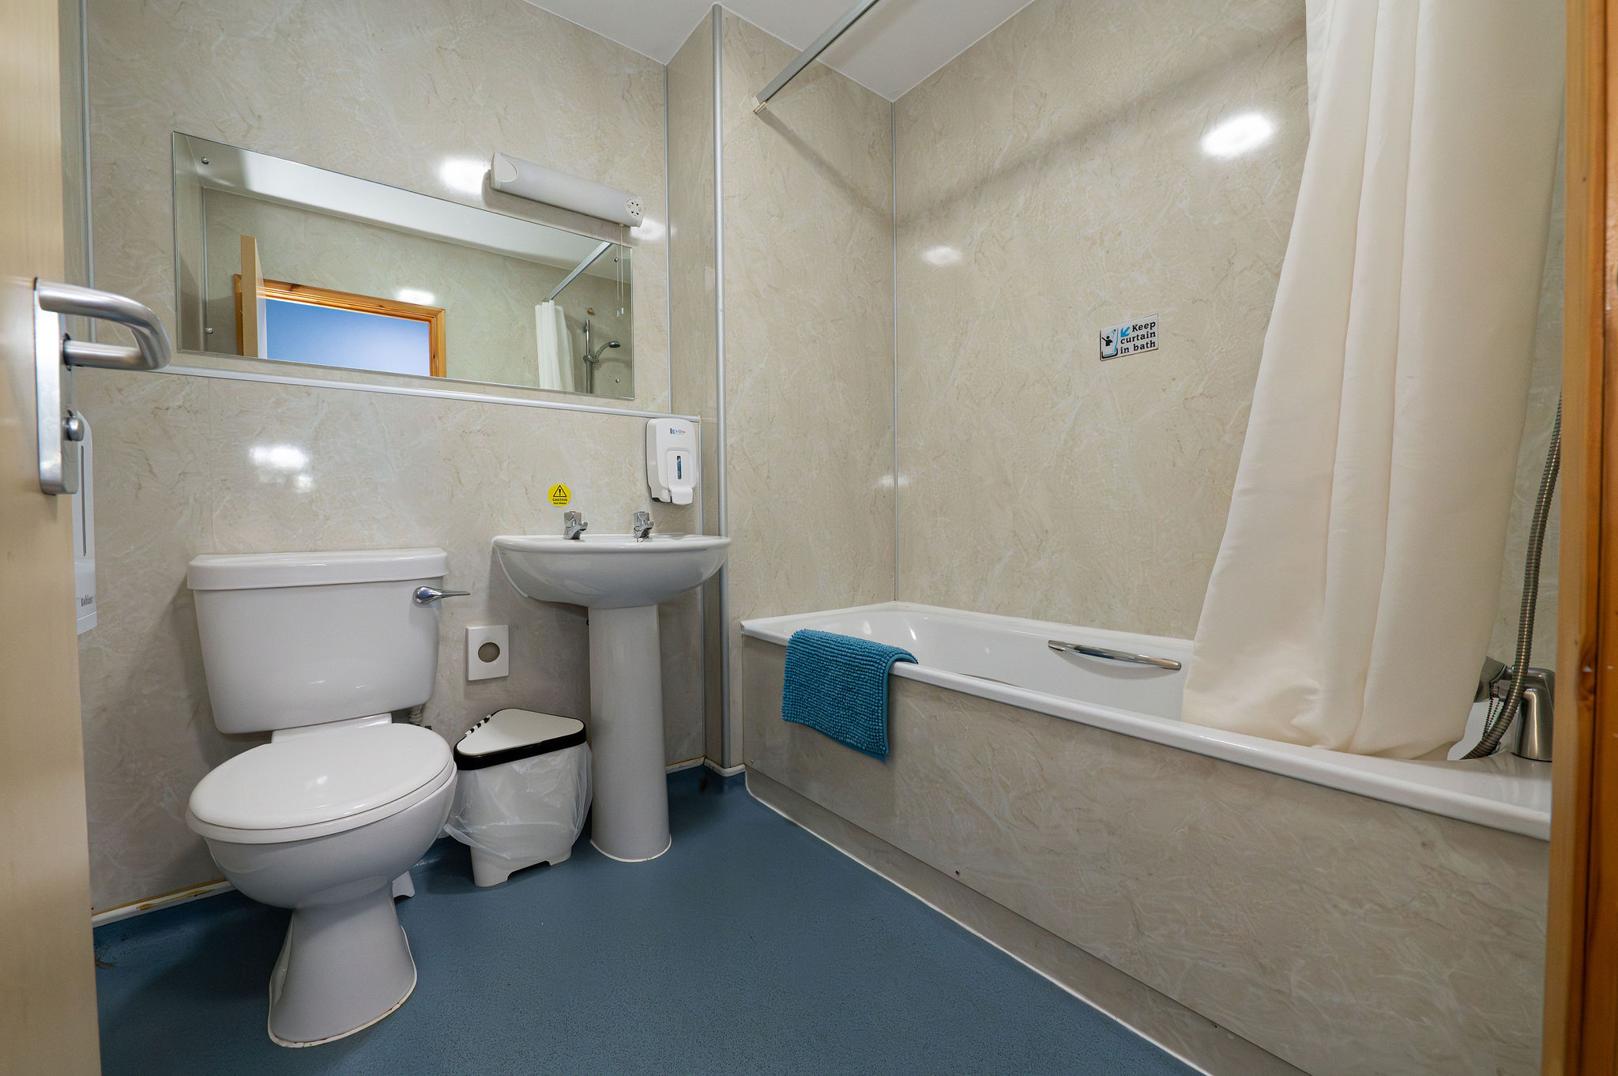
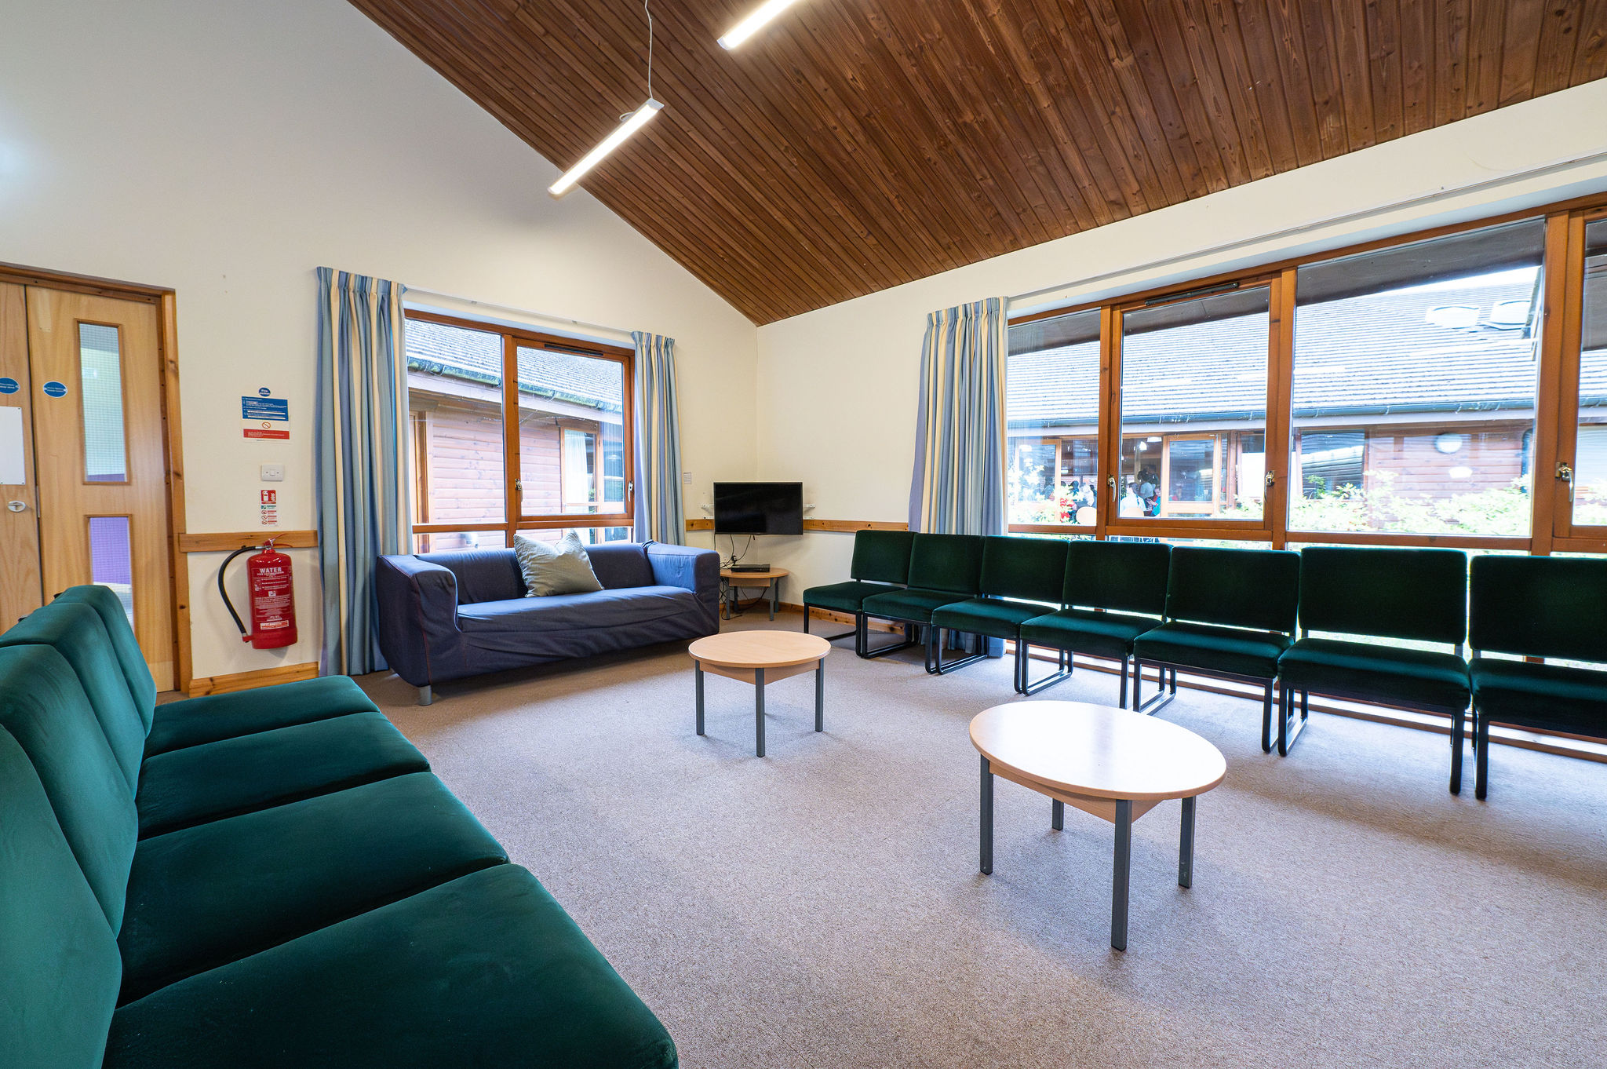
The Lodges
Each school gets their own Lodge(s) for accommodation.
Rooms will be separated into boys and girls and pupils will be given the chance to choose up to 3 people who they want in their room. We guarantee they will get at least one of the people they named.
All rooms are multi-bedded and have en-suite bathrooms.
Every lodge has a Lounge/Day Room.
Whitemoor provide all bedding, but children are asked to make their own beds.
Towels are not provided.

Slide 10
Safeguarding
________________________________
At least one school safeguarding lead will be in attendance, most likely more and all work act in loco parentis whilst we are away with your child.
Medication will be given as necessary – please provide us any medication that they need to take on a regular basis. We will also take calpol, piriton, a spare inhaler and a spare epipen.
Contact with you will be limited to only that which is absolutely essential. If you don’t hear anything, all is well!
Photo consent will be requested prior to the trip (unless already provided and can be withdrawn) as photos of the pupils will be posted in the school’s x account. If there is no photo consent for a pupil, there will be no photos posted.
No electronics of any kind, especially those that can take photos.
No money is required
Photos will be posted on @GlenfieldPrim on X (twitter)

Slide 11
Price
Approximately £247, this is based on 40 pupils going.
Register of Interest form will go live today and close on 7th October.
Deposit will need to be paid by 30th October.
This is an indication of the expected price. Final price is dependent upon final numbers attending and may vary slightly.
This price includes everything, including coach costs.
There will be a non-refundable deposit of £50. By paying the £50, you are committing to the trip and the full price will have to be paid, even if your child no longer attends.
The trip will be subsidized for pupil premium children. Please contact the school office for further details.

Slide 12
Site Safety
On arrival to the centre, everyone is given a site tour, which will include the fire assembly point. Children and staff both have the opportunity to ask questions.
Whitemoor Lakes staff are onsite 24/7.
We have a manned Reception Desk from 8am until 10pm.
Our Night Porter covers from 10pm until 8am.
Centre staff are first-aid trained.
Security is very important; Whitemoor performs a full site lock up throughout the day and have a full perimeter fence and gates.
Each Accommodation lodge has a lockable front door.
All fire exits are alarmed so are aware if anyone exits.
CCTV throughout the site.

Slide 13
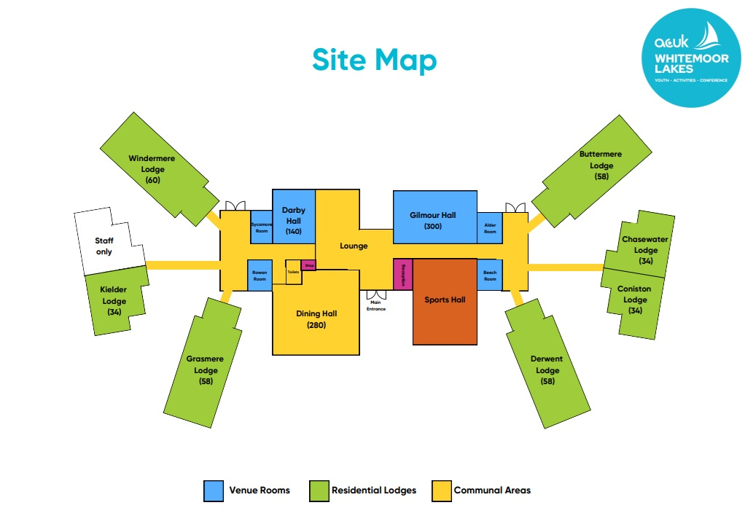
And finally….
For further information, please visit our Website:
www.whitemoorlakes.org.uk/
Youtube Videos:
Whitemoor Lakes Residential Trips
Activities at Whitemoor Lakes
Site Map:
- There will be another meeting in the Spring term for those who will be attending.
- Pupils will have multiple meetings in school before attending.
- Kit lists will be provided in the Spring Term.

